Slide 1
Welcome Everyone!
OUR WEBCAST WILL BEGIN SHORTLY

Slide 2
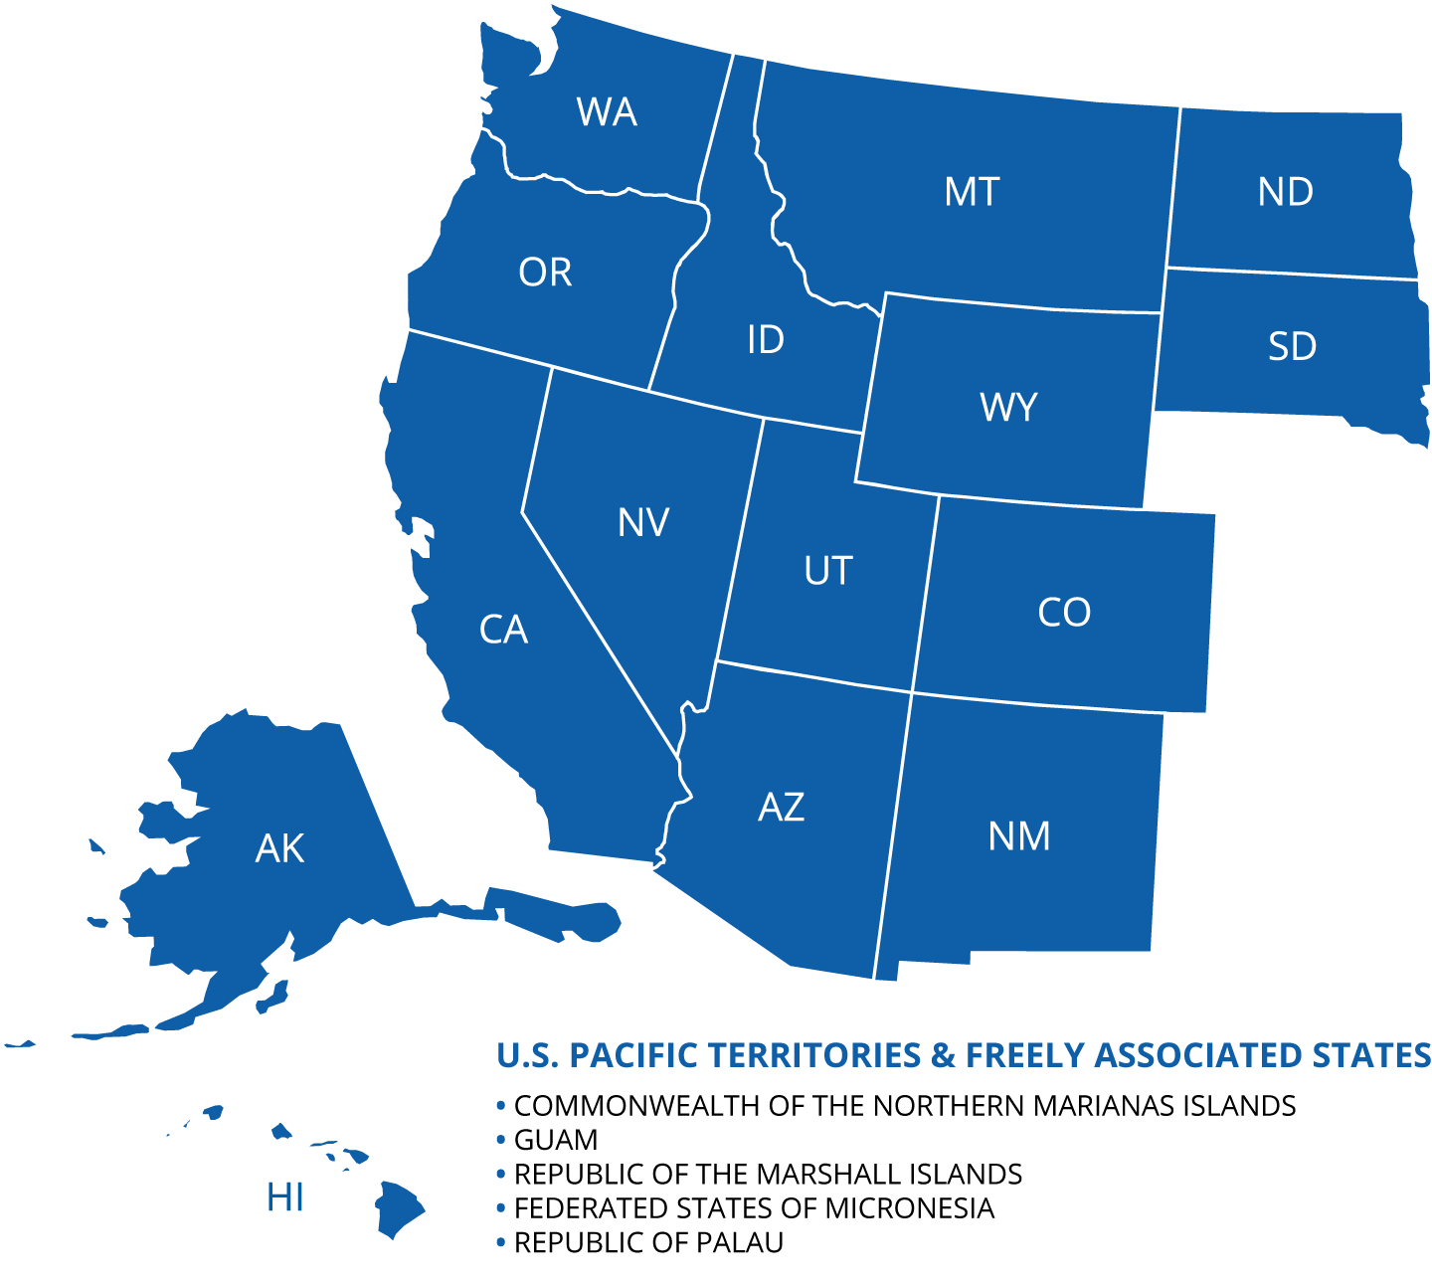
What is WICHE?
One of four regional interstate education compacts
Established in 1953
Mission:
  Expand educational access and excellence.
  Strengthen higher ed’s contributions to the region’s social, economic, and civic life.
AMERICAN SAMOA
COMMONWEALTH OF THE NORTHERN MARIANA ISLANDS
FEDERATED STATES OF MICRONESIA
GUAM
REPUBLIC OF THE MARSHALL ISLANDS
REPUBLIC OF PALAU

Slide 3










History and background: What is Knocking?
Notes:
Background and introduction:
What is knocking (for those that might not be familiar)?
Why is it important?
What is a little of the history
What is the connection to the WICHE mission?
Focus a little more on the 10th edition, where it left off

Slide 4
11th Edition
Interactive Dashboards: www.wiche.edu/knocking

Slide 5








A true team effort
Peace Bransberger
Dir. of Programs & Evidence
Bella Ciarico
Digital Communications Coord.
Colleen Falkenstern
Senior Research Analyst
Joseph Garcia
Senior Graphic Designer
Patrick Lane
VP, Policy Analysis & Research
Jeanette Porter
Senior Administrative Coord.
Melissa Sanders
Administrative Assistant III
Melanie Sidwell
Director of Communications

Slide 6


A true team effort

Slide 7
Special thanks
To the state agency staff who made this work possible by working with our team, providing data, and patiently explaining nuances of their state context…
Thank you!

Slide 8
Logistics
30-minute presentation
Enter questions into the Q&A box – Upvote if possible
Slides will be available at www.wiche.edu/knocking
Granular data available at www.wiche.edu/knocking
Sign up for more information at https://www.wiche.edu/about/news/alerts/
Follow-up: Media inquiries – Melanie Sidwell, msidwell@wiche.edu
Follow-up: Data ?s, requests for presentations – Patrick Lane, plane@wiche.edu

Slide 9
So what do the data say?
Key Finding #1: The total number of high school graduates is expected to peak in 2025, then decline through 2041.

Slide 10
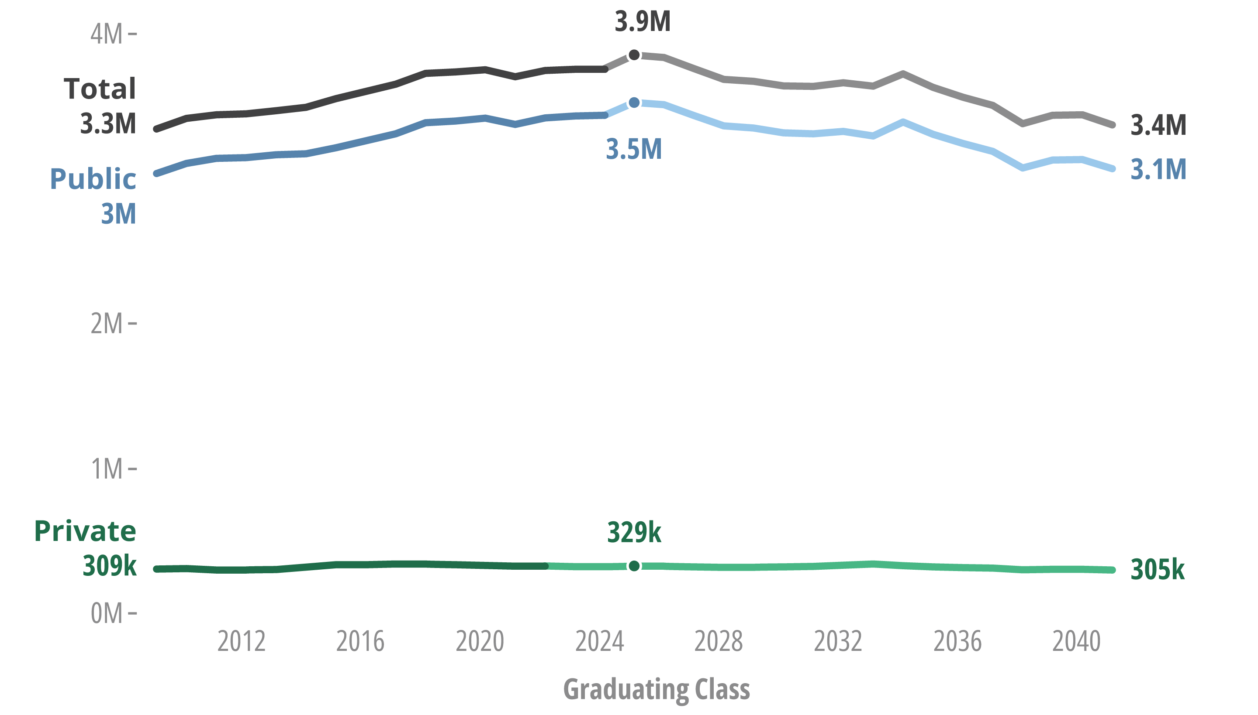
High school graduates, reported (2009 to 2023) and projected (2024 to 2041)

Slide 11
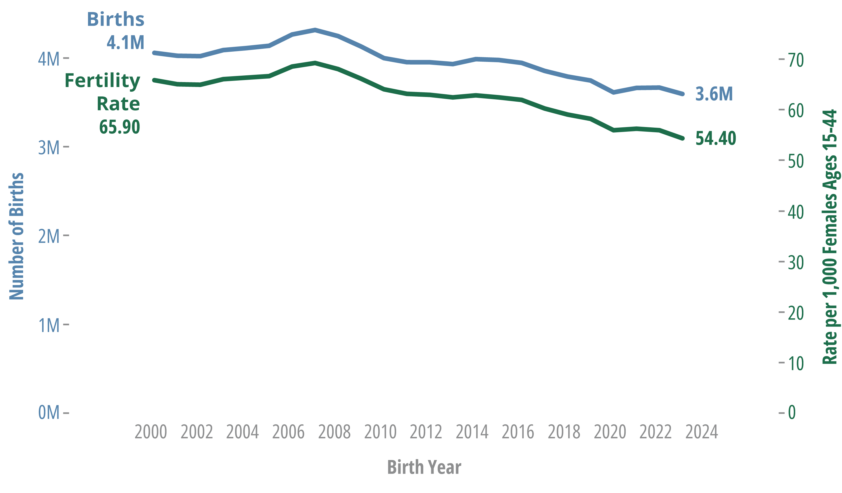
Factor #1: Births (actuals, 2000-2023)
Source: Centers for Disease Control and Prevention

Slide 12
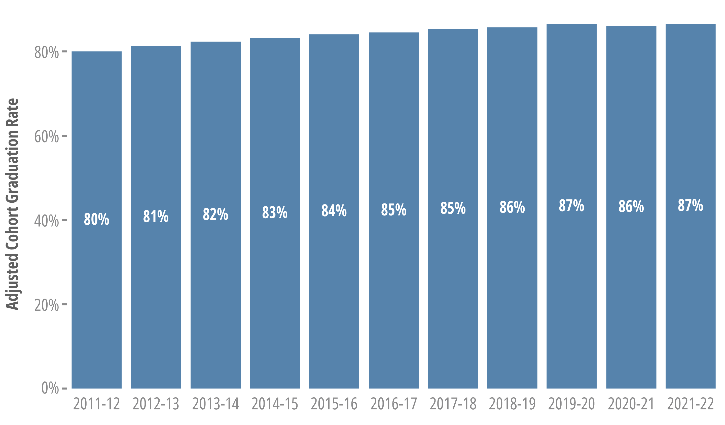
Factor #2: K-12 retention and completion
Source: National Center for Education Statistics
Notes:
NCES four-year adjust cohort graduation rate https://nces.ed.gov/programs/digest/d23/tables/dt23_219.46.asp

Slide 13
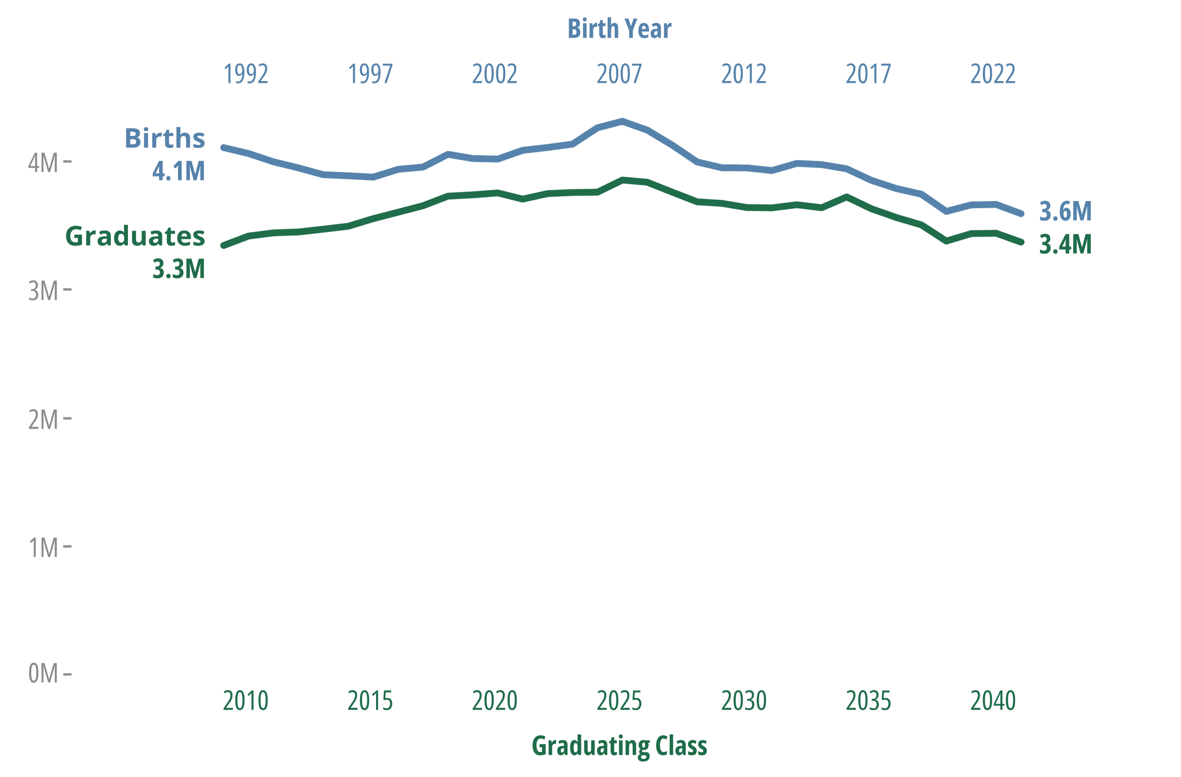
Births, 18 yrs. Earlier & Total Graduates
Sources: Centers for Disease Control and Prevention; WICHE analysis
Notes:
Number of births and graduates 18 years later Births 1991 -2023 & graduates

Slide 14
So what do the data say?
Key Finding #2: The number of graduates identifying as Hispanic or Multiracial is projected to grow. Other populations by race and ethnicity are projected to decline.
Notes:
The second key finding of the report looks at underlying data for public high school graduates by race and ethnicity. Although the number of high school graduates in projected to decline – the number of multiracial and Hispanic high school graduates is projected to increase over the course of the projections. At the same time, all other populations by race and ethnicity are projected to decrease between 2023 and 2041.
These underlying demographic shifts are not new and have been a key trend from each Knocking report since the inclusion of race and ethnicity detail in 1998.
Before I dig into a little bit more detail – something to note is that data for high school graduates by race and ethnicity is limited to public high school graduates only and WICHE uses the federal definition of the race and ethnicity categories – meaning that Hispanic graduates will include all high school graduates of Hispanic origin regardless of their race or races. Multiracial or two or more races will include all graduates of non-Hispanic origin that are of more than one race. And all other categories are by definition – non-Hispanic single race.

Slide 15
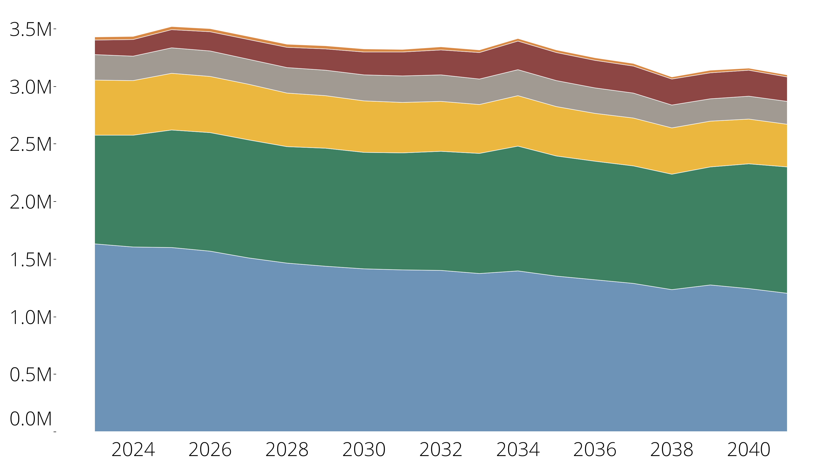
U.S. public high school graduates by race and ethnicity
Race/Ethnicity | 2023 | 2041
AI/AN | 29,706 | 17,566
Multiracial | 127,352 | 214,303
Asian & NHOPI | 217,616 | 196,667
Black | 480,224 | 372,960
Hispanic | 944,299 | 1,094,165
White | 1,629,974 | 1,202,287
Notes:
US High School Graduates 2023 to 2041
This chart displays the U.S. high school graduates by race and ethnicity
White public high school graduates – which is the blue are on the bottom of the chart. Were about 1.6 million in numbers in the class of 2023. This is about 47% of public graduating classes in 2023. Over the course of the projections the number of high school graduates is expected to decline to about 1.2 million graduates – which will be about 39% of public graduates in 2041.
Hispanic public high school graduates – the next largest population nationally is displayed in green. In 2023 there were about 944 thousand Hispanic high school graduates. Over the course of the projections Hispanic high school graduates are expected to increase to 1.1 million public graduates, which is expected to be about 36% of the total in 2041.
Black public high school graduates are expected to decline by over 100,000 from around 480,000 to 373,000 between 2023 and 2041.
Asian and Native Hawaiian and Other Pacific Islander high school graduates are expected to decrease from nearly 218,000 to about 197,000.
As state previously the number of multiracial public high school graduates is expected to increase over the course of the projections from about 127,000 to just over 214,000, which means that the multiracial population is projected to be the fourth largest population of public graduates in 2041 and about 7% of the total.
The number of American Indian/Alaska Native high school graduates are projected to decrease from nearly 30,000 in 2023 to just under 18,000 in 2041.

Slide 16
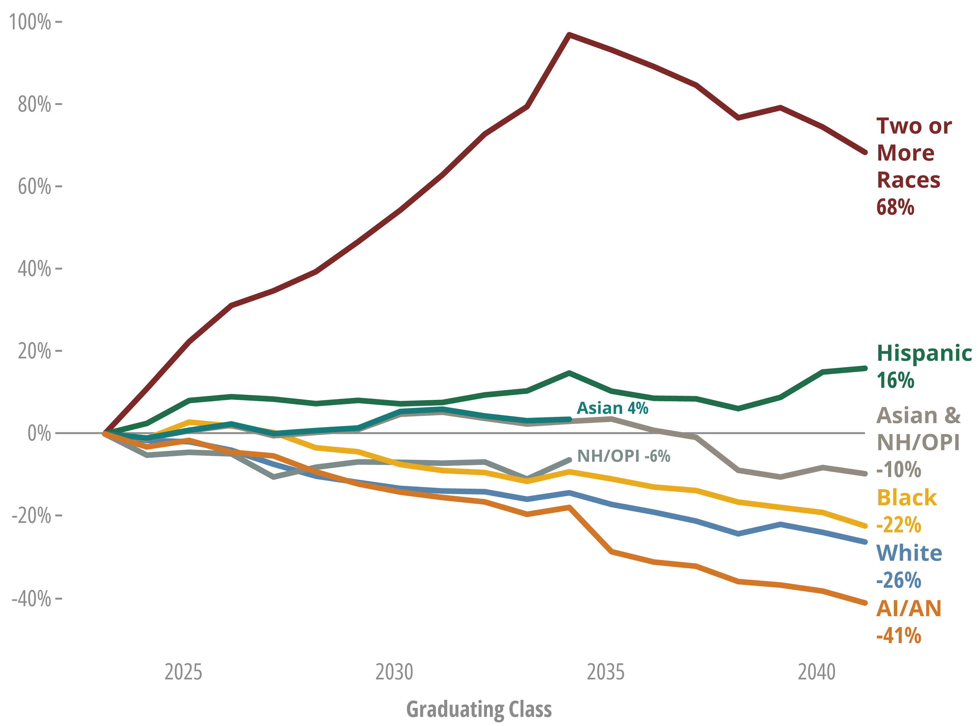
Projected change in U.S. high school graduates, 2023 to 2041
Notes:
U.S. High school graduates projected percent change.
This chart highlights the variation in trends by student population from the class of 2023.
As stated already – graduates of two or more races or multiracial graduates are projected to increase by about 68% over the course of the projections and Hispanic high school graduates are projected to increase by 16%. Two things to note about these increases – when looking at the births in the years between 2016 and 2022 – the number of multiracial and Hispanic babies born were the only populations to increase. And as Pat showed earlier – the number of babies born is recent years drives these trends into the future. Additionally, as a result of increasing births in recent years, when comparing to the last edition of Knocking – Hispanic and two or more races were the only populations to have more projected graduates in this edition compared to the 2020 edition
Asian and Native Hawaiian and Other Pacific Islanders are projected to decrease by about 10% from 2023 to 2041. A couple of things to note:
Due to limitations in births data we can only report separate counts of Asian and Native Hawaiian and Other Pacific Islander graduates through 2034 – and use a combined total for the whole time series.
In the 2020 edition, the number of Asian and Native Hawaiian and Other Pacific Islander graduates were expected to continue to increase in the end of the projections, but between in the past 5-6 years the declines in Asian and Native Hawaiian and other Pacific Islander graduates has been much steeper than the nation and other populations.
Black public graduates are projected to decline by about 22%
White public high school graduates are projected to decline by about 26%
And American Indian/Alaska Native public high school graduates are projected to decline by 41%.
A couple of things to note about the American Indian/Alaska Native population – these data only include students enrolled in public schools and does not include the number of students enrolled and graduating from Bureau of Indian Education schools.
Additionally, we know by looking at other data sources – such as US Census data that those who identify as American Indian/Alaska Native are more likely to be of Hispanic origin or multiracial.

Slide 17
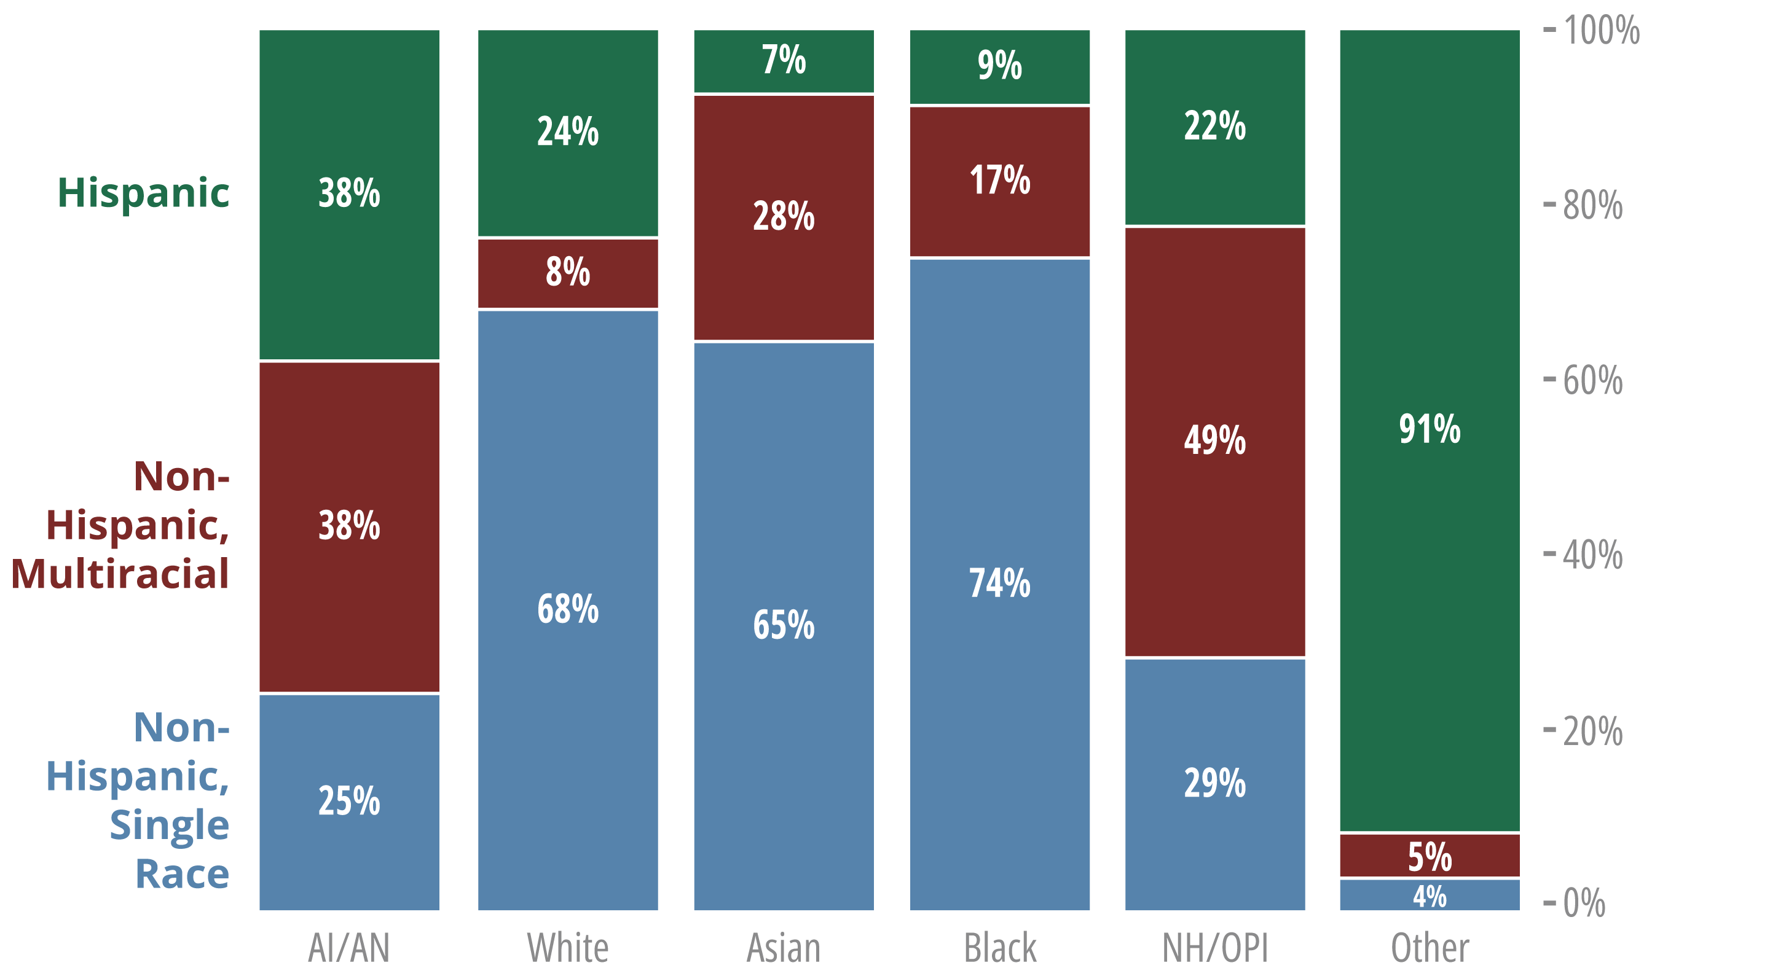
A closer look at the Two or More Races Population
Notes:
Given the expected increase in multiracial high school graduates next 15 years – we looked at census data to better understand this population. There are two key takeaways from analysis that I think are important.
First, being that the multiracial population described in our education data systems these projections is extremely diverse within itself.
Additionally, among the other racial groups – American Indian/Alaska Native, White, Asian, Black , and Native Hawaiian and Other Pacific Islander – described in this report there are certain populations that are more impacted by the narrowly defined race and ethnicity categories.
For example – if you look at the AI/AN bar on this chart – which is going to include all those who identify as AI/AN – regardless of the races in combination, alone or Hispanic origin – we see that just 25% are both non-Hispanic and single race – which is the definition used in education data analyzed for these projections. 38% are non-Hispanic and multiracial – meaning the would be categorized as two or more races in education data, and 38% are of Hispanic origin – and would be categorized as Hispanic in the education data.
Another population that is heavily impacted is the Native Hawaiian and Other Pacific Islander population – which just 29% of those in the Census data that reported being Native Hawaiian/Other Pacific Islander alone and non-Hispanic .
This is important as these are two smaller populations of students and projected to decrease over the course of the projections, but with a broader definition and/or category of race and ethnicity the numbers would be larger.

Slide 18
So what do the data say?
Key Finding #3: Declines in the West, Midwest, and Northeast will be steeper than previously projected; the number of graduates in the South is projected to increase.
Notes:
The next key finding looks at the underlying regional variation that exists underlying the national projections. Again, this variation is not new to these projections but there are some noticeable things I will highlight. First and foremost being that the number of high school graduates in the south is expected to increase – and this region is the only region projected to increase.

Slide 19
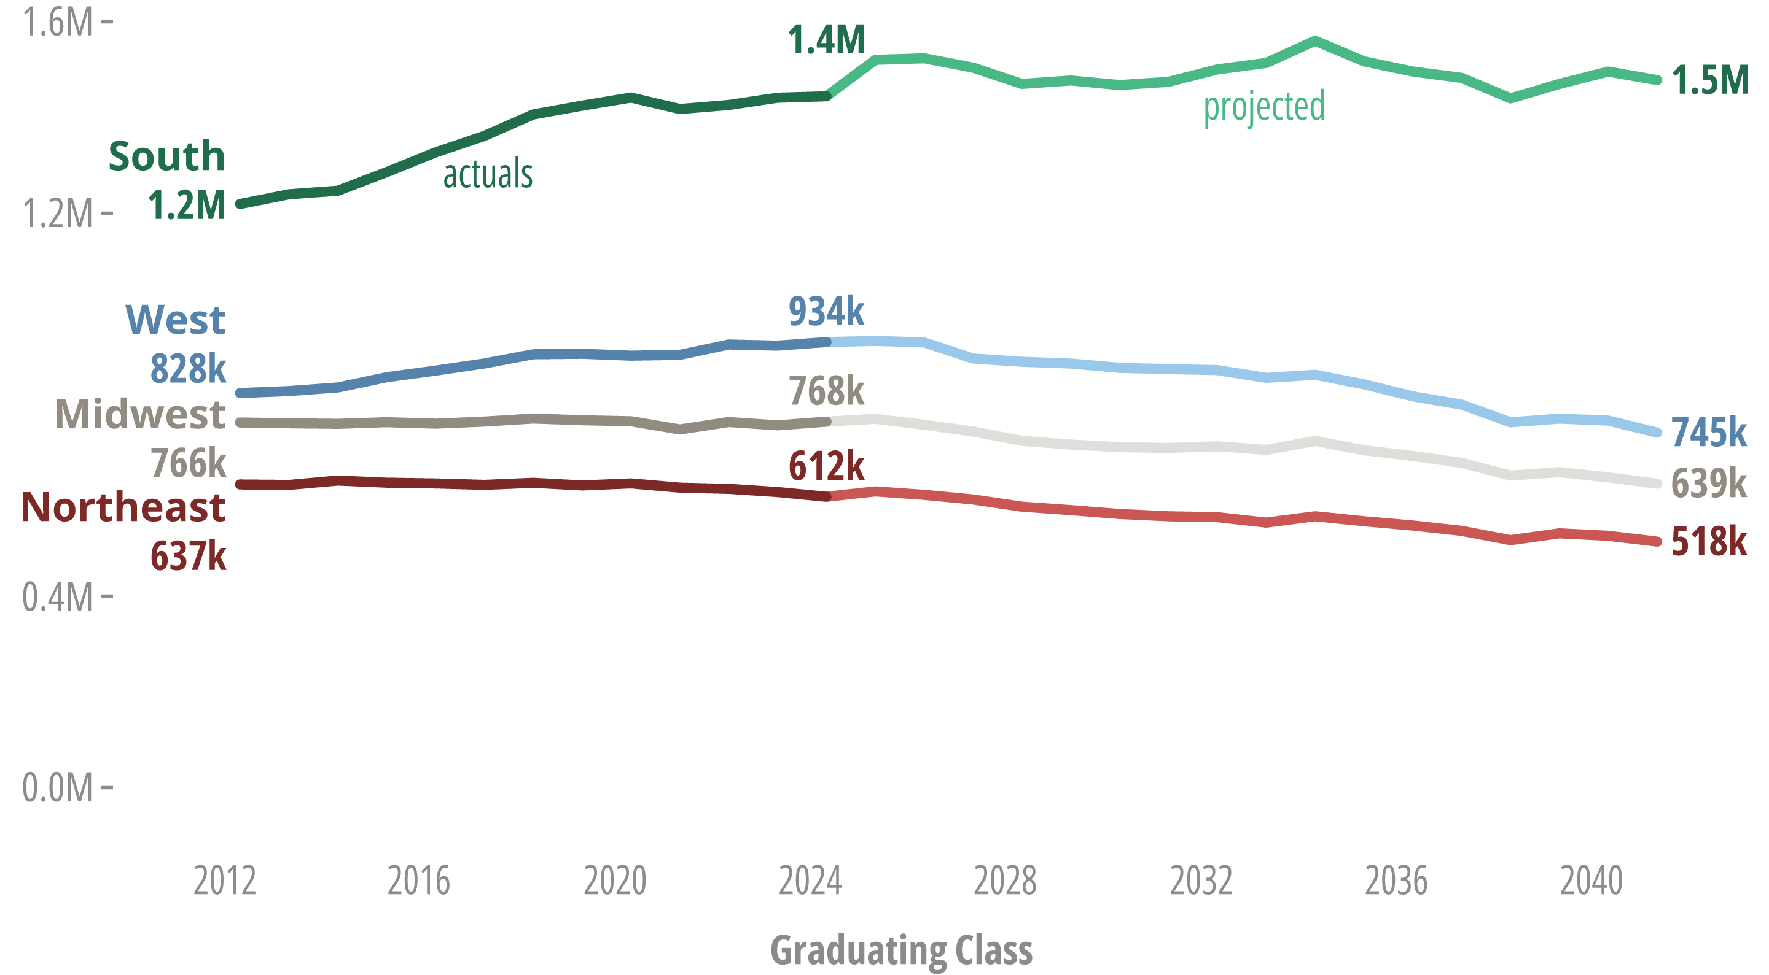
Regional variation
Notes:
This chart highlights the variation in the trends across the four regions.
The south, which has long been the largest region in terms of high school graduates, is expected to increase , albeit at a slightly slower rate, from about 1.4 M to 1.5 M graduates
The West – which compared to the projections from 2020 is projected is expected to see steeper declines than previously projected – over the region is projected to go from 934000 in 2024 to about 745000 in 2041, which is a decline of about 20%
The Midwest – has remained relatively flat in the number of graduates in the past decade but between 2024 and 2041 the number of graduates is projected to decline from about 768,000 to 639,000 – which is a decline of about 16%
The Northeast has been experiencing a decline of high school graduates for the past decade and that trend is expected to continue, with a projected decline from about 612,000 to 518,000 graduates.

Slide 20
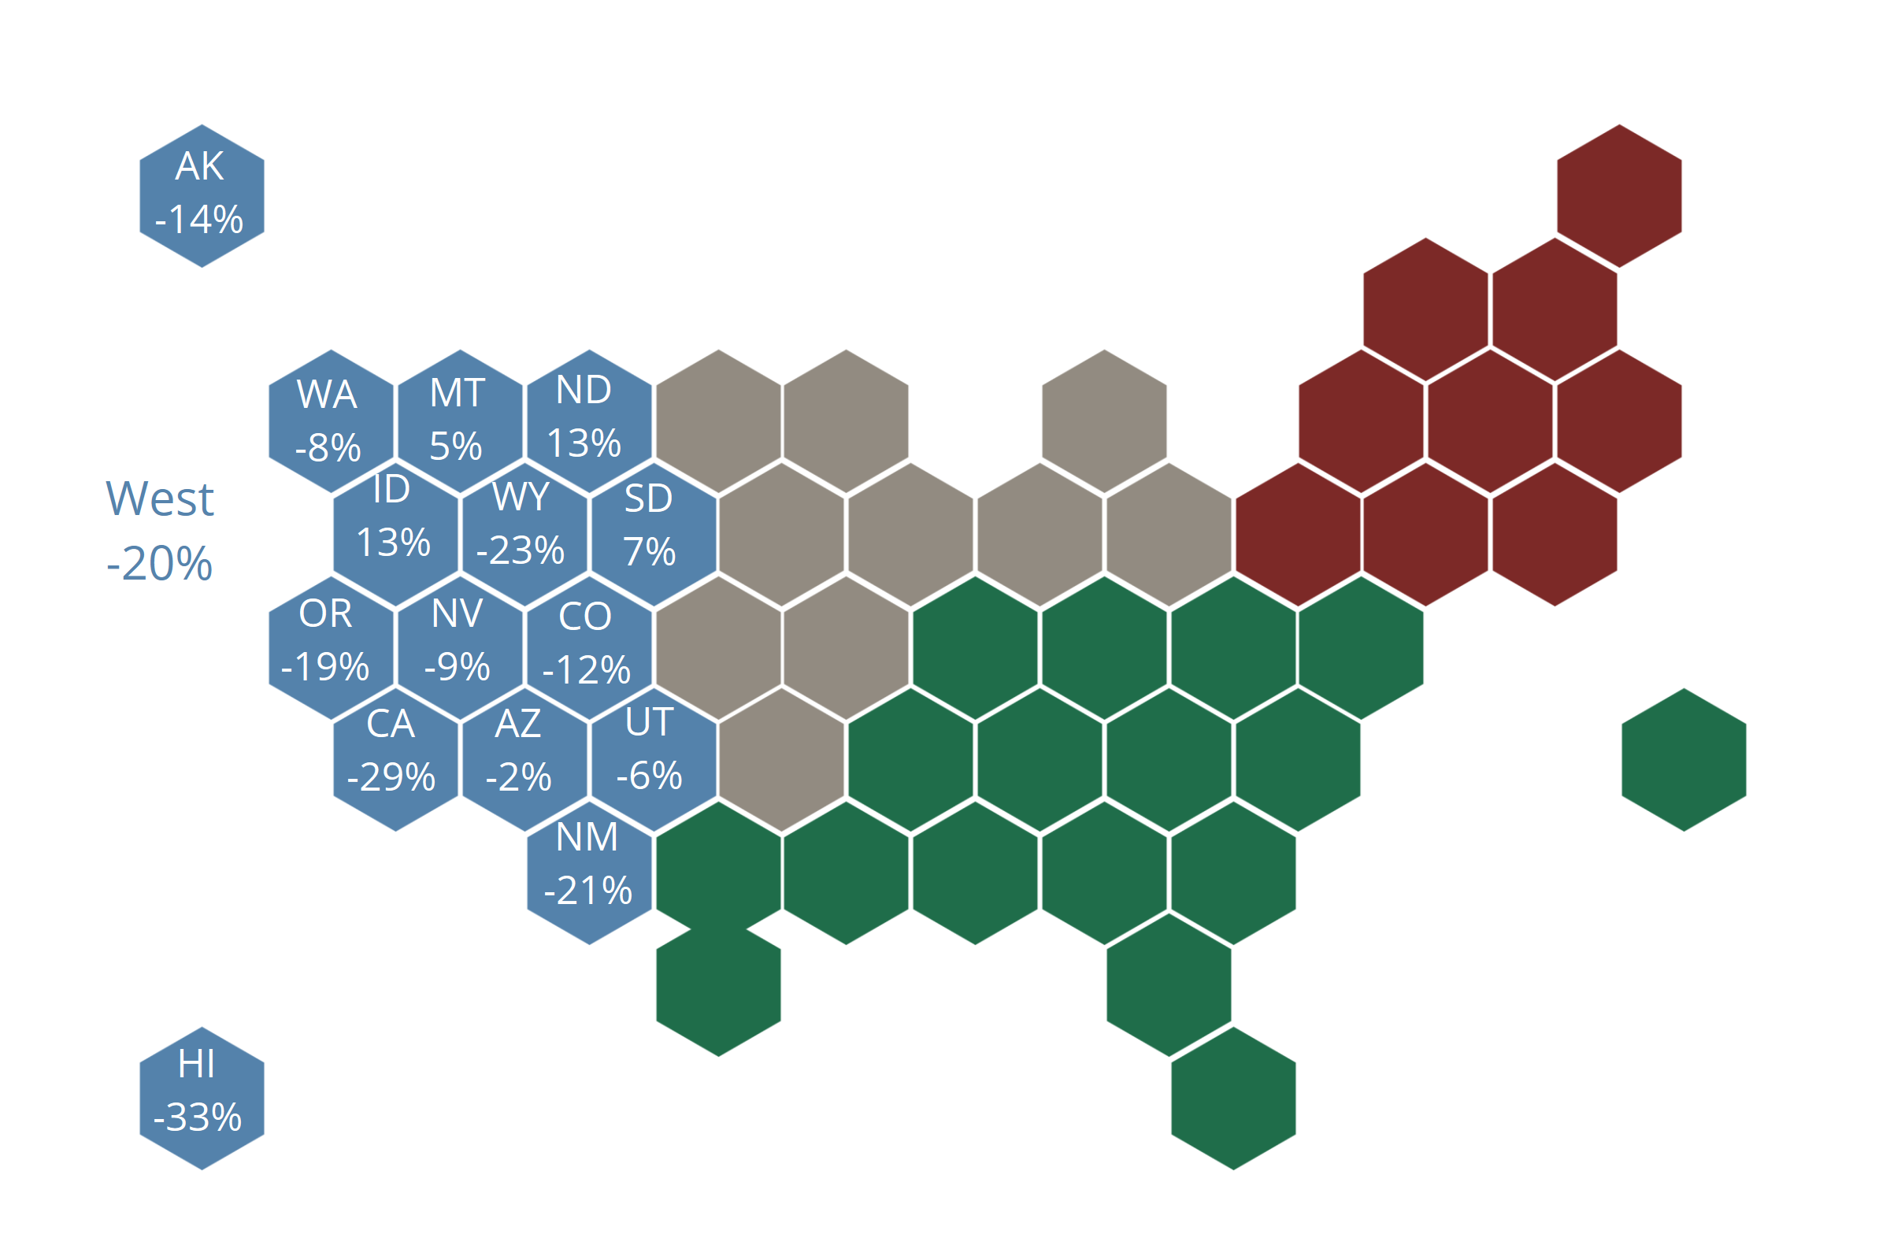
Projected change in high school graduates in the West, 2023 to 2041
Trends in the West
  Increases among Multiracial and Private graduates and declines among all other racial and ethnic populations
  Projected increases in Idaho, Montana, North Dakota, and South Dakota
Notes:
Starting in the west.
Overall the number of graduates in the West is projected to decrease by about 20% or about 188,000 fewer graduates – and although the region is projected to see a nearly doubling in the number of Multiracial high school graduates by 2041 and a modest 2% increase in private graduates – it is not enough to offset declines in all other race and ethnicity populations.
Looking at the states in the region – Idaho, Montana, North Dakota, and South Dakota are all projected to see increases in the number of high school graduates.
There are noticeable declines in Hawaii (33%) and California (29%). One thing of note about the impact of California on the regions overall trends – without California, the region’s overall decrease in graduates would be cut in half and about 10%

Slide 21
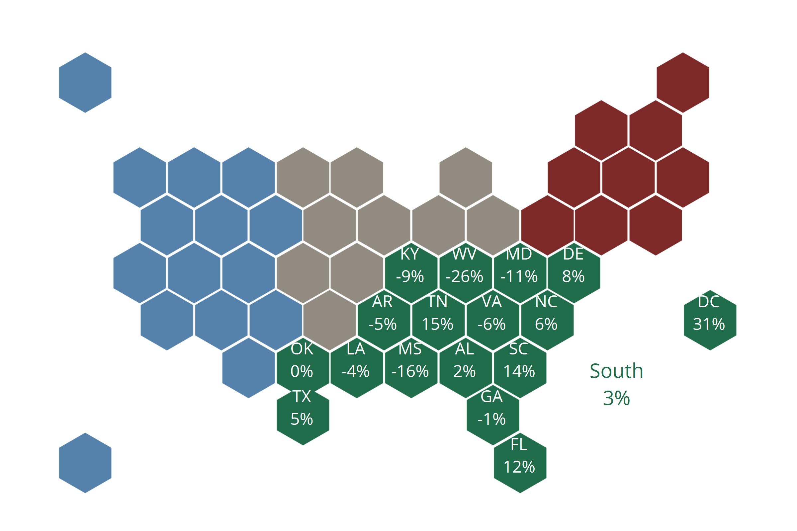
Projected Change in High School Graduates in the South, 2023 to 2041
Trends in the South
  Increases among Multiracial, Hispanic, Asian and NH/OPI, and Private graduates drives growth in the region
  Wide variation in projected change by state, ranging from 31% increase in D.C. to a 26% decrease in West Virginia
Notes:
As previously mentioned, the South region is the only region projected to increase by 2041
That growth is propelled by increases in multiracial, Hispanic, private graduates and Asian and NHOPI graduates. The south is the only region projected to see growth among Asian/NHOPI graduates.
There is wide variation in trends in the region. For example, the smallest population of graduates is from the District of Columbia, which is projected to increase by 31%. When looking by state – Tennessee, Florida, and South Carolina are all projected to see double digit increases. On the other hand, Maryland, Mississippi, and West Virginia are projected to see double digit decreases.

Slide 22
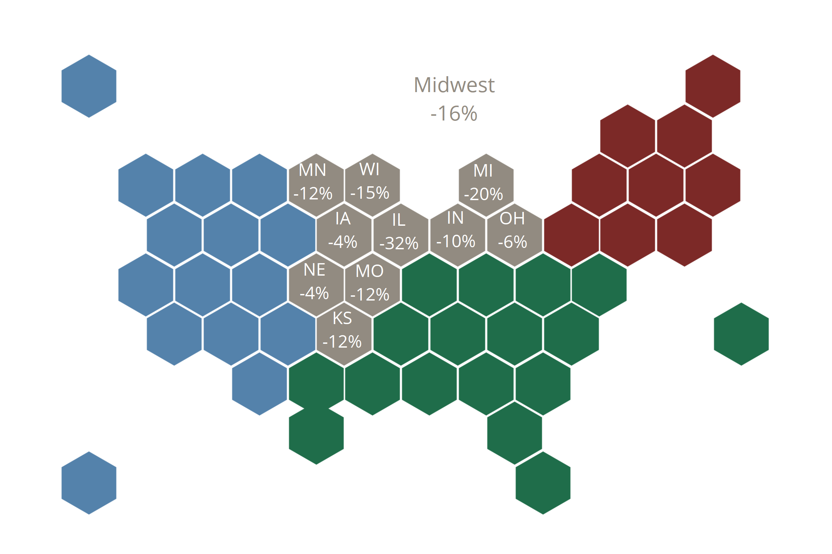
Projected Change in High School Graduates in the Midwest, 2023 to 2041
Trends in the Midwest
  Projected increases in Multiracial and Hispanic graduates are not enough to offset declines among White, Black, AI/AN, Asian & NH/OPI, and Private graduates
  Every state is projected to decrease in total graduates between 2023 and 2041, with the largest expected declines in Illinois and Michigan
Notes:
Overall the Midwest is projected to decrease by about 16% - which is about 120,000 fewer graduates
The region is projected to see increases in Hispanic and multiracial graduates – both at about a 26% increase and declines among all other populations. This includes a 18% projected decrease among private high school graduates.
Every states in the region is projected to decline in the number of high school graduates –with two of the largest states – Illinois projected to see a 32% decrease and Michigan projected to see a 20% decline
Minnesota, Wisconsin, Missouri, Kansas, and Indiana are expected to see declines between 10 and 15%, while Ohio, Nebraska, and Iowa are expected to see declines fewer than 6%

Slide 23

Projected Change in High School Graduates in the Northeast, 2023 to 2041
Trends in the Northeast
  Projected increases in Multiracial and Hispanic graduates are not enough to offset declines among White, Black, AI/AN, Asian & NH/OPI, and Private graduates
  Every state is projected to decrease in total graduates between 2023 and 2041, with the largest expected declines in New York and Pennsylvania
Notes:
And lastly the northeast region – the region is projected to see a 17% decline
Hispanic and multiracial graduates are projected to increase over the course of the projections but it is not enough to offset declines among all other populations
Same as the Midwest- every state in the Northeast is projected to decline with the largest declines expected in New York, with a projected 27% decline, followed by Pennsylvania with a 17% decline. New Jersey is expected to see the smallest declines with just a 1% decline over the course of the projections.

Slide 24
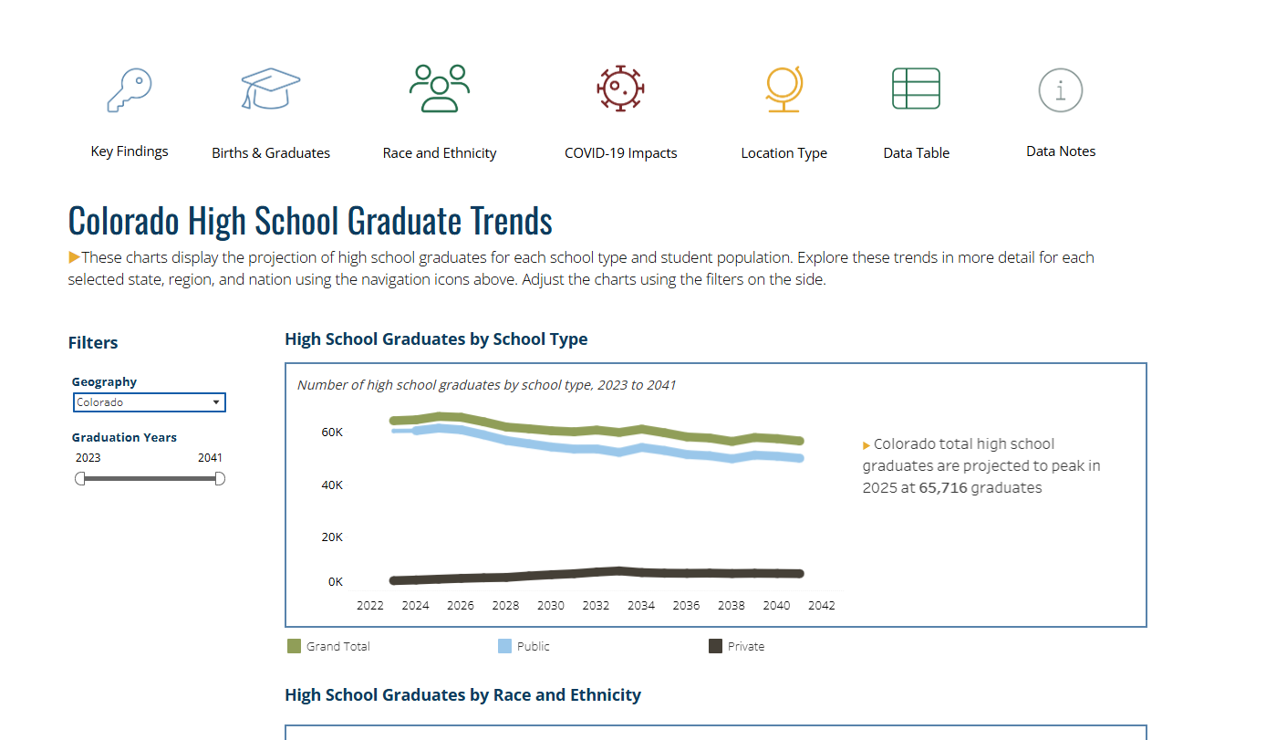
Explore State Data in Interactive Data Visualizations
Data Profiles
  A single state view of the key trends from the 11th edition of Knocking at the College Door
https://www.wiche.edu/knocking/data-visualizations/geography/
Notes:
In addition to the report itself we have a suite of data visualizations that allow you to explore state level trends in more detail.
The data profile looks at a all the Knocking trends and data – including births, total graduates, race and ethnicity for a single state at a time

Slide 25
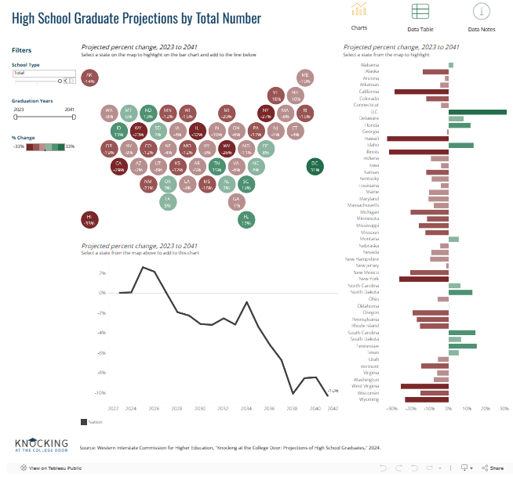
Explore State Data in Interactive Data Visualizations
Key Findings Dashboards
  Cross state view of key trends in total graduates, graduates by race and ethnicity, and COVID-19 impacts on enrollment and graduates
https://www.wiche.edu/knocking/data-visualizations/
Notes:
We also have three dashboards that highlight the variation in these trends – these dashboard allow for a cross state view of trends in total graduates, graduates by race and ethnicity, and potential impacts from COVID

Slide 26
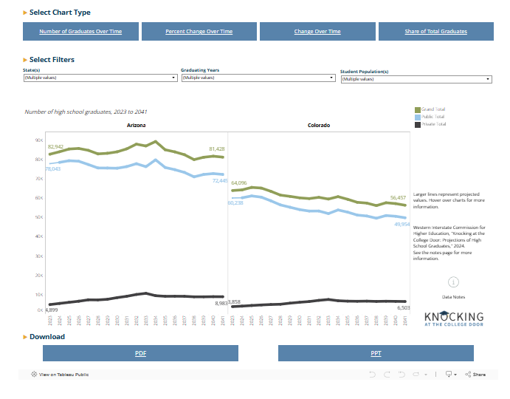
Explore State Data in Interactive Data Visualizations
Develop Your Own Charts
  Select from a few common Knocking charts and customize your own charts for each state or multiple states
https://www.wiche.edu/knocking/data-visualizations/
Notes:
Lastly we have a chart builder that lets you select a state or states and build charts for selected years and populations. For example – if you want to compare the number of Hispanic graduates Arizona and Colorado side by side in a line chart you could do that.

Slide 27
So what do the data say?
Key Finding #4: Enrollment data show a steeper drop in earlier grades of both K-12 public and private school systems than projected before the COVID-19 pandemic.

Slide 28
Model adjustment – Public graduates
Progression rates for 2020-21 school year were low but generally rebounded in 2021-22 and beyond.
Adjustment detailed in the Technical Appendix. Essentially, four-year cohort instead of five.
Using historical data, criterion for evaluating was closeness to WICHE’s standard model (not closeness to the “truth”).

Slide 29
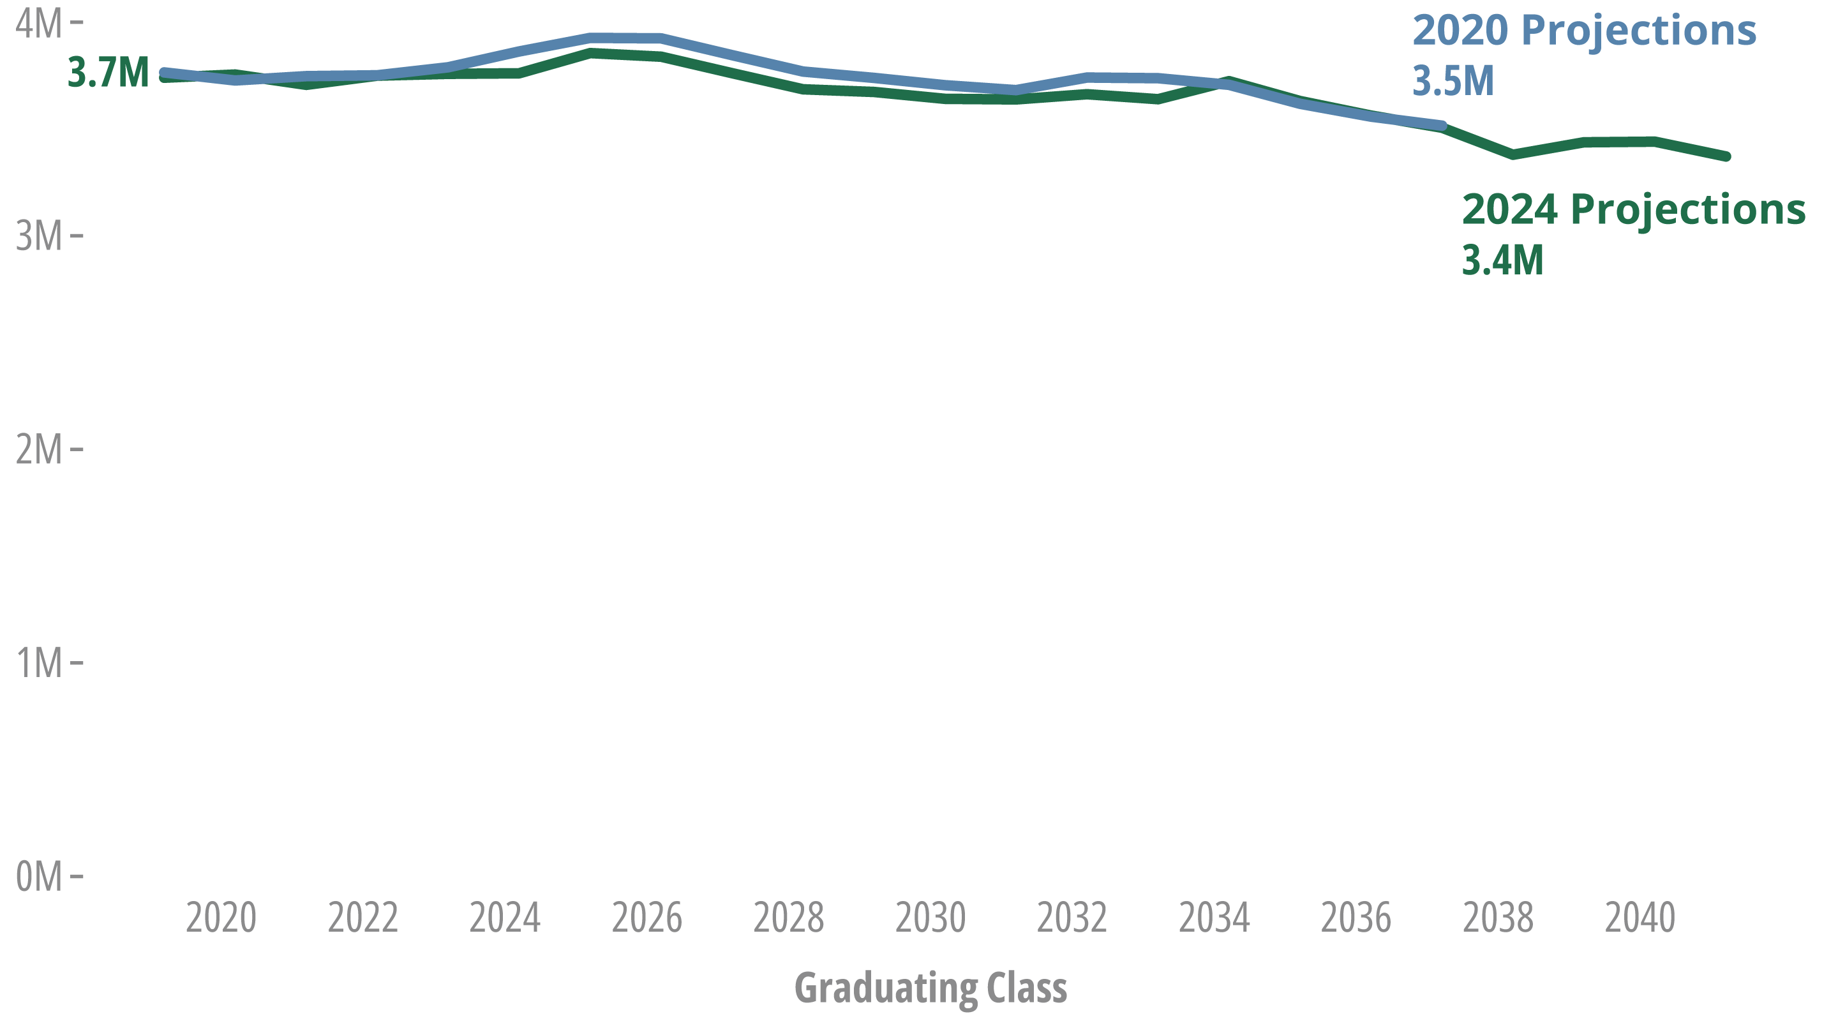
2020 vs. 2024 editions
More Hispanic and Multiracial public school graduates, fewer of all other race and ethnicities
Cumulative: New projections estimate 750,000 fewer graduates (1.5%) between 2024 and 2037
Notes:
More Hispanic and two or more race students. Less of everyone else.

Slide 30
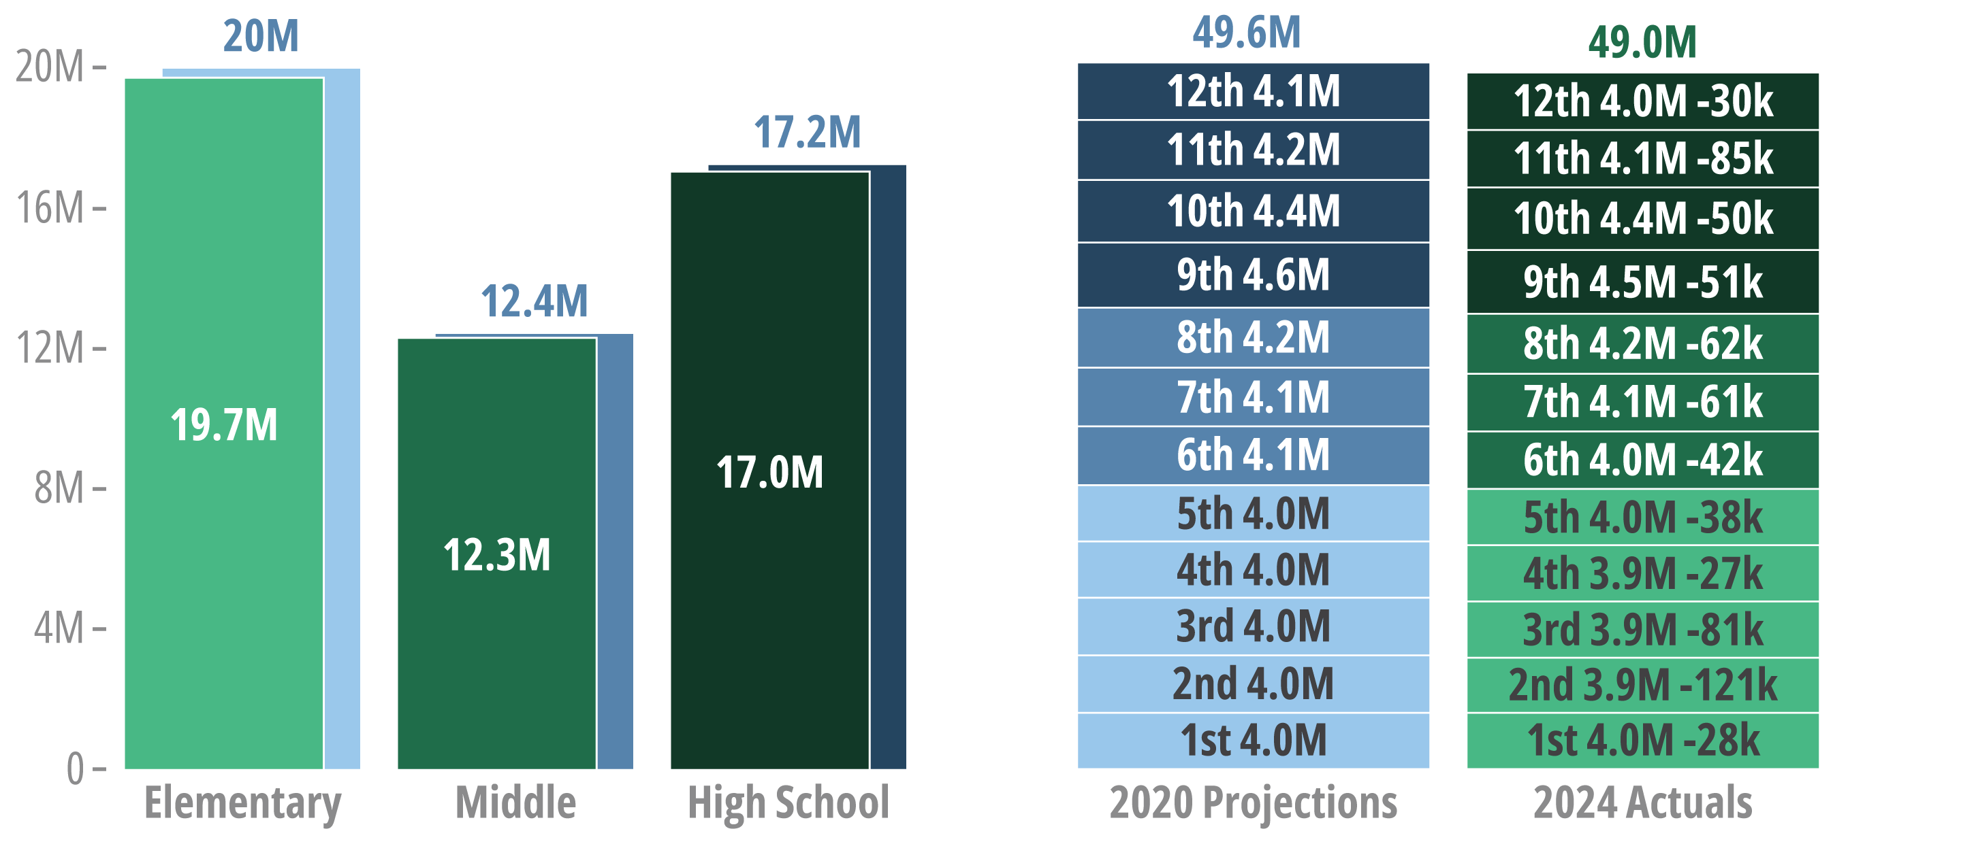
2022-23 enrollments by grade level, 2020 Knocking projections compared to 2024 actuals

Slide 31
So what? Why do we care?

Slide 32





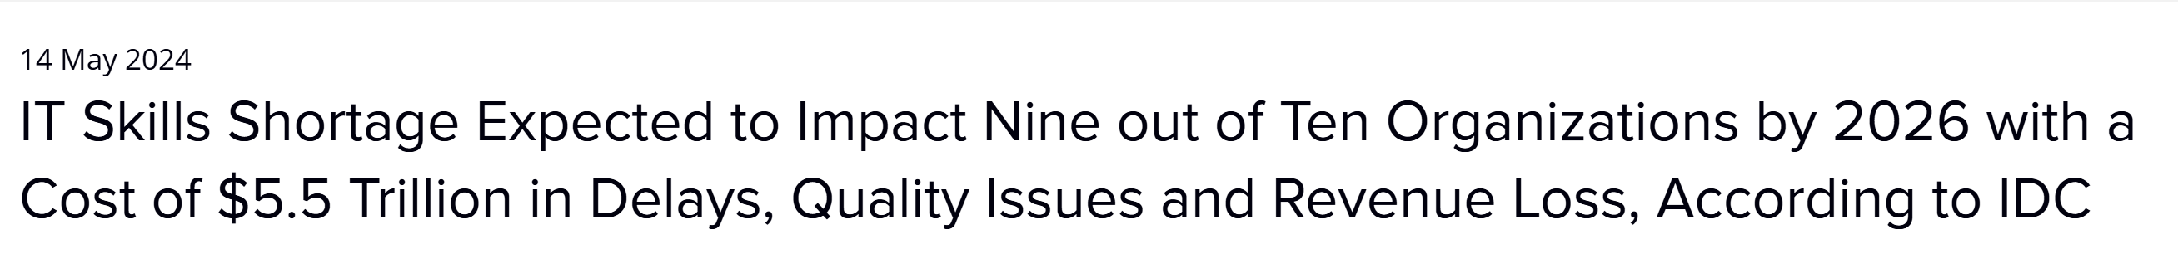
Workforce shortages

Slide 33
So what? What can be done?

Slide 34
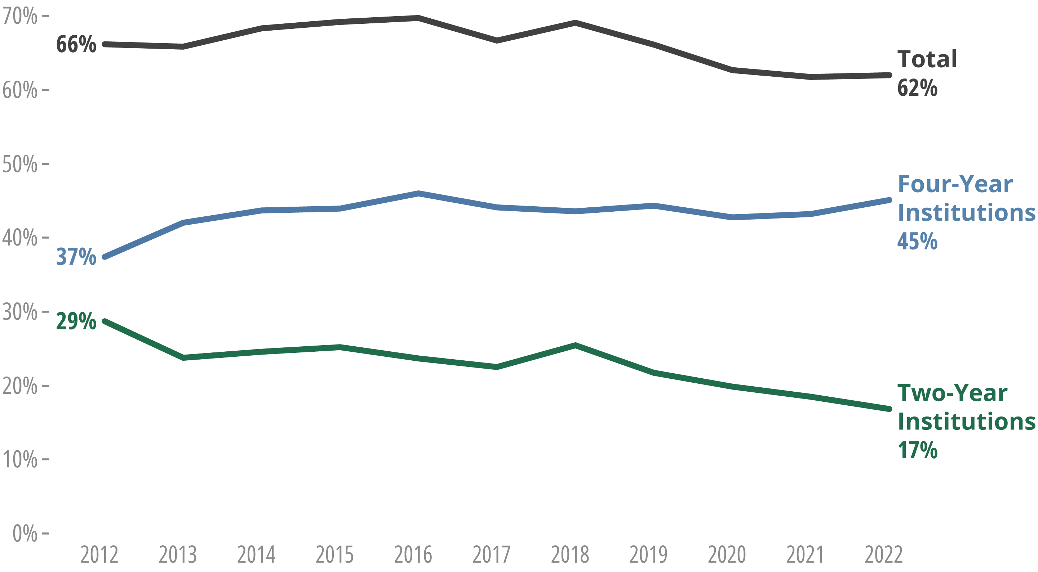
Immediate college-going, national
Sources: BLS, National Center for Education Statistics
Notes:
NCES Immediate College Enrollment Rate, https://nces.ed.gov/programs/coe/indicator/cpa/immediate-college-enrollment-rate

Slide 35
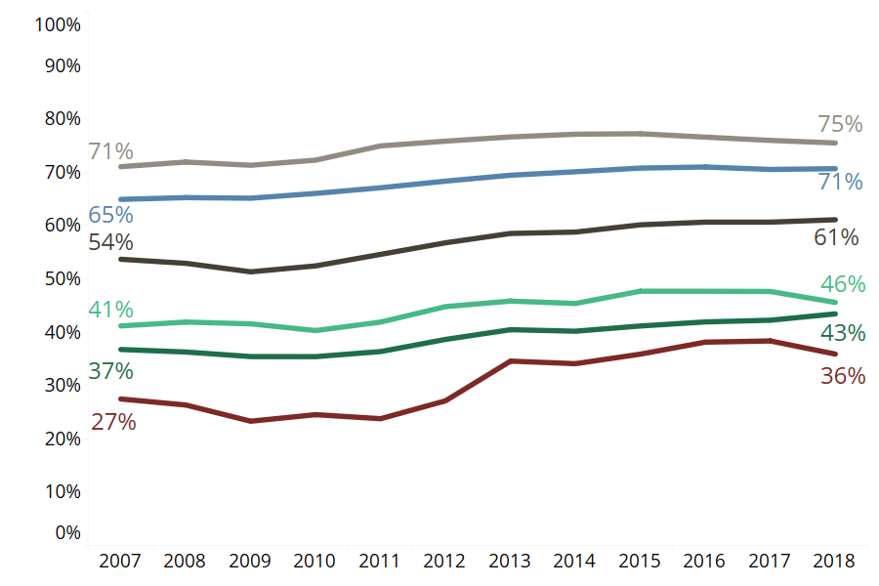
Six-year completion rates by starting institution type, cohorts 2007 to 2018
Private, Non-Profit 4-Year
Public, Four-Year
Total
Public, Associates/Baccalaureate
Public, Two-Year
Private, For-Profit 4-Year
Source: National Student Clearinghouse Research Center, Yearly Progress and Completion

Slide 36




Evidence-backed approaches

Slide 37


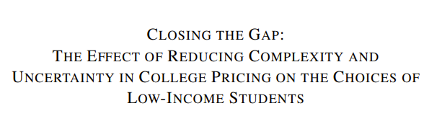
Evidence-backed approaches

Slide 38



Evidence-backed approaches

Slide 39
Coming soon…
More Knocking data
  U.S. Territories and Freely Associated States
  Gender analyses
Webinar series on evidence-backed approaches
  ‘Scaling the Cliff Slightly Downward Sloping Trend’: Policy Responses to Demographic Changes

Slide 40
Thank you!
For further information:
Patrick Lane plane@wiche.edu
Colleen Falkenstern cfalkenstern@wiche.edu https://www.wiche.edu/knocking
Sign up for more information at https://www.wiche.edu/about/news/alerts/

Slide 41
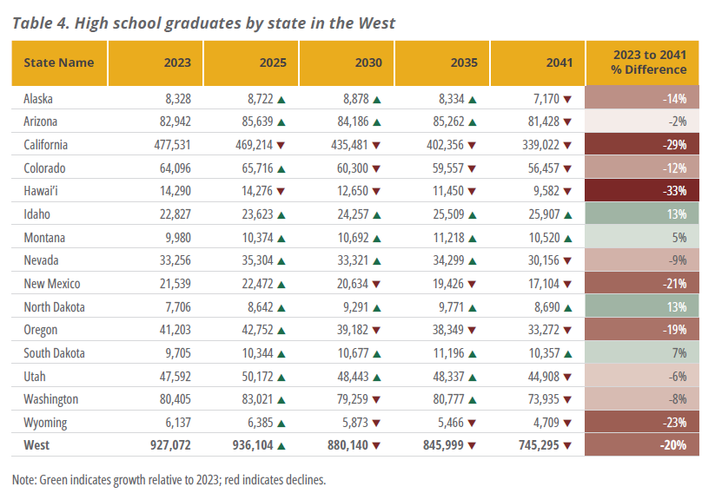

Slide 42
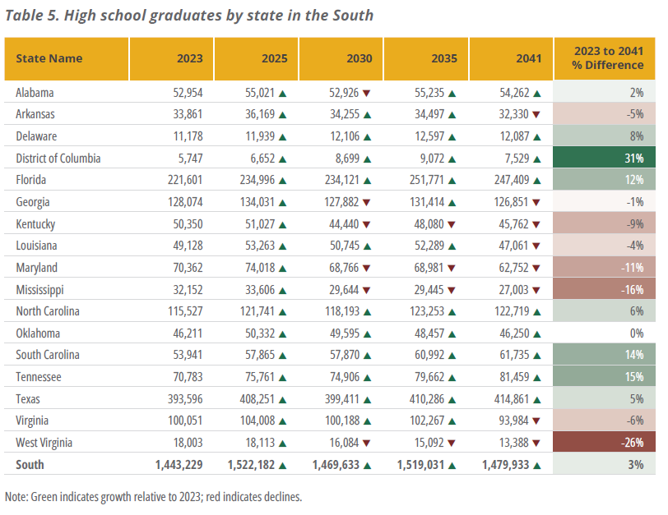

Slide 43
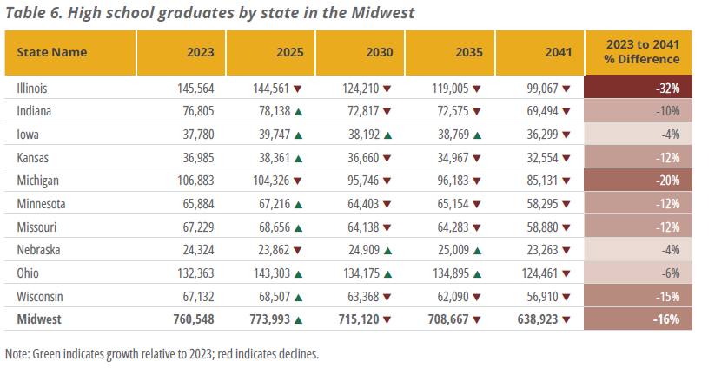

Slide 44
