Slide 1
WICHE Legislative Advisory Committee
August 12, 2023
Notes:
The Wyoming Innovation Partnership (WIP) was created at the request of Governor Gordon in 2021 to modernize and focus Wyoming’s efforts to develop a resilient workforce and economy. The effort aims to better align Wyoming’s economic development agenda by increasing collaborations between state entities and ultimately local partners. The partnership involves the University of Wyoming, the state’s community colleges, Wyoming Business Council, and Department of Workforce Services with an emphasis on developing innovative solutions that support and enhance Wyoming’s economy, workforce, and sources of revenue.
WIP intends to build on and complement existing state efforts in support of Wyoming’s economic development strategy (e.g., Wyoming's Tomorrow, Learn to Earn, Wyoming Works, WY Next Gen Sector Partnerships, Workforce Development Council, Higher Educational Attainment Exec Council and others), and recognizes the need for healthy and sustainably funded institutions to do this work.

Slide 2
Wyoming Innovation Partnership
Structure
8 Community Colleges
1 University
Wyoming Business Council
Wyoming Department of Workforce Services
Wyoming Department of Education
Wyoming Community College Commission

Slide 3
Process
Board/Governance
Governor Mark Gordon
Stakeholders
Industry
Presidential Steering Committee
WIP Executive Director
Students
Project Management Team
Legislature
Institution/Agency

Slide 4
What is the Wyoming Innovation Partnership?
Business
Wyoming’s
Economy
Workforce
Education
Notes:
What does that really mean? I am going to give you an overview of where we are with phase 1 and phase 2 and a few of the exciting things that we have moving forward
The Wyoming Innovation Partnership (WIP) is a collaboration to align education, workforce development and industry to support Wyoming's economic development needs. WIP aims to support growth for our economy and build a highly skilled, ambitious and qualified workforce through innovation, and by linking community goals with the state’s economic strategy. This partnership will be driven by data to ensure a return on investment for the people of Wyoming.

Slide 5





Areas of Focus
Community Goals
Data Driven
Collaboration
Alignment
Align With State Economic Development Strategy
Notes:
WIP work began almost 2 years ago and my goal within the first year has been to organize what has been completed, identify and track short term metrics, identify long term metrics, plan and roll out the process for phase 2. To support this process I spent time traveling to the college campuses meeting with the college presidents, including UW, many of the teams working on WIP programs and the economic development groups in those communities.
Currently we have identified about 20 short term metrics and 19 long term metrics and are working through the process of collection of these metrics to measure the impact WIP is having. We are actually in final review process for the Phase I report - which includes metrics for each category and success stories.

Slide 6
Short Term Metrics
Specific to WIP Programs
New educational program stood up - by type & by location
Number of students enrolled
Number of dual and concurrent enrolled students
Anticipated number of graduates
Jobs available in Wyoming that match degree/certificate
Average wage of jobs
Anticipated need of job based on industry trends
Number and type of business partnerships
Number of internships/apprenticeships created
Transition to higher education/degree to UW
Student retention
Is program capacity met? Does it meet industry need?
Recruitment of nontraditional students - over 24, single parents, retraining
Job placement after graduation
Number of courses that are not offered traditionally - online, hybrid, night classes
Average financial aid per student within WIP programs
Child care assistance? What's the impact
Full time/Part time - are students already within the workforce
Number of business incubation currently being served
Total number of business clients served (new, existing, ongoing)
Notes:
These are the short term metrics that we are measuring to report back on the impact that Phase 1 is making across Wyoming. As you can see, many of these metrics are being tracked at the colleges and the Department of Workforce Services. We will be pulling these together for each of the WIP programs to begin to tell the story about the impact that this funding along with the partnerships and collaborations have on the State.

Slide 7
Long Term Metrics
New business starts
Wyoming business expansions (# jobs)
Business relocation (# jobs)
New jobs added to Wyoming's economy
Average wage of WIP program graduates
Retention of Wyoming graduates
Research activity - aligned with economic impact
Number of patents, intellectual property and market commercialization
Diversification of economy - 2-5 years
Graduation - UW and Grad school
Job placement after graduation
Job growth within smaller communities under 10,000/5,000
ROI - dollars invested per job created/graduate retained in Wyo within sector trained
Additional money invested (grant and private sector investment)
New housing builds and new builds on commercial property
Housing and rental price data
Total number of business clients who opened businesses
Total number of business clients who opened businesses - still in business 3 and 5 years
Total estimated business size, dollars of annual revenues - 3 and 5 years
Notes:
When you look at the long term metrics this is where we will really begin to see the impact that WIP and many of the other programs/projects collectively have on Wyoming and the different industries and business needs. Many of these long term metrics, including the ROI of WIP funds will take a few years to collect however they will be very valuable once we get there.

Slide 8
Timeframes & Phasing
  Through June 2023
    Infrastructure Support
    Launch of WIP’s collaborative, programmatic efforts
    Short Term Metrics Reporting – July 2023
Phase 1
  July 2023 – June 2024
    Metric driven programming rollout
    Shared curriculum stood up at multiple locations
    Students begin to enter workforce/transfer to UW
Phase 2
  July 2024 – Beyond
    Iterative process to build sustainability
    Long term metrics realized
    Return on investment
Phase 3
Notes:
Here is a brief overview of the phasing and what that will look like. You can see that phase 1 is standing up the partnership and we will begin to see metrics for Phase 1 in July of 2023.
Phase 2 is where we will begin to see shared curriculum at multiple colleges and toward the end of the phase 2 we will see students starting to transfer to the University or enter the workforce depending on which program they were enrolled in. Phase II funding was just announced and we will go over those in just a few minutes.
Phase 3 is when we will begin to realize what the return on investment for these investments along with the collaboration and partnerships will be across Wyoming.

Slide 9
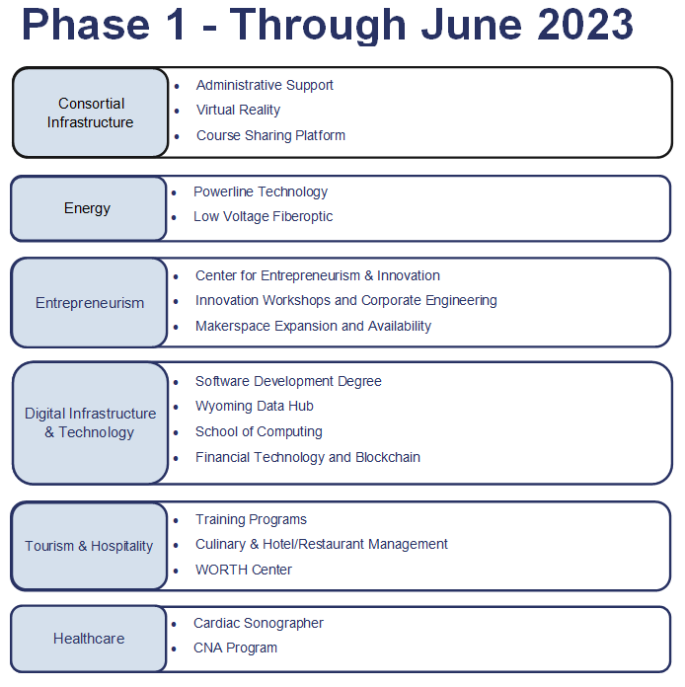
Notes:
Phase 1 – we are currently towards the end of phase 1 which has supported start up of 6 different component categories in phase 1 with 17 different charters – purchasing equipment, getting instructors hired, building curriculum and receiving approval and accreditation of curriculum.
We expect that most Phase 1 charters will continue into phase 2 of the program, however we will be utilizing data to determine impact, need, and return on investment throughout. There are also phase 1 charters that will not need WIP funding and have achieved sustainability through Phase 1.

Slide 10
Administrative Support
Program Infrastructure
Substation Technician Electrical and Instrumentation
Energy
Creative Economy
Innovation Workshops and Corporate Engineering
Makerspace Expansion and Availability
Entrepreneurship
Software Development Data Hub
Digital Credential Wallet Research and Education - AI/Cybersecurity
Expanding Access to Careers in a Technology Driven Economy
Digital Infrastructure & Technology
PHASE II
WORTH Center Training Programs
Culinary & Hotel/Restaurant Management
Tourism and Hospitality
Healthcare
Registered Nursing and Practical Nursing Program Expansion
Certified Nursing Assistant and Medical Assistance Expansion
Controlled Environment Agriculture
Precision Agriculture
Ranch Management & Agricultural Leadership
Agriculture
Advanced Manufacturing Manufacturing Works
Manufacturing
Construction Trades Workforce Training Certifications
Young Adult Interships
Workforce Development

Slide 11
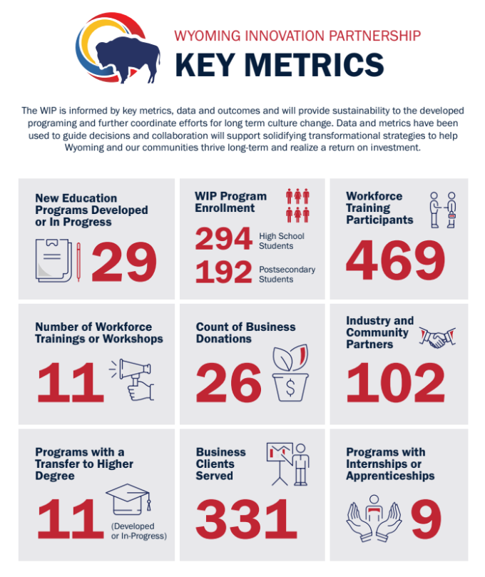
Program Success
Powerline Technology
Software Development
Echocardiography
Virtual Reality
Course Sharing

Slide 12
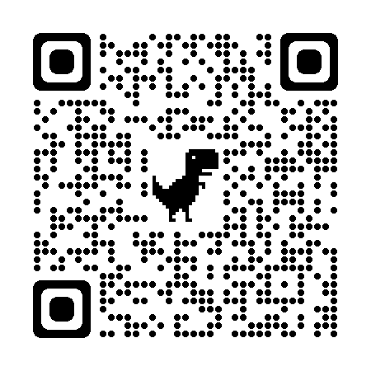
More Information at https://wip.wyo.gov/
Notes:
I have included this qr code and website for more information. We do have each of the phase I components summarized
Upcoming Items
Marketing RFP - statewide informational campaign
Closing out phase I - we are starting to pull in metrics and outcomes for the phase I programs. By the end of June/beginning of July, I plan on having a report put together for each component and each project to share metrics and outcomes and success stories.

