Slide 1



Federal Policy and Postsecondary Value
Austin Reid, Senior Legislative Director
The National Conference of State Legislatures
September 13, 2023

Slide 2
SESSION QUESTION
What federal policy changes- whether recent, in-process, or possible- have the potential to impact how states think about higher education accountability, funding, and impact?

Slide 3
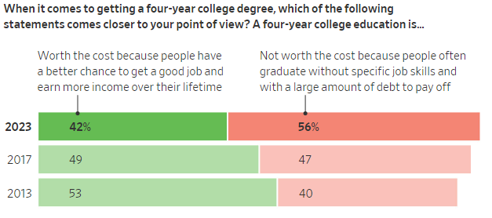
Wall Street Journal-NORC poll: March 2023
Notes:
https://www.wsj.com/articles/americans-are-losing-faith-in-college-education-wsj-norc-poll-finds-3a836ce1?ns=prod/accounts-wsj

Slide 4
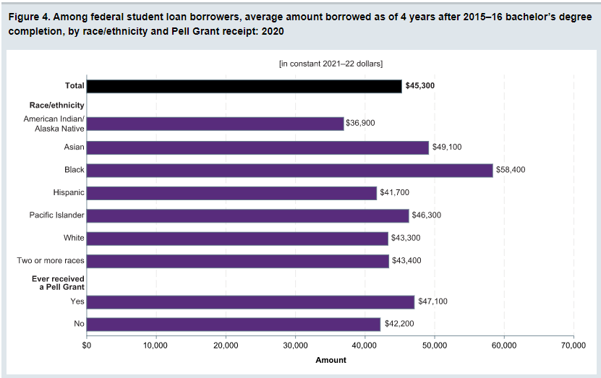
Recent 4-year graduates have $45,000 in debt
Notes:
https://nces.ed.gov/programs/coe/postsecondary

Slide 5
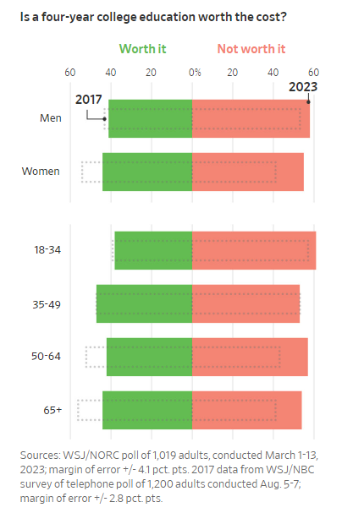
Notes:
https://www.wsj.com/articles/americans-are-losing-faith-in-college-education-wsj-norc-poll-finds-3a836ce1?ns=prod/accounts-wsj

Slide 6
BIG PICTURE
Past: Students bear downside risks in higher education
Present: Federal taxpayers bear an increasing share of the downside risks and associated costs
Future: Will institutions become more accountable for downsides? Will public become higher ed risk-averse?

Slide 7
SESSION OUTLINE
Present:
Federal student loan program is becoming costly
USED regulatory agenda focus on value/accountability
Future:
Reauthorized HEA focus on transparency/accountability

Slide 8
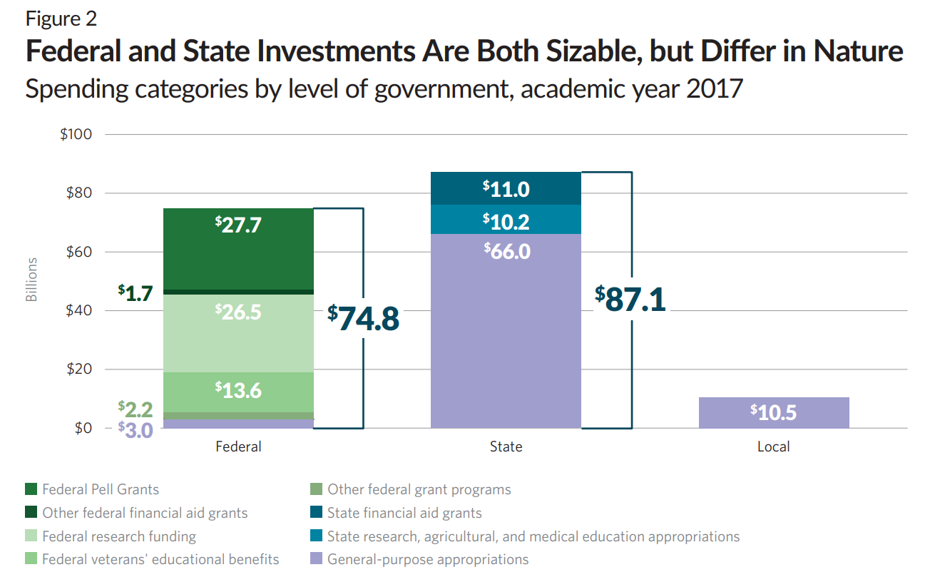
Notes:
https://www.pewtrusts.org/en/research-and-analysis/issue-briefs/2019/10/two-decades-of-change-in-federal-and-state-higher-education-funding

Slide 9
State Higher Ed Funding Trends
Unadjusted for inflation, Grapevine Report on State Fiscal Support for Higher Education
Notes:
https://shef.sheeo.org/grapevine/

Slide 10
FY21 “Back of the Napkin” State-Fed Funding Comparison
FEDERAL UNDERGRAD
STATE HIGHER ED
$25.6 billion in Pell grants
  $1.1 billion TRIO
  $1.2 billion Federal Work Study (FWS)
  $880 Supplemental Education Opportunity Grant (FSEOG)
$10.6 billion in veterans benefits
~$30+ billion in research grants (Austin’s guess)
$44 billion in undergrad student loans
$39 billion in grad student loans
  = $70 billion direct funding + $83 billion lending
$97.3 billion direct appropriations
Notes:
https://www.benefits.va.gov/REPORTS/abr/docs/2021_education.pdf

Slide 11
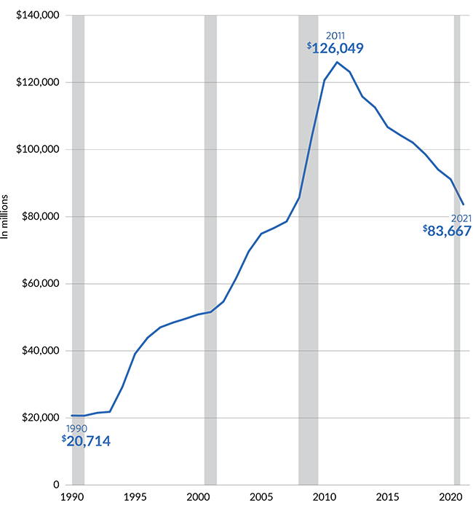
Annual Federal Student Lending- Pew
$44 billion undergrad
$39 billion grad
Notes:
https://www.pewtrusts.org/en/research-and-analysis/issue-briefs/2021/12/how-the-pandemic-could-affect-the-rise-in-student-debt

Slide 12
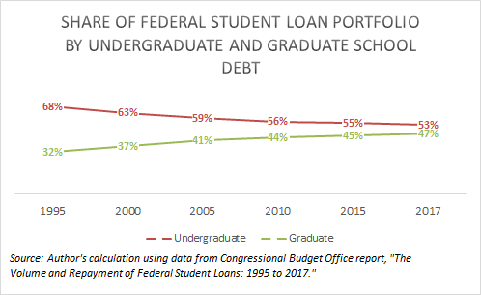
Notes:
https://twitter.com/delislealleges/status/1461377863047954437?s=20&t=OhcJLlnluZ2M9-fI__lmMQ

Slide 13
1. Federal student loan program is becoming costly

Slide 14
KEY UNDERSTANDINGS
Past: Before pandemic, loan program wasn’t revenue neutral
Present: Loan relief during pandemic era was significant and costly
Future: Loan program reforms and new programs will increase costs

Slide 15
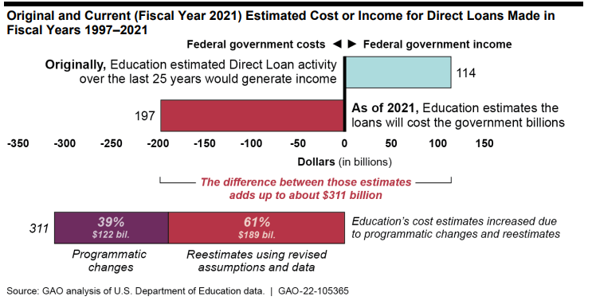
Notes:
https://www.gao.gov/products/gao-22-105365

Slide 16
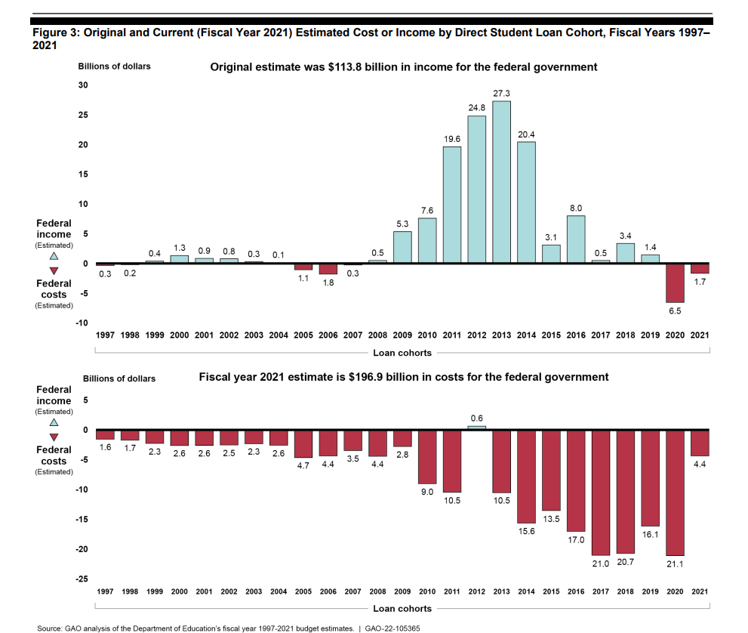
Notes:
https://www.gao.gov/products/gao-22-105365

Slide 17






SINCE 2020, OVER $300 BILLION IN LOAN RELIEF, including $116 BILLION FORGIVEN
Student Loan Pause
Borrower Defense to Repayment
Total and Permanent Disability
Income-driven Repayment
Public Service Loan Forgiveness
42-month pause likely cost $5 billion/month
Claims of fraud, misrepresentation, institution closure
Submit discharge form in event of disability
20-25 years of qualifying payments based on income level
10 years of qualifying payments in IDR with qualifying employers
~$200 billion
$22 billion
$10.5 billion
$39 billion
$45 billion

Slide 18
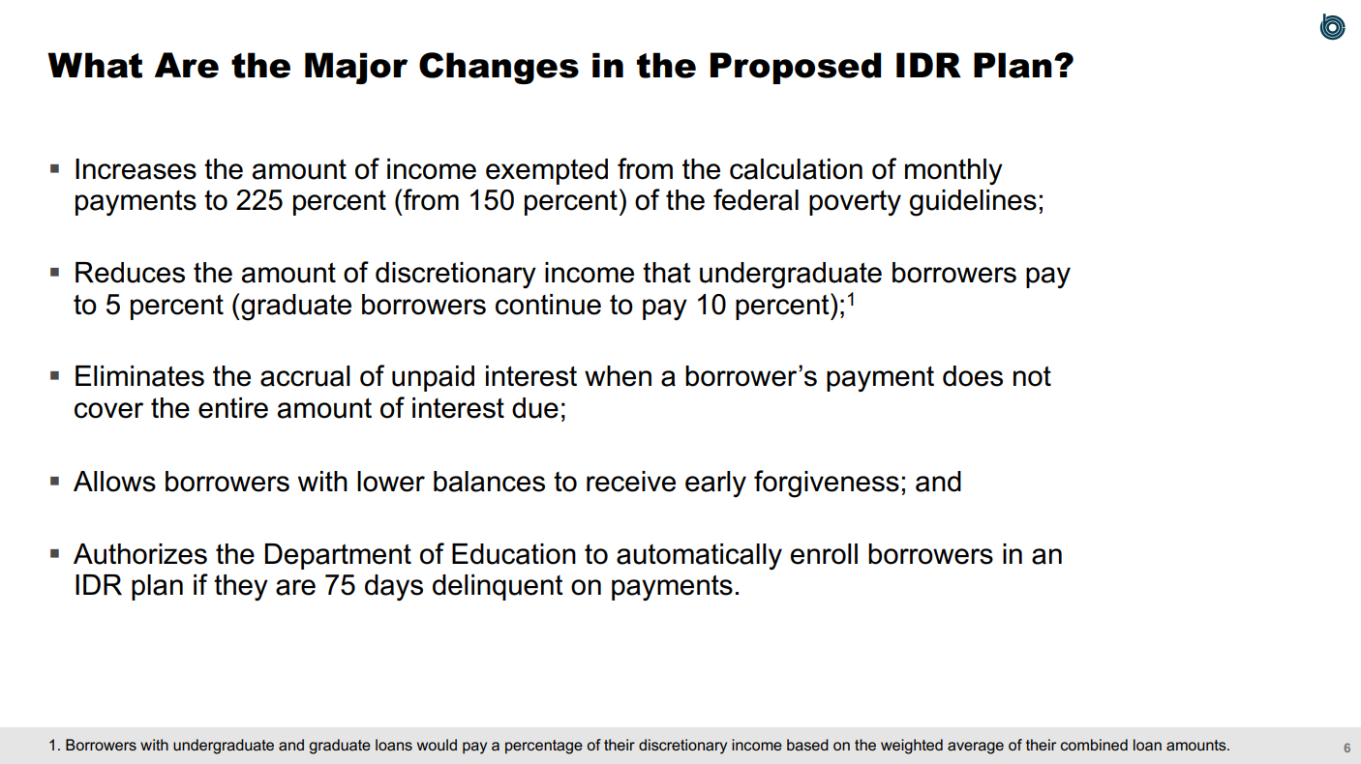
Notes:
https://www.cbo.gov/system/files/2023-05/59113-IDR.pdf

Slide 19
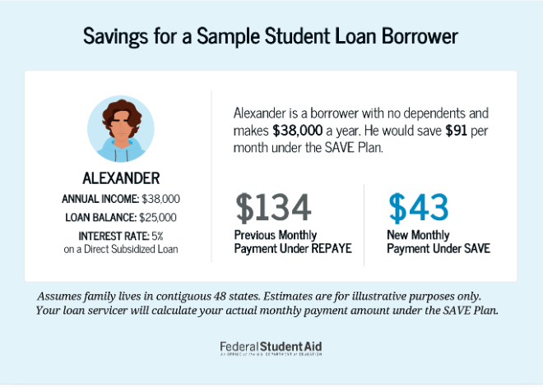

Slide 20
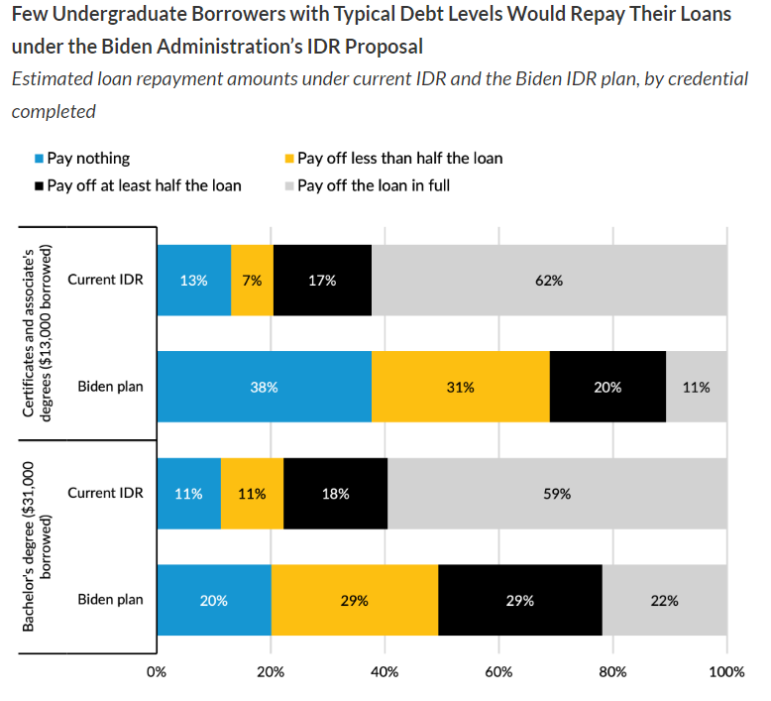
Notes:
https://www.urban.org/research/publication/few-college-students-will-repay-student-loans-under-biden-administrations

Slide 21
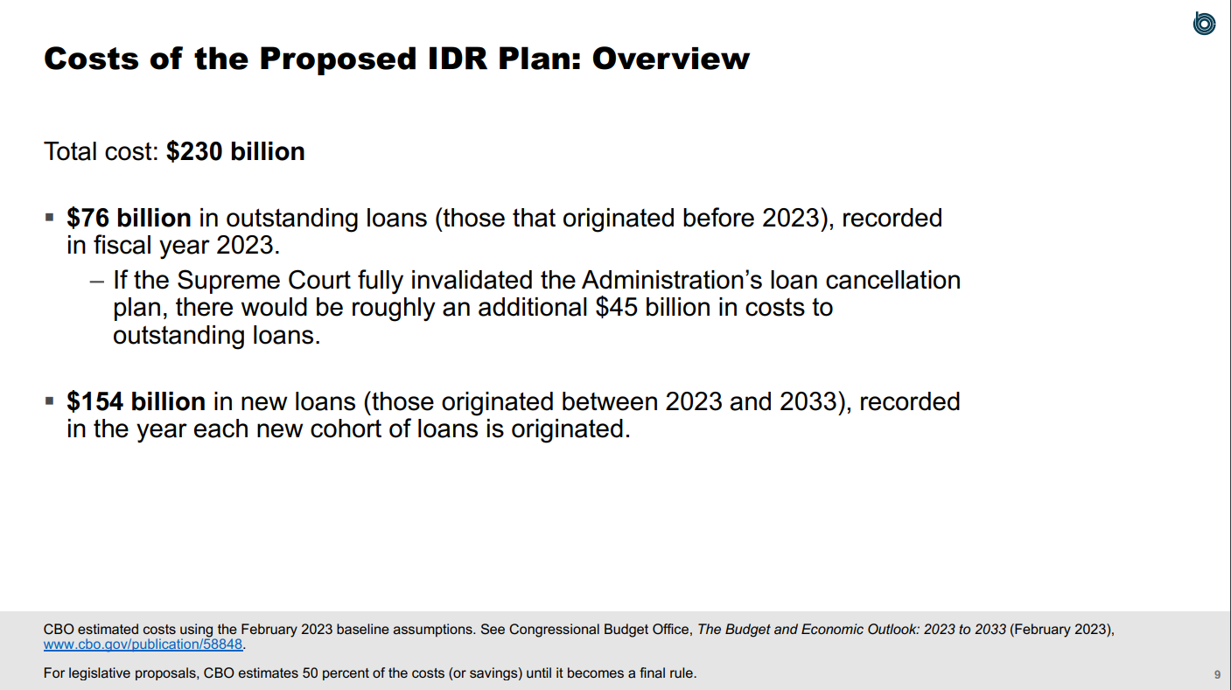
Notes:
https://www.cbo.gov/system/files/2023-05/59113-IDR.pdf

Slide 22
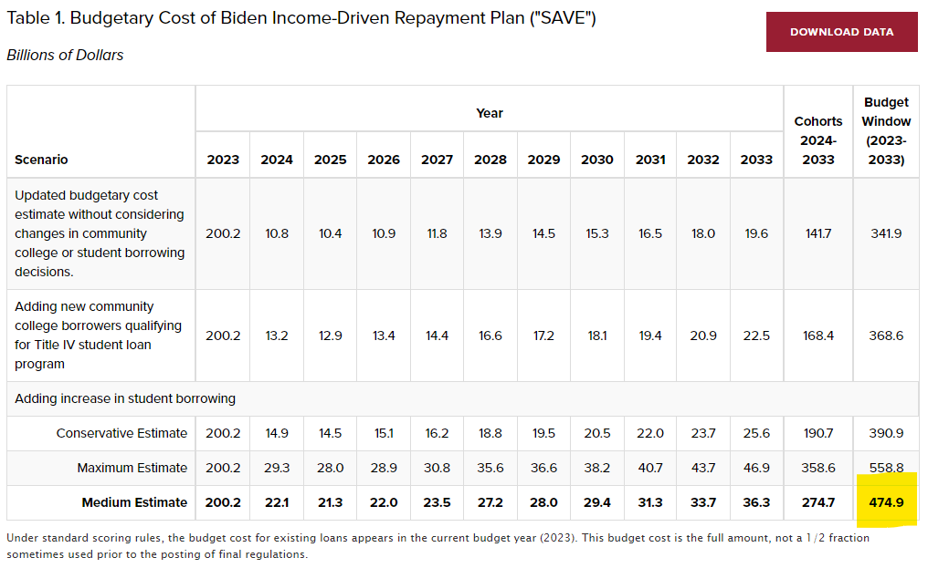
Notes:
https://budgetmodel.wharton.upenn.edu/issues/2023/7/17/biden-income-driven-repayment-budget-update

Slide 23
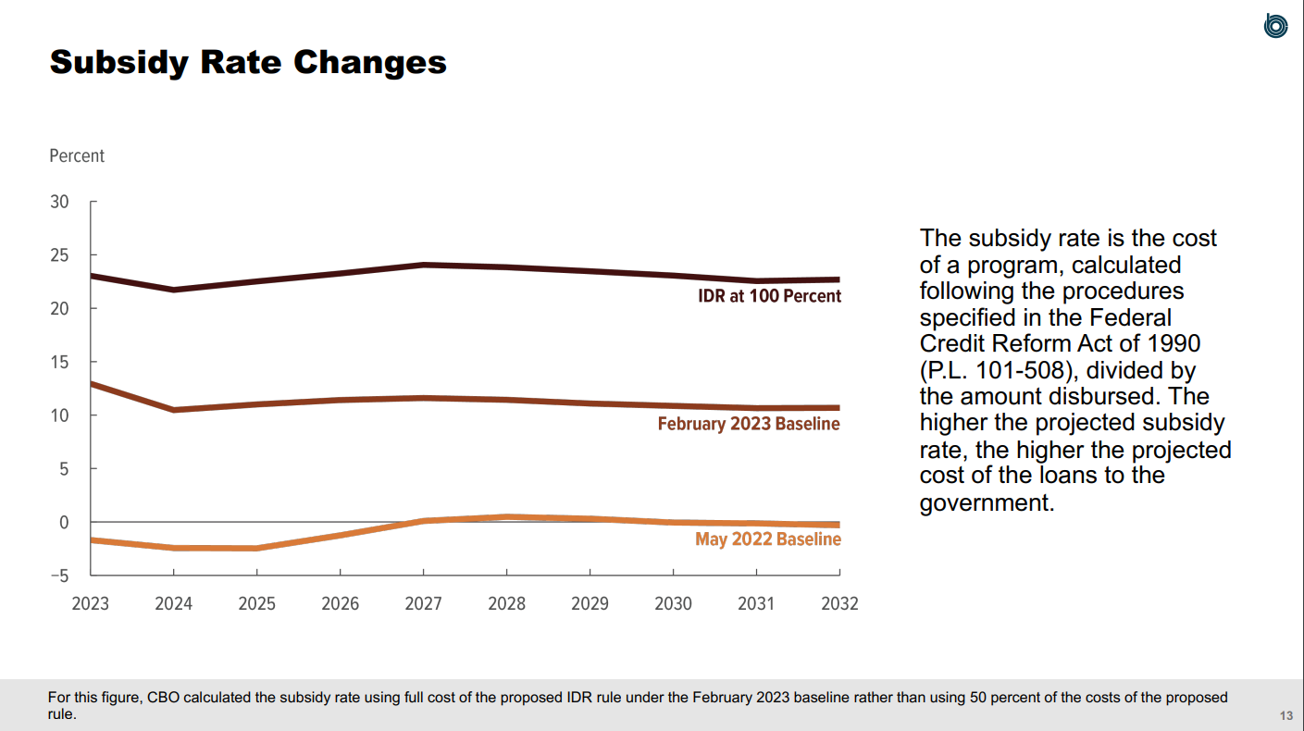
Notes:
https://www.cbo.gov/system/files/2023-05/59113-IDR.pdf

Slide 24
TAKEAWAY
Federal loan program increasingly functioning as a partial subsidy for higher education on par with Pell Grant funding
WHICH
Invites federal policymakers to examine return-on-investment for institutions and programs

Slide 25
2. USED regulatory agenda focuses on value and accountability

Slide 26
ED Regulatory Highlights
List of low-value programs (RFI proposed)
  Cohort default rate (CDR) rendered useless via loan reforms
Gainful employment rule (proposed)
College Scorecard + New Blog
Borrower Defense (final) + SARA interest (proposed)

Slide 27
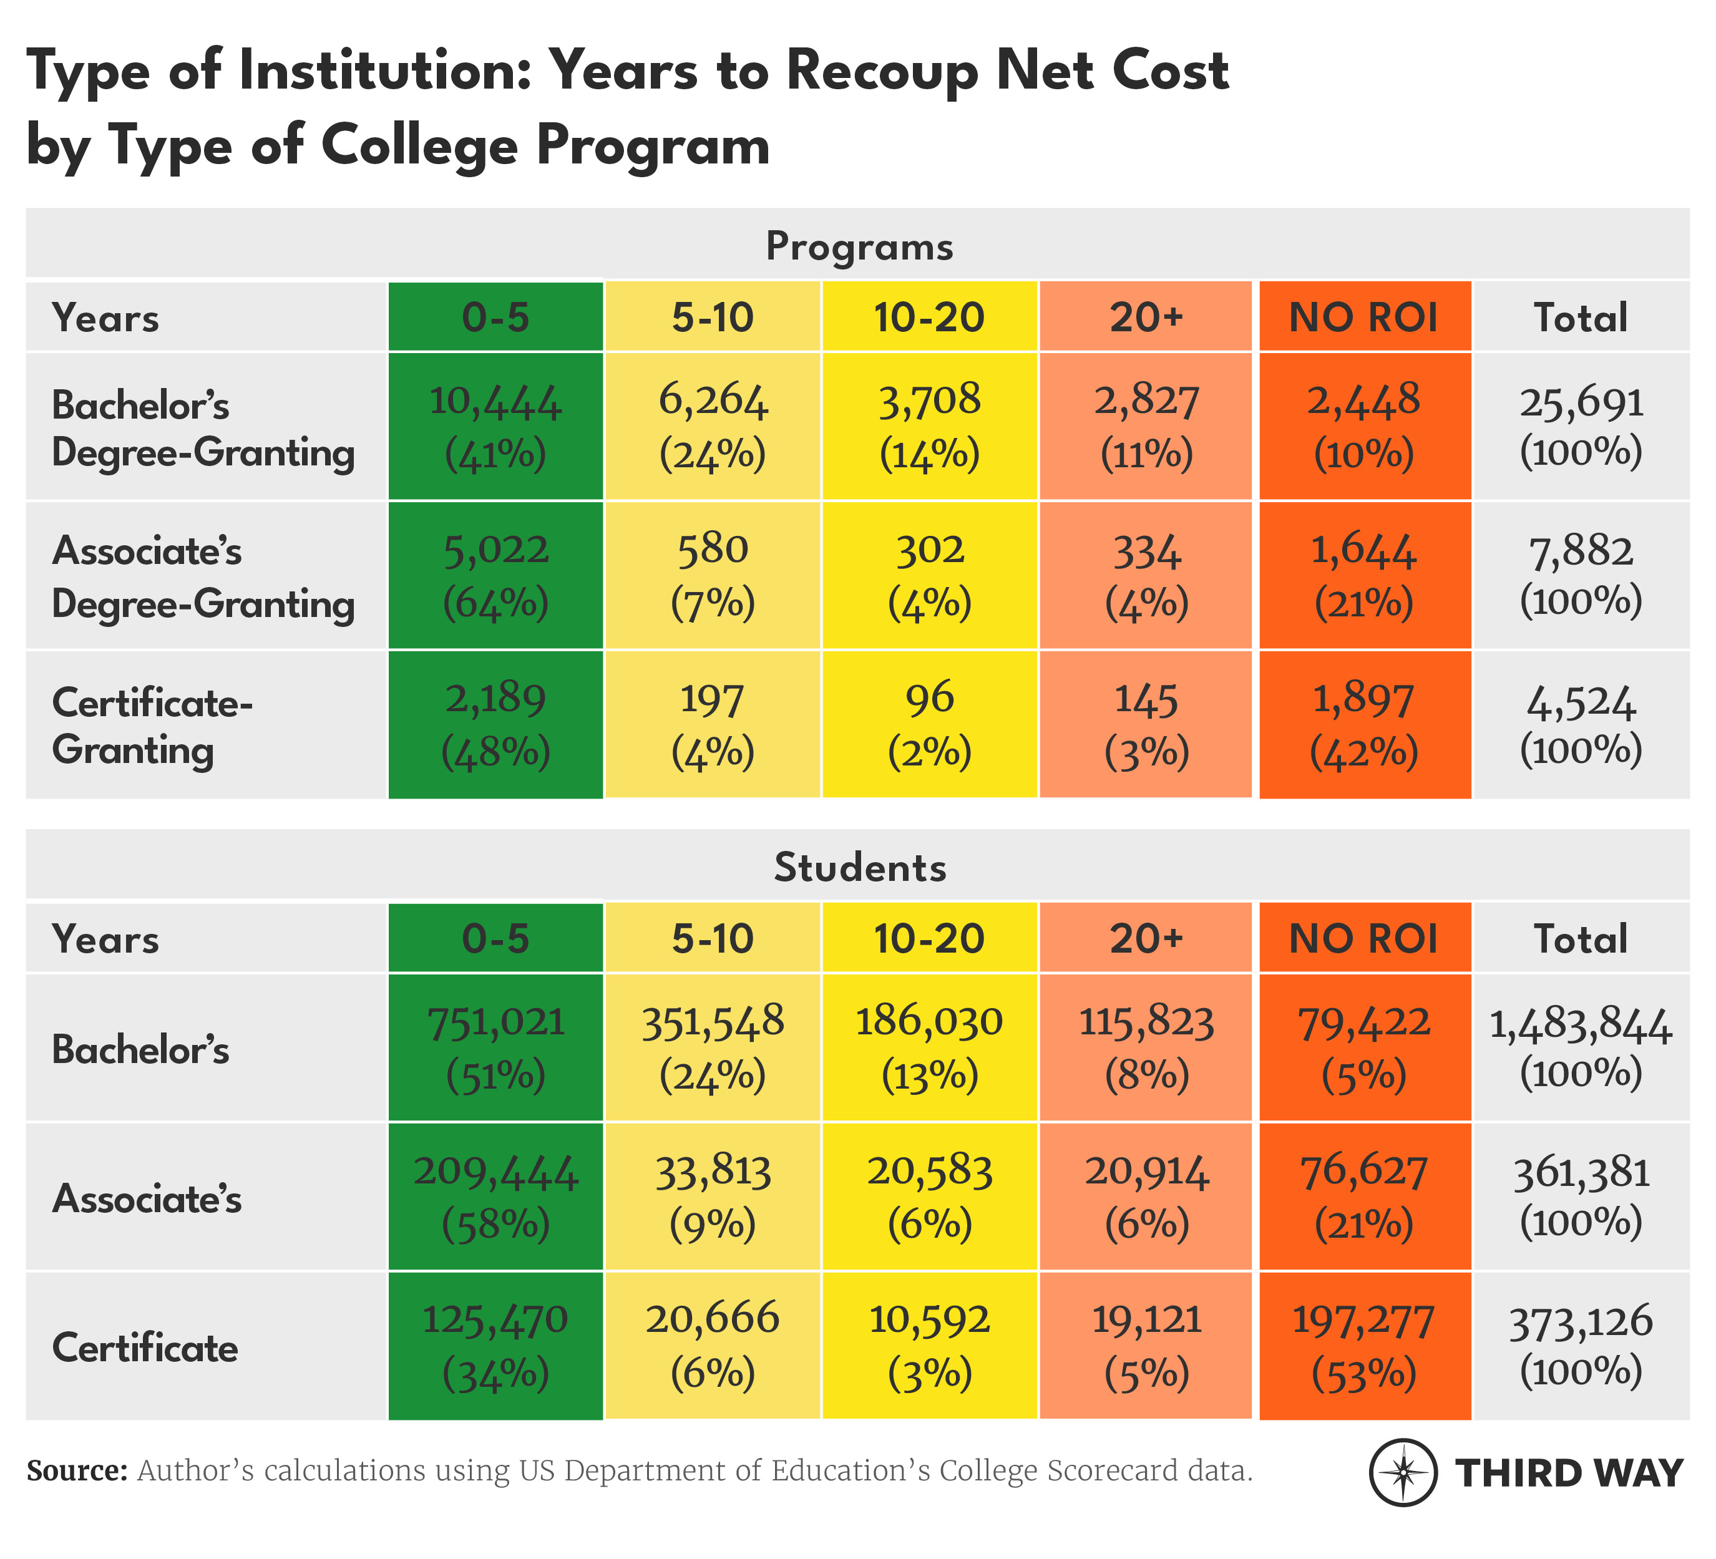
Notes:
https://www.thirdway.org/report/which-college-programs-give-students-the-best-bang-for-their-buck

Slide 28
List of Low-Financial-Value Programs RFI
Taxpayers bear burden when borrowers cannot repay loans
“Taxpayers also shoulder the costs when a substantial number and share of borrowers are unable to successfully repay their loans. The number of borrowers facing challenges related to the repayment of their student loans is significant.”
New repayment plans increased potential for taxpayer subsidy
“IDR plans can transfer some of the cost of financing a low-financial-value postsecondary program to taxpayers through debt forgiveness. The goal of the IDR program is to reduce the burden of loans for low- and middle-income borrowers, not to subsidize programs that fail to help many of their students graduate and achieve their goals.”
A list of low-financial-value programs will improve borrower choices, lessen taxpayer burden
“The Department believes annually publishing a list of the programs with the lowest financial value will draw public attention to these programs. The Department also is committed to sending letters to institutions with the most concerning programs to ask for their plans to improve the value of their programs. These steps should reduce the extent to which students and taxpayers are exposed to the negative consequences resulting from low-financial-value programs.”
Notes:
https://www.federalregister.gov/documents/2023/01/11/2022-28606/request-for-information-regarding-public-transparency-for-low-financial-value-postsecondary-programs

Slide 29
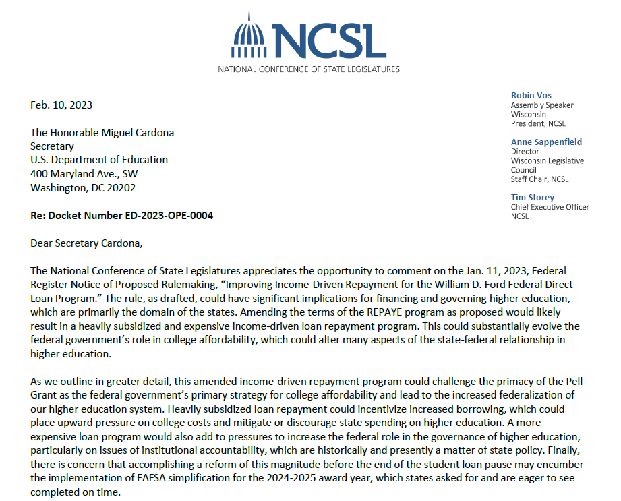
Notes:
https://www.regulations.gov/comment/ED-2023-OPE-0004-13386

Slide 30
ED Regulatory Highlights
List of low-value programs (RFI proposed)
  Cohort default rate (CDR) rendered useless via loan reforms
Gainful employment rule (proposed)
College Scorecard + New Blog
Borrower Defense (final) + SARA interest (proposed)

Slide 31
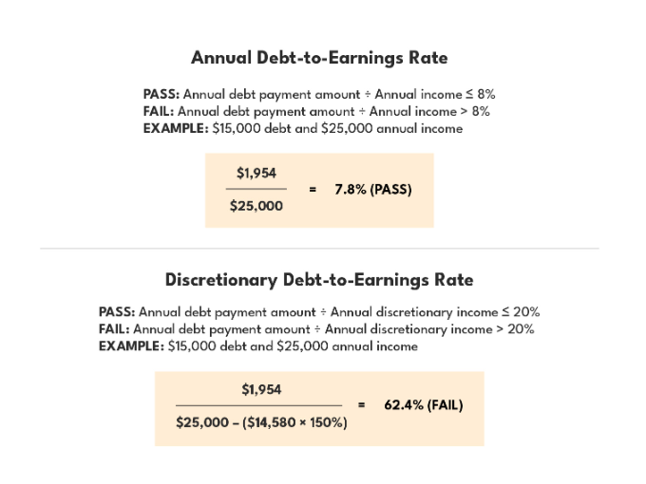
Proposed Gainful Employment Rule
Notes:
https://www.thirdway.org/blog/q-a-whats-in-the-new-gainful-employment-rule

Slide 32
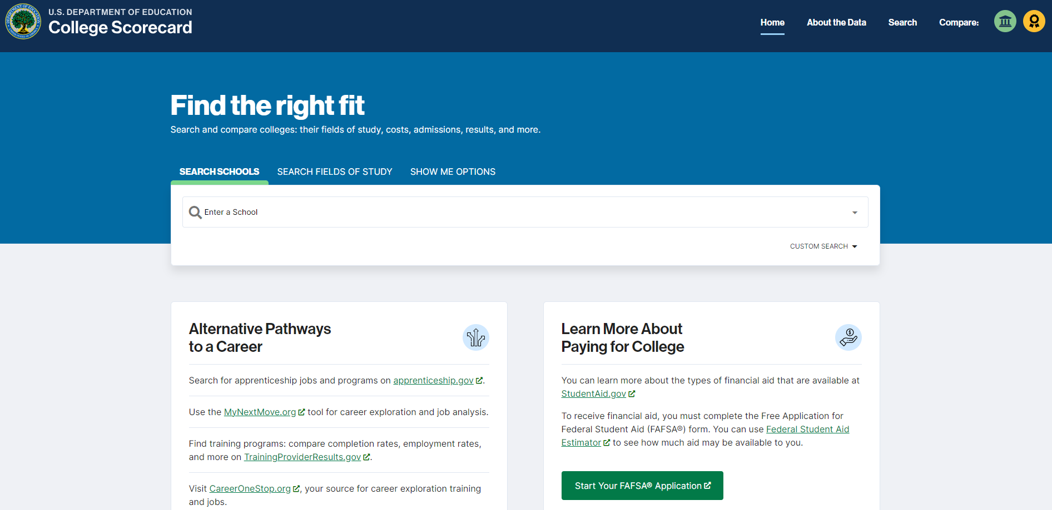
Data and Analysis: College Scorecard + New Blog
Notes:
https://www.thirdway.org/blog/q-a-whats-in-the-new-gainful-employment-rule

Slide 33
ED Regulatory Highlights
List of low-value programs (RFI proposed)
  Cohort default rate (CDR) rendered useless via loan reforms
Gainful employment rule (proposed)
College Scorecard + New Blog
Borrower Defense (final) + SARA interest (proposed)

Slide 34
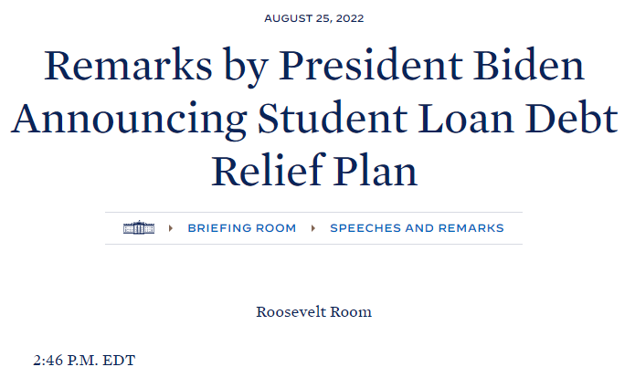
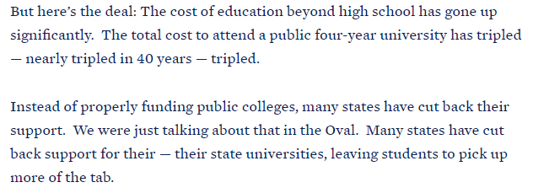
Notes:
https://www.whitehouse.gov/briefing-room/speeches-remarks/2022/08/25/remarks-by-president-biden-announcing-student-loan-debt-relief-plan/

Slide 35
3. Reauthorized HEA could focus on transparency + value/accountability

Slide 36
Ideas for Reauthorized HEA
Increased Transparency (to improve decision-making)
  Increased and improved data (i.e. lift student unit record ban)
  Standardized aid letters
  Improved loan counseling
Accountability Proposals
  Risk-sharing
  Gainful Employment for all
  Minimum state authorization requirements
Loan limits (esp. for Grad Plus and Parent Plus)
Short-term Pell grants
State-Federal Partnerships

Slide 37
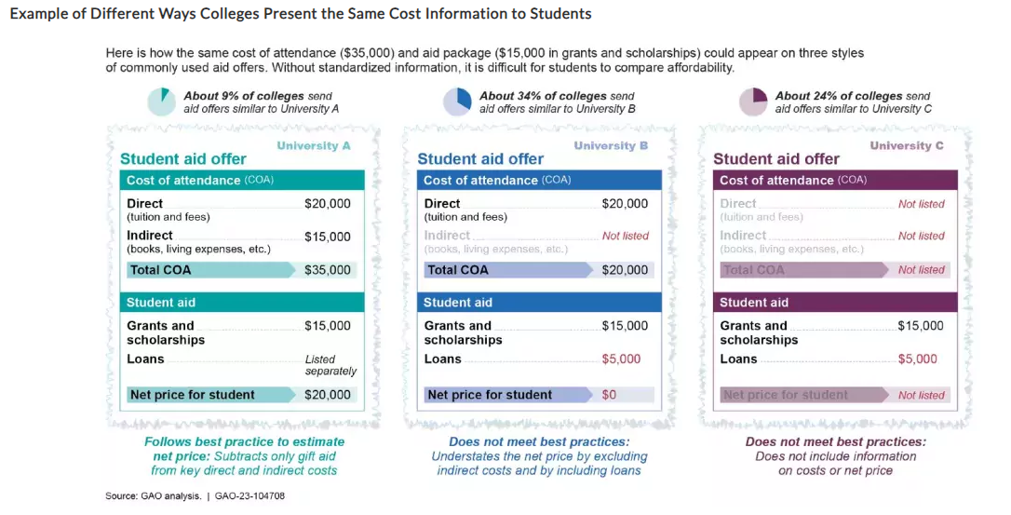
GAO REPORT ON FINANCIAL AID OFFERS
Notes:
https://www.gao.gov/blog/what-financial-aid-offers-dont-tell-you-about-cost-college

Slide 38
BIG PICTURE
Past: Students bear downside risks in higher education
Present: Federal taxpayers bear an increasing share of the downside risks and associated costs
Future: Will institutions become more accountable for downsides? Will public become higher ed risk-averse?

Slide 39
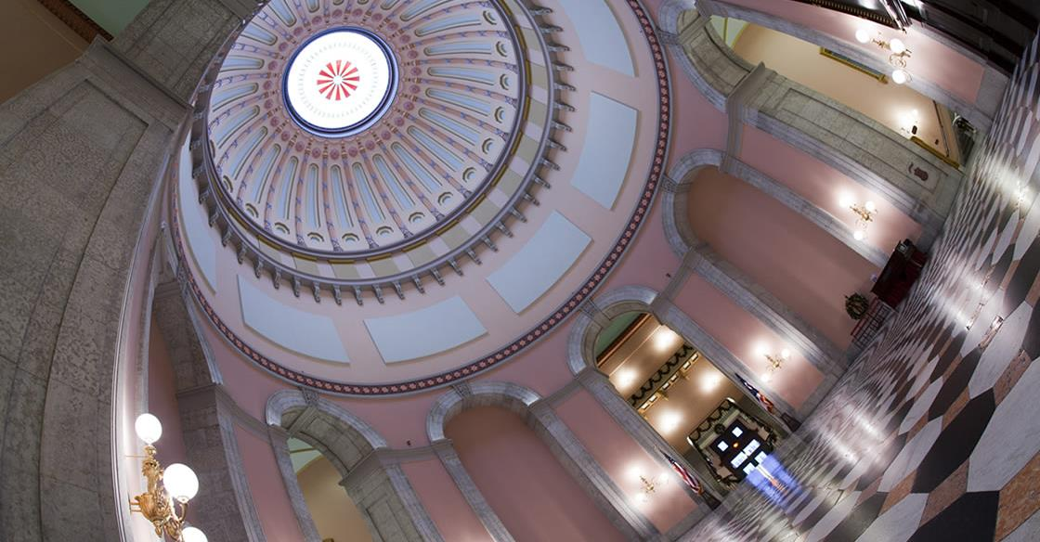

THANK YOU
Notes:
The National Conference of State Legislatures is the country’s most trusted bipartisan organization serving legislators and staff for more than 40 years.
We promote policy innovation, create opportunities for lawmakers to share knowledge and ensure state legislatures have a strong, cohesive voice in the federal system.
We do this because we believe in the importance of the legislative institution and know when states are strong, our nation is strong.

