Slide 1
A National Analysis of State Higher Education Funding Strategies
Robert Kelchen, University of Tennessee, Knoxville
rkelchen@utk.edu
https://informedstates.org/
September 12, 2023

Slide 2
Acknowledgements
Co-PIs: Dominique Baker (Southern Methodist University), Justin Ortagus (University of Florida), Kelly Rosinger (Pennsylvania State University)
Funders: Arnold Ventures, Bill & Melinda Gates Foundation, Joyce Foundation, William T. Grant Foundation
Small army of graduate assistants

Slide 3
State higher education funding
First question: Is a college education worth public subsidies? Research says yes, on average
Second question: Fund colleges (appropriations) or students (financial aid)?
FY2022 data on public higher education (SHEEO):
$92.8 billion to fund general operations
$10.2 billion to fund student financial aid

Slide 4
State higher education funding
Most attention from researchers and policymakers has focused on performance funding—only about 10% of total funding
Little has been known about the other mechanisms of direct state appropriations
And no details about the characteristics of student financial aid programs

Slide 5
Scope of our project
Collected data from FY97-20 on performance funding model details and FY04-20 on overall higher education funding and student financial aid models
Unit of analysis is system/sector level for funding and state level for student financial aid
All data and research available at informedstates.org
Starting an update process to go through FY23/24

Slide 6
Funding model theory
Think of funding models as how colleges may be induced to respond
Traditional model: Colleges have no ability to influence funding through their direct actions (base-plus, no formula)
Incentive model: Colleges can influence funding by improving metrics (enrollment and performance funding)
Hybrid model: Combines incentive components with base-plus
Often has hold-harmless or stop-loss provision

Slide 7
Frequency of funding models
 | Four-year universities |  |  | Two-year colleges
Funding model (pct) | FY04 | FY12 | FY20 | FY04 | FY12 | FY20
Traditional model | 45.7 | 49.9 | 40.8 | 19.2 | 18.9 | 7.0
No formula | 23.8 | 24.0 | 24.1 | 4.3 | 7.8 | 2.6
Base adjusted only | 22.9 | 26.8 | 17.6 | 15.3 | 11.9 | 5.1
Incentive model | 13.9 | 2.0 | 7.2 | 23.6 | 13.7 | 21.4
Enrollment only | 13.7 | 0 | 0 | 23.6 | 13.7 | 7.7
Performance only | 0.2 | 0.7 | 5.6 | 0 | 0 | 4.5
Enrollment+performance | 0 | 1.3 | 1.6 | 0 | 0 | 9.2
Hybrid model | 40.4 | 48.1 | 51.9 | 57.2 | 67.3 | 71.5
Base+enrollment | 30.9 | 34.4 | 23.4 | 46.3 | 49.1 | 13.2
Base+performance | 2.4 | 5.1 | 18.5 | 7.0 | 2.9 | 10.7
Base+enrollment+performance | 7.1 | 8.6 | 10.0 | 3.9 | 15.3 | 47.7

Slide 8
Funding models in WICHE states
 | Four-year universities |  |  | Two-year colleges
State | Traditional | Incentive | Hybrid | Traditional | Incentive | Hybrid
Alaska | 2004-20 |  |  | 2004-14
Arizona | 2004, 2009-12, 2015, 2018-20 |  | 2005-08, 2013-14, 2016-17 | 2004, 2011-12, 2020 |  | 2005-10, 2013-19
California (UC, CCC) | 2009-10, 2014-15 |  | 2004-08, 2011-13, 2016-20 |  |  | 2004-20
California (CSU) | 2009-10, 2013 |  | 2004-08, 2011-12, 2014-20
Colorado (most) | 2004-05 | 2016-19 | 2006-15, 2020 | 2004-05 | 2016-19 | 2006-15, 2020
Colorado (Aims CC & CO Mtn.) |  |  |  | 2004-20
Hawaii | 2004-16 |  | 2017-20 |  |  | 2004-20
Idaho | 2008, 2011-12 |  | 2004-07, 2009-10, 2013-20 | 2004-06, 2011-12 |  | 2007-10, 2013-20
Montana (MT University system) | 2010-11 | 2014-20 | 2004-09, 2012-13 | 2010-11 | 2014-20 | 2004-09, 2012-13
Montana (others) |  |  |  |  | 2004-07 | 2008-20
North Dakota | 2004-13 |  | 2014-20 | 2004-13 |  | 2014-20
New Mexico |  |  | 2004-20 |  |  | 2004-20
Nevada | 2010-13 | 2004-09, 2014-20 |  | 2010-13 | 2004-09, 2014-20
Oregon |  | 2004-15 | 2016-20 |  | 2004-20
South Dakota | 2004, 2011-12, 2014-20 |  | 2005-10, 2013
Utah (tech colleges) |  |  |  | 2009-17 | 2018-20 | 2004-08
Utah (others) |  |  | 2004-20 | 2004-16 |  | 2017-20
Washington | 2004-20 |  |  |  |  | 2004-20
Wyoming | 2004-20 |  |  |  |  | 2004-20

Slide 9
Effects of PBF on student outcomes
Most research has found limited effects of PBF on a host of outcomes
Ours generally follows suit, even with better data
We find null or modest positive/negative effects
Some unintended consequences on access at highly selective colleges and increases in debt among those who did not graduate
But PBF also modestly increased earnings at four-year institutions
Also worth considering: if not PBF, will there be funding?

Slide 10
PBF dosage characteristics: FY20

Slide 11
Effects of broader funding models
Focused on breakdown of incentive or hybrid versus traditional models
Four-year institutions: generally no effect of funding type on enrollment or completions
Two-year institutions: hybrid models increased enrollment, but not completions

Slide 12
Describing financial aid programs
Need-based aid: Purely based on financial need without academic requirements beyond satisfactory academic progress
Merit-based aid: No need-based components whatsoever
Combo aid: Need-based aid with academic performance components

Slide 13
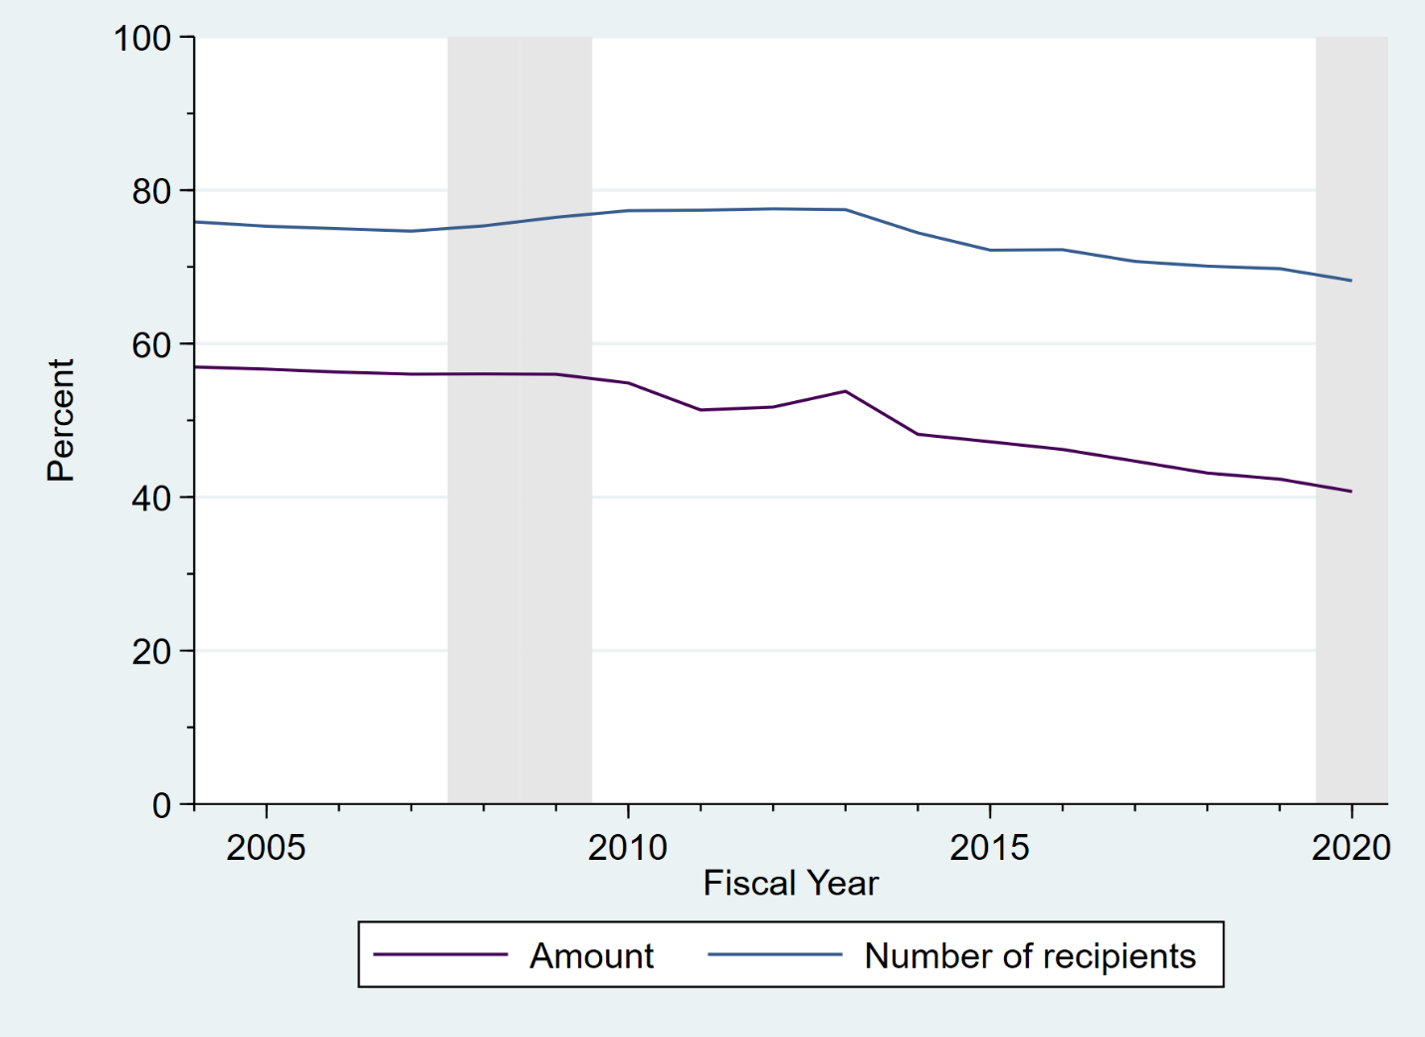
Need-based aid as share of state aid (number=top line, amount=bottom line)

Slide 14
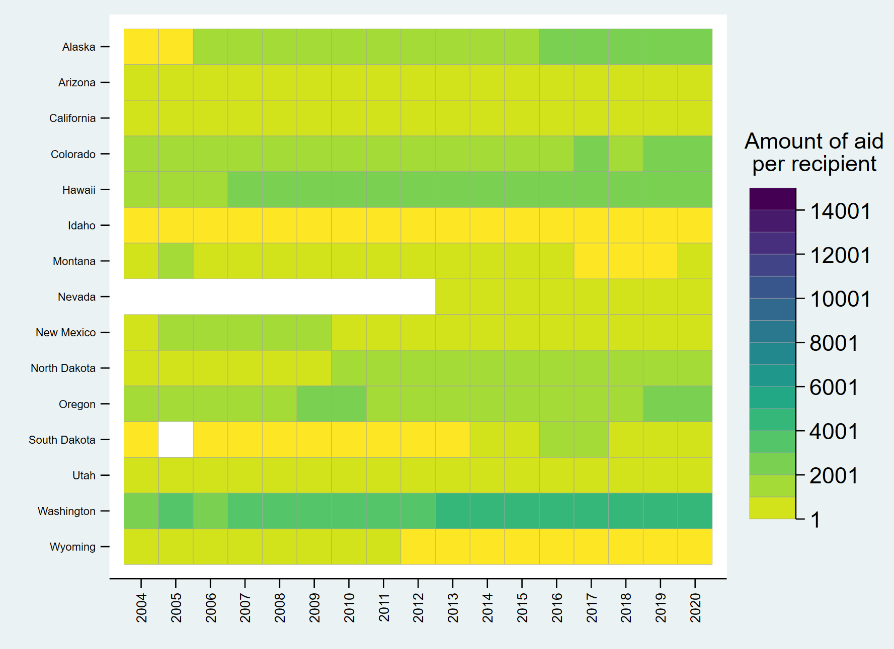
Need-based aid per recipient over time

Slide 15
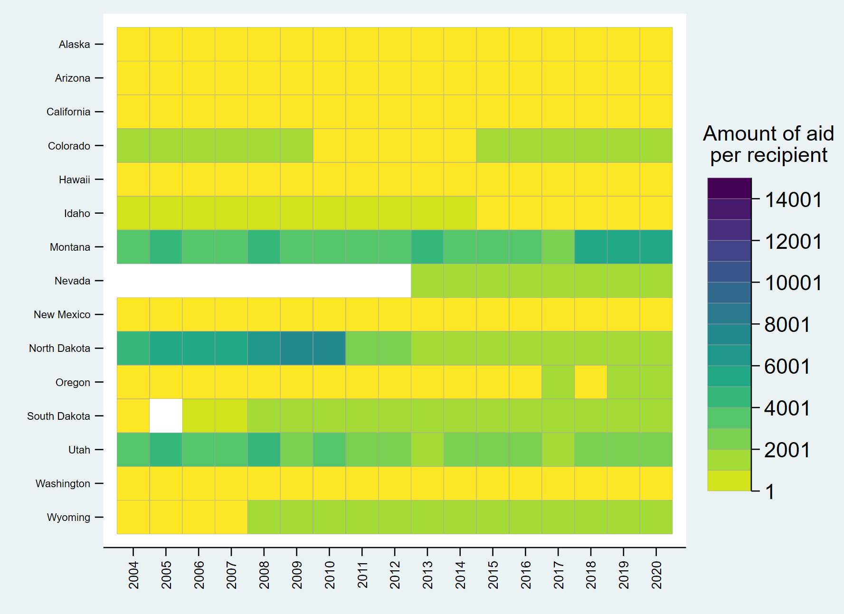
Merit-based aid per recipient over time

Slide 16
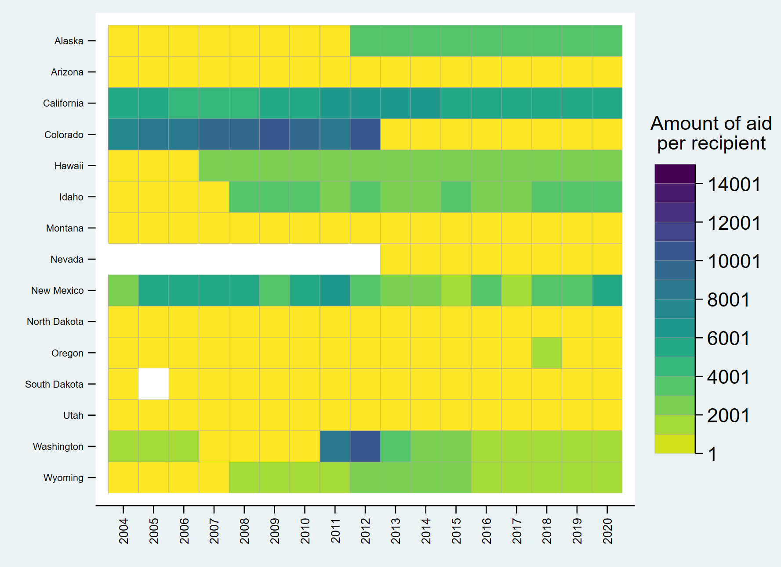
Combo aid per recipient over time

Slide 17
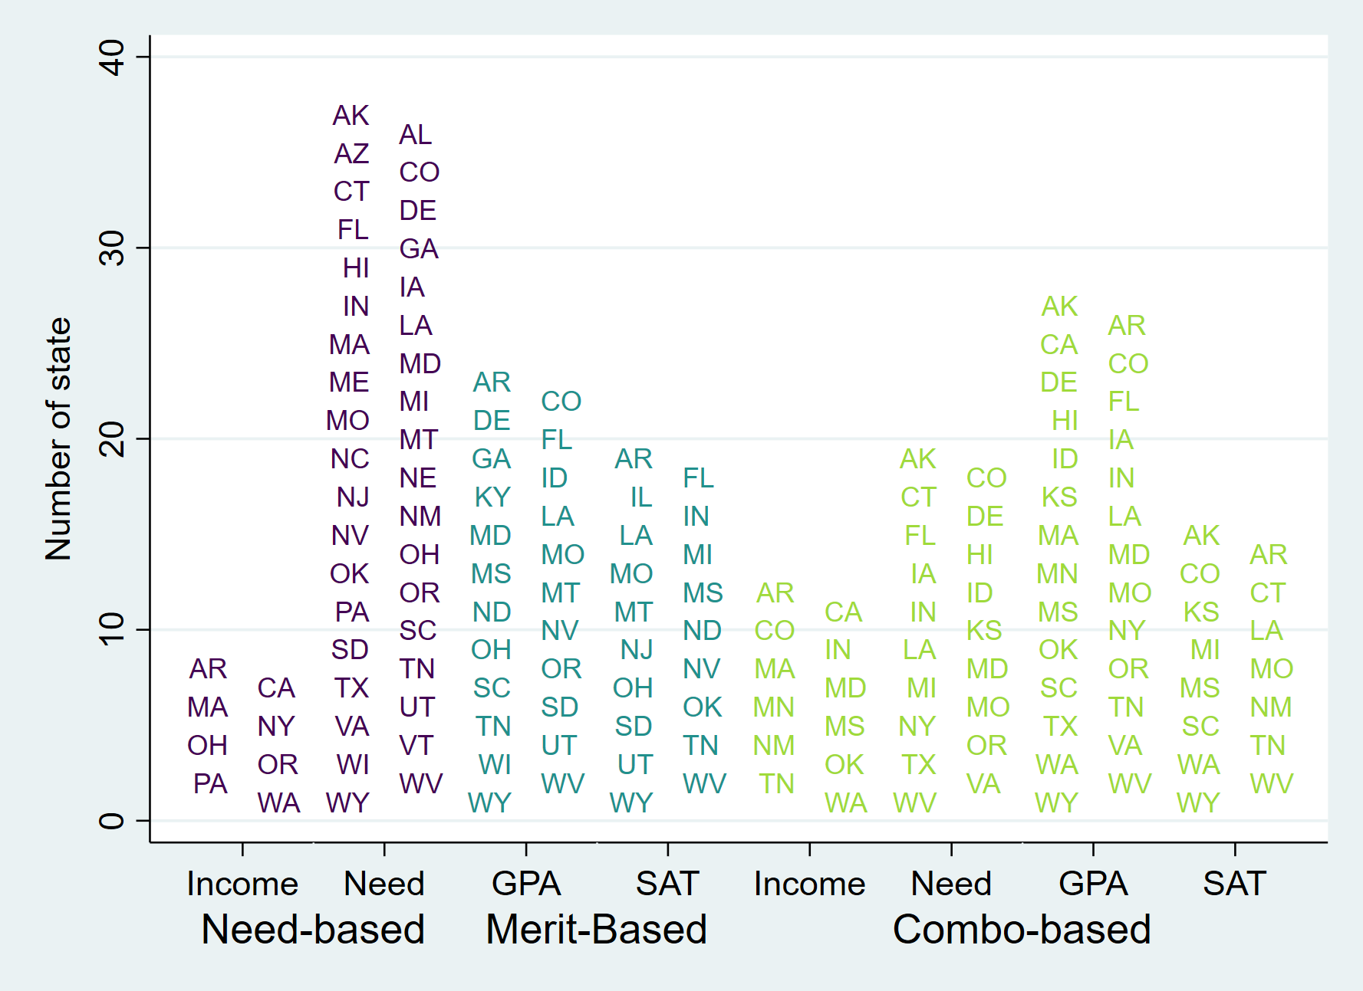
State aid eligibility criteria (most inclusive program)

Slide 18
Effects of aid programs on outcomes
Amount of aid per recipient did not affect number of completions or graduation rate as a whole
But requiring ACT/SAT or requiring demonstrated need for combo aid reduced enrollment and completions
On the other hand, combo aid increased degree completions and graduation rates
Much more work needs to be done in this area

Slide 19
Concluding remarks
Balancing act among model complexity, getting support from institutions, and getting support from policymakers
Think about what mechanisms can move the needle with colleges and students
Keep in mind other policies (tuition caps, who sets prices, differential tuition, etc.)
Finally, we’re here for you as a resource!

