Slide 1
Save on Tuition with WUE
Discover your options in the West!
Updated February 2025

Slide 2
CONSIDERING AN OUT-OF-STATE COLLEGE IN THE WEST?
Let WUE help you save money on tuition!

Slide 3
WHAT IS WUE?
America’s largest regional interstate tuition savings program.
The Western Undergraduate Exchange (WUE) is an agreement among WICHE’s 16 member states and territories, through which 170 participating public colleges and universities provide steep nonresident tuition savings for Western students.

Slide 4
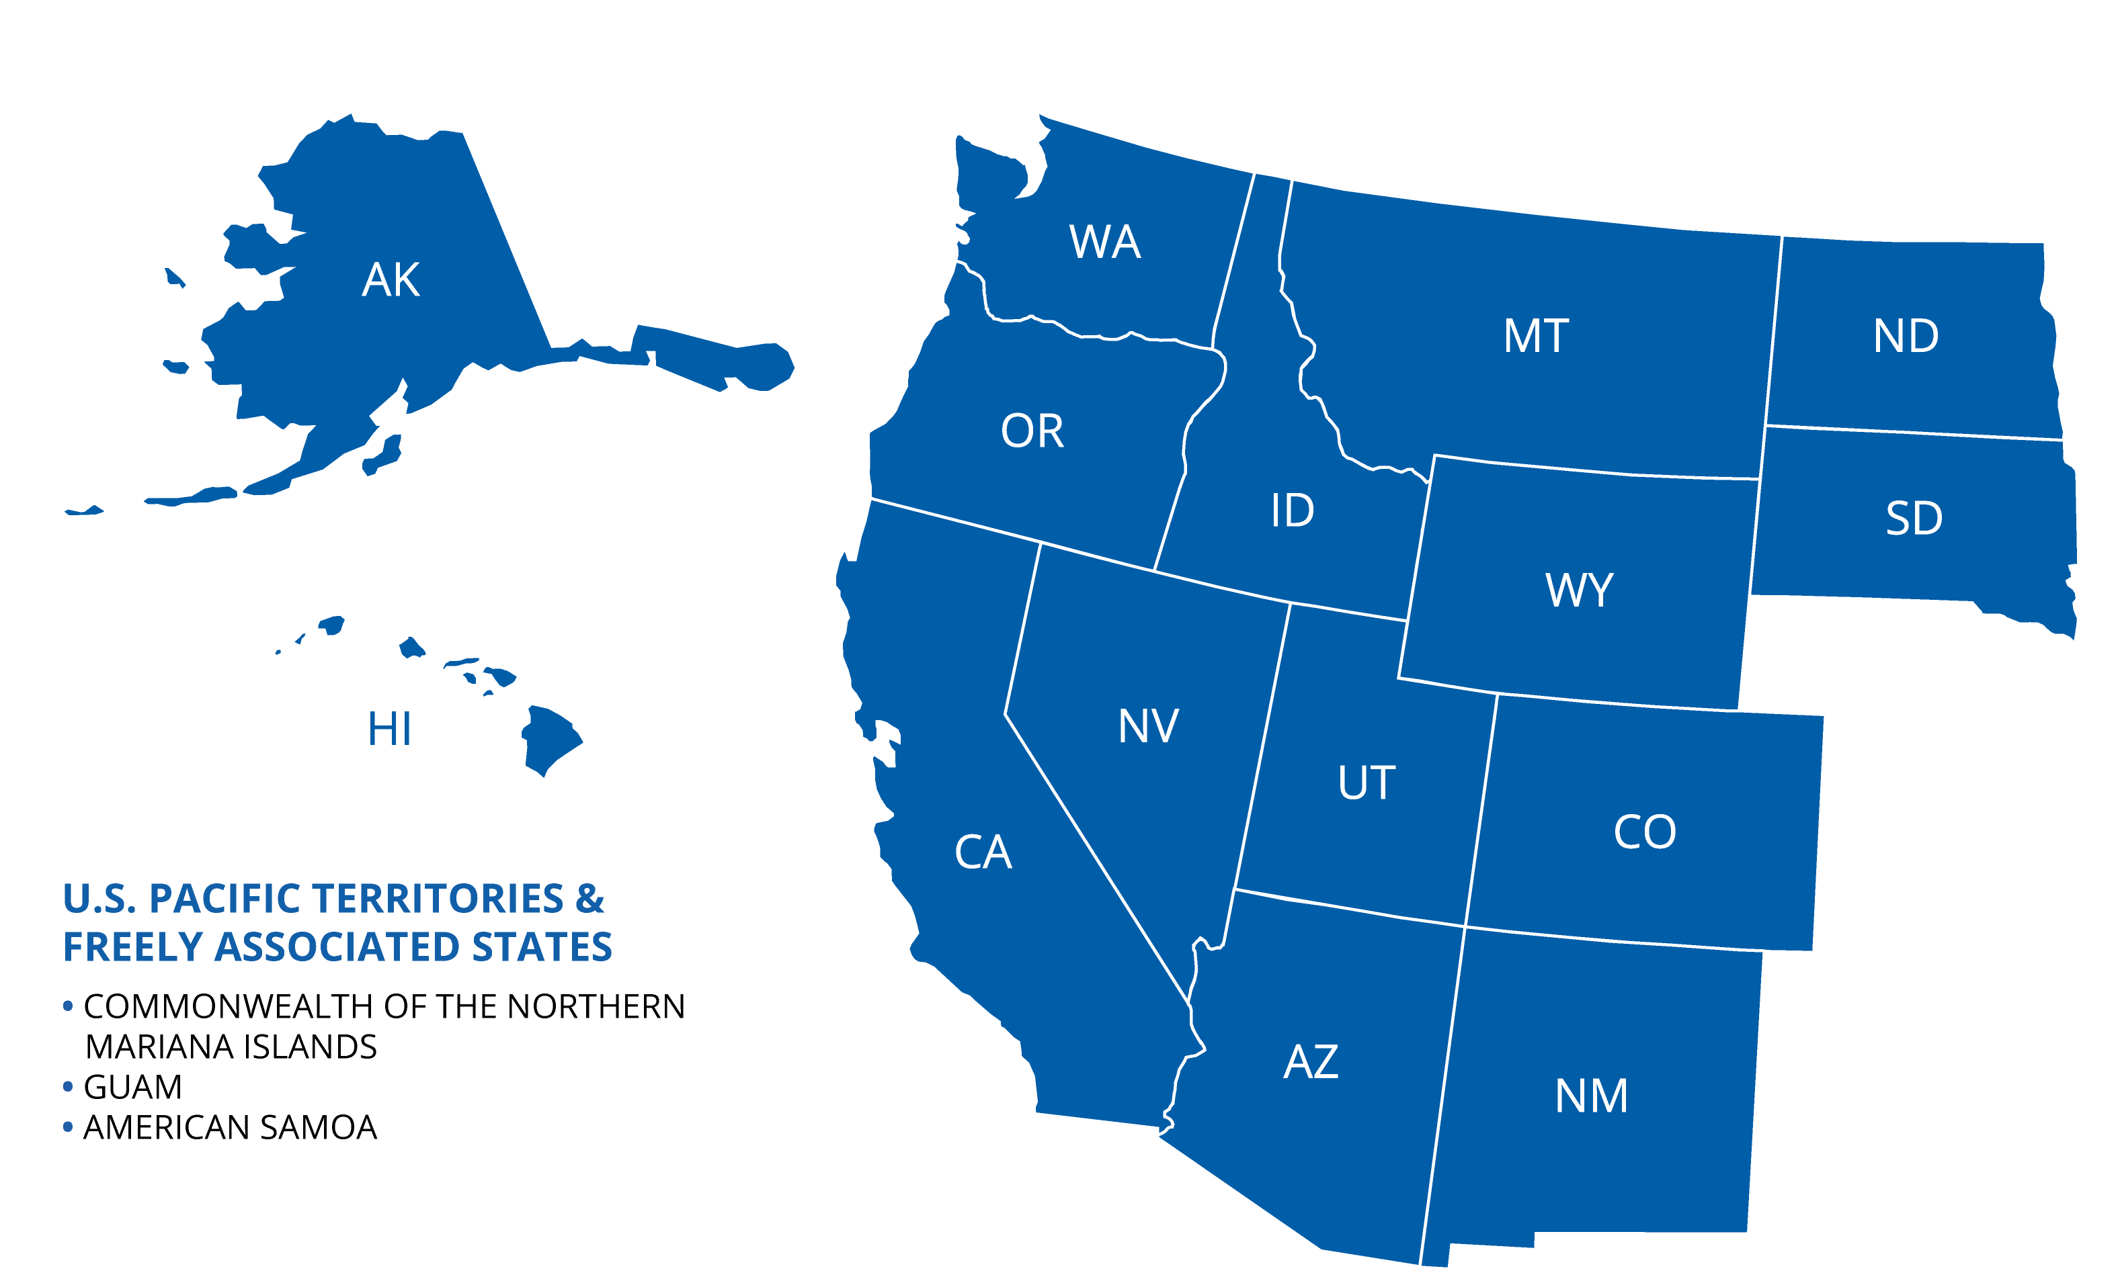
ELIGIBLE STATES AND TERRITORIES

Slide 5
HOW MUCH IS WUE TUITION?
WUE is 150% of the enrolling school’s resident tuition (sometimes less!)
Examples of 2024-25 WUE Tuition Rates
 | In-State Tuition | Non-Resident Tuition | WUE Tuition (resident * 1.5) | Savings
Oregon State University | $12,045 | $36,015 | $18,068 | $17,947
Salt Lake Community College (UT) | $3,928 | $13,746 | $5,892 | $7,854

Slide 6
HOW MUCH IS WUE TUITION?
But wait… there’s more!
Visit wiche.edu/resources/wue-savings-chart for a look at more WUE tuition rates across the West!
NOTE: Savings estimates based on standard programs. Special program tuition may be higher (i.e., engineering, nursing, etc.)

Slide 7
ACADEMIC YEAR 2024-25 FIGURES
49,177
WUE Students
$615.6M
In Out-of-State Tuition Savings
$12,517
Average Savings per Student

Slide 8
THE WUE ROADMAP
1. Be a resident of a WICHE state or eligible Pacific Island jurisdiction.
3. Check to see if the desired major is eligible.
5. Determine if a separate application is required.
1
3
5
2
4
6
2. Search for colleges on the WUE Savings Finder at wiche.edu/tuition-savings/wue.
4. Check application deadlines and/or minimum requirements. WUE is not guaranteed, you must qualify.
6. Apply directly to the college.

Slide 9
THINGS TO KNOW
Institutions set their own requirements to qualify for the WUE rate; requirements vary by college.
WUE is not automatically awarded to western region residents — you must qualify.
Remain in good academic standing to keep your WUE rate.
You can’t establish in-state residency while on WUE.

Slide 10
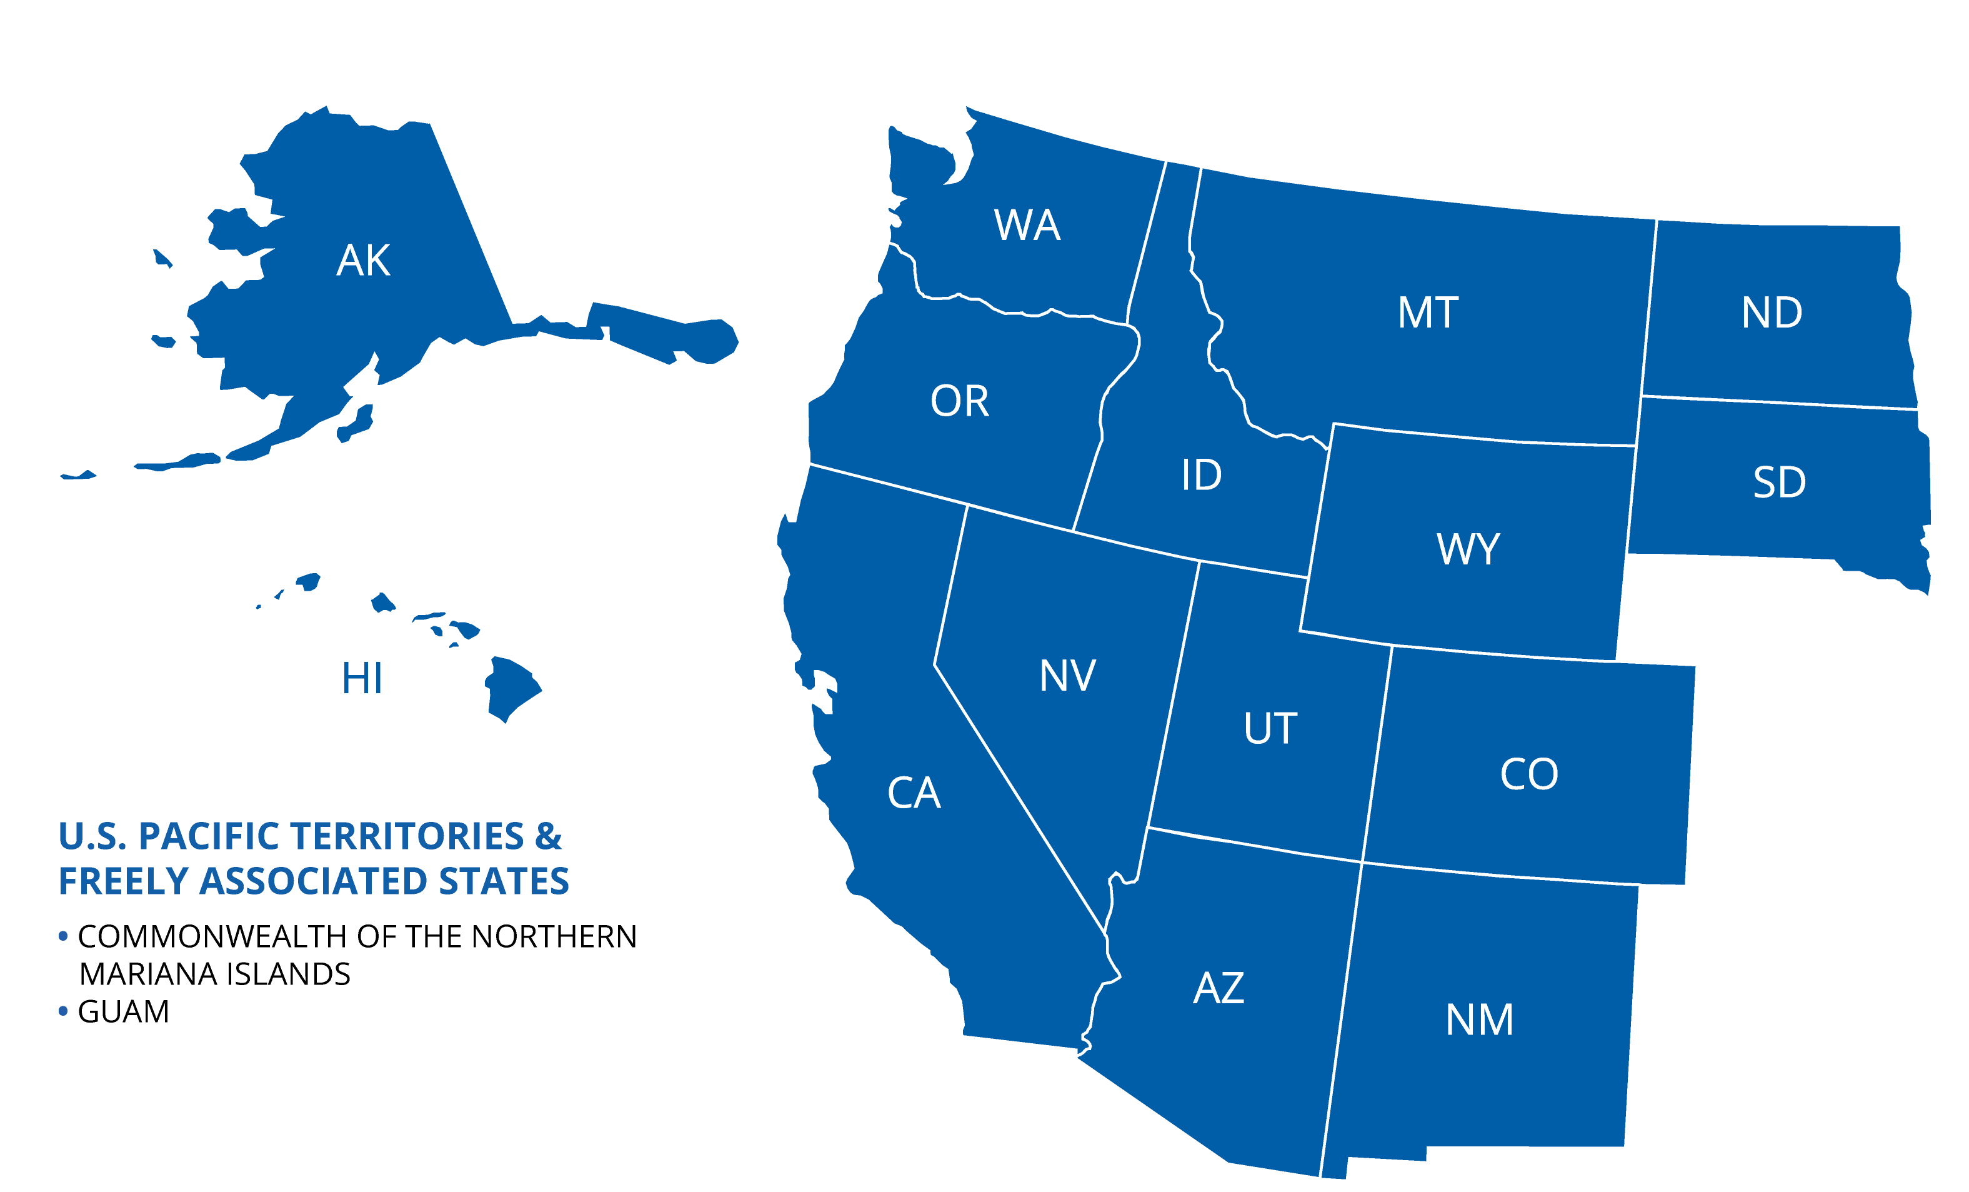
WHERE ARE THE WUE SCHOOLS?
Our 170 two- and four-year schools are located throughout the WICHE region.

Slide 11
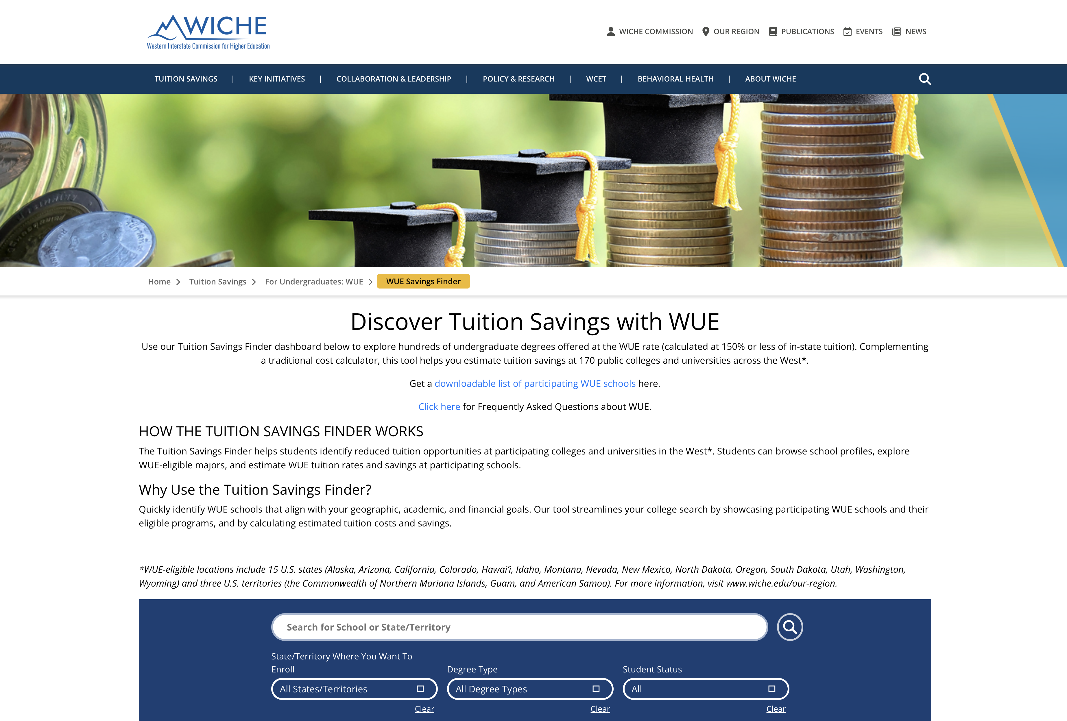
THE WUE SAVINGS FINDER
Use the WUE Savings Finder for the complete list of WUE schools and their eligible majors.
Visit wiche.edu/tuition-savings/wue/wue-savings-finder.

Slide 12

DOWNLOAD THE WUE HANDOUT
Get more information and see a complete list of participating colleges and universities.
Visit wiche.edu/resources/wue-handout.

Slide 13
PARTICIPATION DISCLOSURES
Schools that don’t participate in WUE:
Colorado School of Mines
University of Colorado Boulder
University of Oregon
University of Washington
Schools with limited degree options with WUE:
University of Arizona, Tucson offers only two majors at the WUE rate:
  Mining Engineering
  Natural Resources

Slide 14
QUESTIONS ABOUT WUE?
The schools are your best resource!
Visit wiche.edu/tuition-savings/wue/wue-savings-finder.
Check the school’s website for information.
Contact the school’s financial aid, scholarship, or admissions departments directly.
If you still have questions, contact WICHE at 303.541.0270 or info-sap@wiche.edu.

