Slide 1
Behavioral Health Workforce
Pamela Sagness, Behavioral Health Executive Director June 20, 2022

Slide 2
What is Behavioral Health?
A state of mental/emotional being and/or choices and actions that affect WELLNESS.
Preventing and treating depression and anxiety
Preventing and treating substance use disorder or other addictions
Supporting recovery
Creating healthy communities
Promoting overall well- being

Slide 3
BEHAVIORAL HEALTH IS HEALTH

Slide 4
Why is Behavioral Health Important?
Persons with behavioral health disorders die, on average, about 5 years earlier than persons without these disorders.
Persons with serious mental illness (SMI) are now dying 25 years earlier than the general population
(Druss BG, et al. Understanding Excess Mortalityin PersonsWith Mental Illness: 17-Year FollowUp ofa Nationally
Representative USSurvey.Medical Care 2011; 49(6), 599–604.)
4

Slide 5
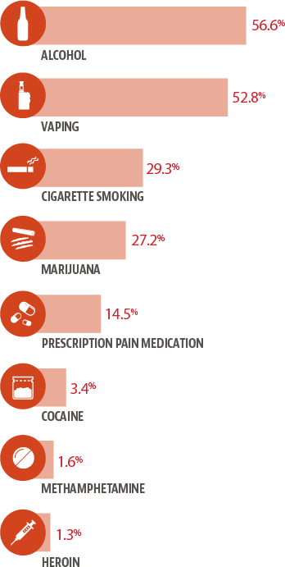
ND Youth Lifetime Substance Use
(High School Students)
5

Slide 6
Prevention Works!
Current Alcohol Use (past 30 days) among ND High School Students
Youth Risk Behavior Survey
60.5%
59.2%
54.2%
49.0%
46.1%
43.3%
38.8%
35.3%
30.8%
29.1%
27.6%
1999
2001
2003
2005
2007
2009
2011
2013
2015
2017
2019
6

Slide 7
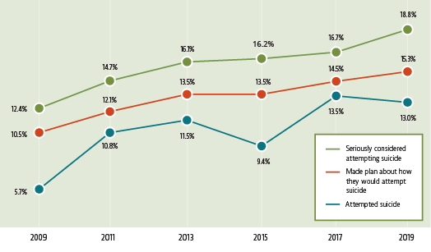
Youth Suicide
(High School Students; past 12 months)
7

Slide 8
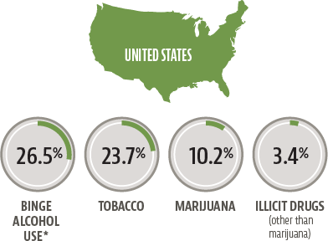
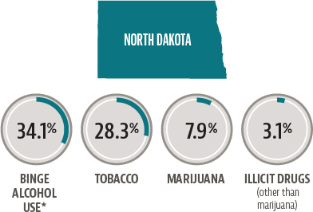
Adult Substance Use
(Age 18+; past 30 days)
8

Slide 9
BEHAVIORAL HEALTH DATA BOOKLET
All data resources are available at www.behavioralhealth.nd.gov/data.

Slide 10
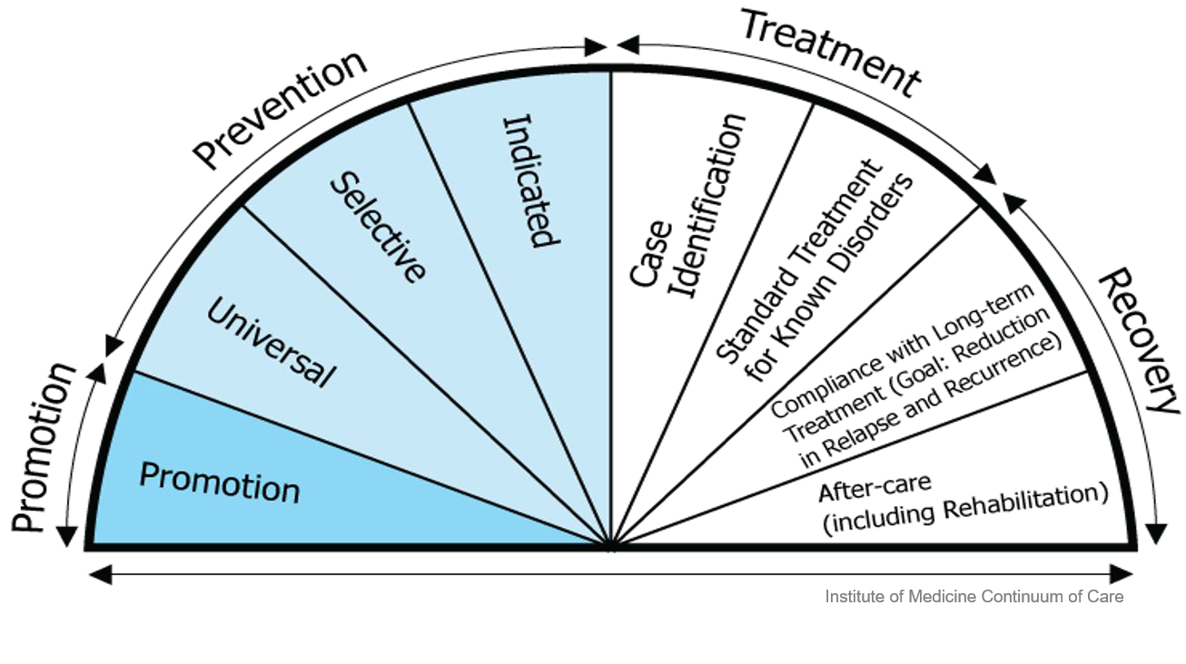
Keys to Reforming North Dakota’s Behavioral Health System
Support the full Continuum of Care
Increase Community-Based Services
Prevent Criminal Justice Involvement for Individuals with a Behavioral Health Condition
10

Slide 11
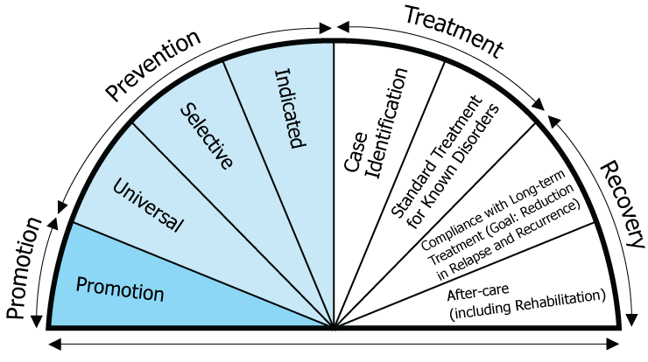
Continuum of Care
The vision for the North Dakota Behavioral Health System is grounded on the Institute of Medicine’s Continuum of Care model.
Institute of Medicine Continuum of Care
The goal of this model is to ensure there is access to a full range of high quality services to meet the various needs of North Dakotans.
11

Slide 12
Considerations
In each area of the Continuum of Care, the following are considerations:
Funding/ Reimbursement | Infrastructure (Agency, workforce, oversight, etc.) | Best Practices
12

Slide 13
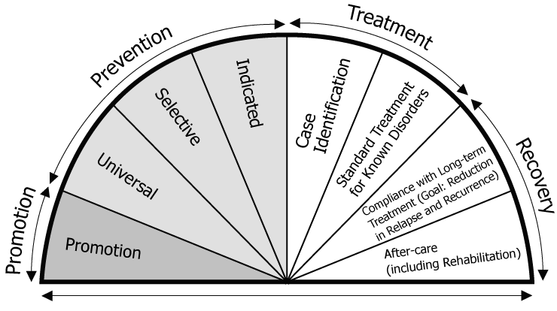
System Approach
 | Prevention/ Promotion | Early Intervention | Treatment | Recovery
Funding
Workforce
Best Practice
READINESS & SOCIAL DETERMINANTS OF HEALTH

Slide 14
ROADMAP
The Behavioral Health Systems Study, April 2018
14

Slide 15
1. Develop a comprehensive implementation plan
Invest in prevention and early intervention
Ensure all North Dakotans have timely access to behavioral health services
Expand outpatient and community-based service array
Enhance and streamline system of care for children and youth
Continue to implement/refine criminal justice strategy
Engage in targeted efforts to recruit/retain competent behavioral health workforce
Expand the use of tele-behavioral health
Ensure the system reflects its values of person-centeredness, cultural competence, trauma-informed approaches
North Dakota Behavioral Health System Study RECOMMENDATIONS
The 250-page report provides more than
65 recommendations in
13 categories.
Encourage and support the efforts of communities to promote high-quality services
Partner with tribal nations to increase health equity
Diversify and enhance funding for behavioral health
Conduct ongoing, system-side data-driven monitoring of needs and access
15

Slide 16
Behavioral Health Workforce
2018
Human Service Research Institute Study(HSRI) concluded; this includes recommendations around behavioral health workforce
2019
Survey public, develop, include top five highest priorities in the strategic plan
2019
North Dakota’s Behavioral Health Plan was developed with 13 AIMS
AIM 7-Engage in Targeted Efforts to recruit and retain a qualified, competent behavioral health workforce
2019-2021
AIM 7---3 Work Goals & 6 Objectives & 11 Action Steps-36% completed and/or in progress

Slide 17
Behavioral Health Workforce Summit
2022
DHS is working in collaboration with University of North Dakota and Western Interstate Commission for Higher Education(WICHE) to:
Gather, compile, and complete a “Discovery Report” on all behavioral health workforce initiatives that have been completed, are in progress, or pending. These stakeholders include, but are not limited to, government entities, Universities, all behavioral health licensing boards, and private and public stakeholders.
Coordinate and facilitate a Behavioral Health Workforce Summit, utilizing the Discovery Report, HSRI Study, and the HSRI ND Behavioral Health Plan to guide the Summit. The purpose of the Summit is to present the Discovery Report findings, make recommendations, provide training on workforce best practices, facilitate discussion with stakeholders on the development of the Behavioral Health Workforce Strategic Plan and develop specific workgroups to facilitate workforce strategic plan.
Work with HSRI to develop goals, objectives and action steps to incorporate a detailed behavioral health workforce plan into the current ND behavioral health plan.

Slide 18
Moving Forward
Follow up and support for workforce collaborative to support work groups attending to specific goals, objectives and action steps
Workforce to support

Slide 19
KEY INITIATIVES
Behavioral Health
19

Slide 20
1915i State Plan Amendment
The amendment allows North Dakota Medicaid to pay for additional home and community-based services to support individuals with behavioral health conditions.
Individual Eligibility | Services
The individual is age 0+; and The individual is currently enrolled in ND Medicaid or Medicaid Expansion; and The individual resides in and will receive services in a setting meeting the federal home and community-based setting requirements, and The individual has a mental illness, substance use disorder or traumatic brain injury diagnosis The individual has a functional impairment, which substantially interferes with or substantially limits the ability to function in the family, school or community setting, as evidenced by a complex score of 50 or higher on the WHODAS 2.0. | Care Coordination Training and Supports for Unpaid Caregivers Community Transitional Services Benefits Planning Non-Medical Transportation Respite Prevocational Training Supported Education Supported Employment Housing Support Services Family Peer Support Peer Support
20

Slide 21
Outcomes of 1915i Implementation
Individuals with highest need receive services that are more robust and targeted to their specific needs (person-centered).
By leveraging other funds, the state is investing less funding yet providing more service to individuals with a behavioral health condition and providing opportunities for providers to expand services.
Providers are able to bill for the specific services they are providing which allows greater opportunity to expand services and increase revenue.
Behavioral health on par with health & sustainable.
21

Slide 22
Peer Support Certification
The ND 66th Legislative Assembly passed Senate Bill 2012 giving the Behavioral Health Division authority to develop and implement a program for the certification of peer support specialists.
Administrative Rules 75-03-43 were promulgated and outlines the requirements and process for two levels of Peer Support Specialist certification:
Certified Peer Support Specialist I (CPSS I)
115 CPSS I (as of June 6, 2022)
Certified Peer Support Specialist II (CPSS II)
21 CPSS II (as of June 6, 2022)
Since 2018 the Behavioral Health Division hosted 27 trainings and trained 716 individuals.
22

Slide 23
Since February 2017 has served 4,274 individuals Currently serving 1233 individuals across North Dakota
Individual Eligibility
18 years of age or older
Involved in criminal justice system
At risk for future criminal justice involvement
Identified behavioral health condition
Since February 2021 has served 2,475 individuals Currently serving 1.494 individuals across North Dakota
Individual Eligibility
18 years of age or older
Have a MH or SUD impacting functionality in domains including
housing, employment, parenting, physical health, and community connections
Priority for parents/caregivers or at risk of homelessness ,CPS involvement, utilization of ER/Detox

Slide 24
HB 1012
Department of Human Services Budget

Slide 25
Section 27. Behavioral Health Bed Management
A new section to chapter 50-06 of the North Dakota Century Code is created and enacted as follows:
Behavioral health bed management system.
The department shall establish and maintain a behavioral health bed management system to improve utilization of behavioral health bed capacity. Public and private providers of residential or inpatient behavioral health services shall participate in and report daily to the department the information and documentation necessary to maintain the behavioral health bed management system in the form and manner prescribed by the department.

Slide 26
SB 2161: Creation of Mental Health Program Registry
A new section to chapter 50-06 of the North Dakota Century Code is created and enacted as follows:
Mental health program registry.
The department shall establish and maintain a registry of mental health programs in the state. A mental health program shall provide the information and documentation necessary to the department at least annually in the form and manner prescribed by the department. The department shall make the registry available to the public on the department's website.

Slide 27
www.behavioralhealth.nd.gov
Thank you
Empower People | Improve Lives | Inspire Success

