Slide 1
Equity through OER: Applying the Rubric
Brittany Dudek, Manager, OER and Libraries, Colorado Community College System
Annika Many, DOERS3 Consultant and Principal, edBridge Partners, LLC
OERWest Network Convening | April 20, 2022

Slide 2
Equity through OER: Applying the Rubric
Agenda:
About DOERS3
Equity Through OER Rubric Overview
Small Group Discussions
Whole Group Discussion
Driving OER Sustainability for Student Success
Notes:
Annika

Slide 3
DOERS3 Statement of Purpose
The Driving OER Sustainability for Student Success (DOERS3) Collaborative is a group of 28 public higher education systems and statewide/provincewide organizations that are committed to supporting student success by promoting free, customizable open educational resources (OER). Launched in 2018, DOERS3 helps member organizations implement, scale, and sustain OER by advancing research and policy, sharing tools and learnings, and showing how OER can foster equity and student success.

Slide 4
What we do
Research
Foster research and data infrastructure to support member OER initiatives
Equity
Promote equity in member organizations and make explicit the role of OER in closing equity gaps and advancing student success
Capacity Building
Build the capacities needed by both internal and external stakeholders to scale and sustain OER
Notes:
Annika
Research Priorities
How does OER improve student success? ​We are framing a research question, providing guidance to ensure data collected at multiple institutions is comparable, and developing a data archive to assist OER researchers.
Equity ​Blueprint
What role can OER play in advancing equity? ​We are developing a guidance document that will define, unpack, and explain the multiple dimensions of equity, foreground the role of OER in closing equity gaps, and provide a blueprint for action. See OER Equity Blueprint​
Tenure and Promotion
How can OER contributions be a part of a successful academic career path? We have developed a framework, the OER Contributions Matrix, that can help institutions and disciplines consider how to reward OER work. This is critical to sustaining OER. See OER Contributions Matrix.
Listing and Fulfillment in Campus Stores
How can we better help students find OER assigned for their courses? We have developed a best practices guide for institutions, faculty, campus stores, and bookstore software providers to improve OER listing and print fulfillment. See Improving the Listing and Fulfillment of OER in U.S. Campus Stores

Slide 5
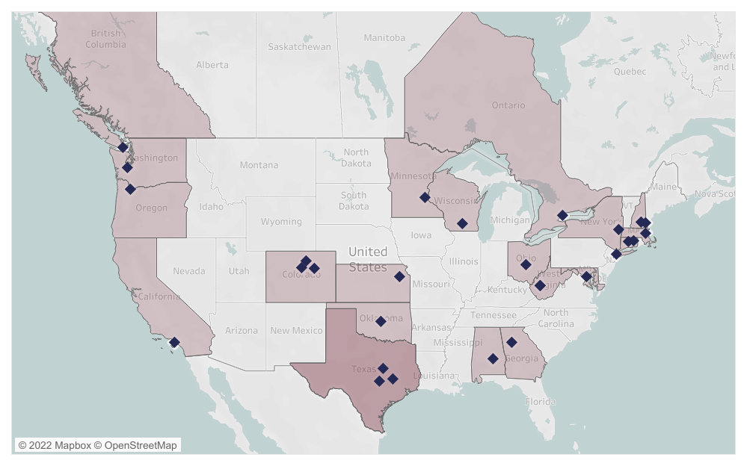
Membership
28 systems/initiatives, 735 colleges/universities, over 6.6 million students
Notes:
Annika

Slide 6
How to join
Eligibility
DOERS3 membership is open to all public higher education systems engaging in large-scale OER work and committing to advancing innovation in OER. Additionally, membership is available to state-wide and province-wide OER initiatives.
Commitment
To be accepted within the DOERS3 collaborative, organizations must be willing to commit to the guiding principles of DOERS3 stated within the Statement of Purpose. In addition, the designated organizational DOERS3 representative must commit to actively engage in DOERS3 efforts through participation in a work group and regular attendance at Network events, convenings, and webinars.
Contact: info@doers3.org
Notes:
Annika

Slide 7
OER Equity Blueprint
Define, unpack, and explain multiple dimensions of equity and foreground role of OER in closing equity gaps.
Key Components
Theoretical and Research Foundation
Equity Through OER Rubric
Case Studies
Notes:
Brittany
Post link to OER Rubric for remote participants: https://www.doers3.org/equity-through-oer-rubric.html

Slide 8
Blueprint Equity Definition
EQUITY
Life chances and choices are limited by many kinds of inequality, including social, income, racial, ethnic, gender, and ability. Equity is a corrective process that demands fairness for marginalized and minoritized populations by reducing gaps in opportunity and achievement through systematic efforts.
Notes:
Brittany

Slide 9
Blueprint Core Values
CORE VALUES
Learner-centered OER promotes equity, inclusion, and accessibility.
Redressing inequities requires taking responsibility and action that is personal and professional, individual and institutional.
Equity and quality should be understood as interdependent components of one another and efforts to make access, participation, and completion equitable without assurance of quality is a hollow promise.
In higher education, achieving equity results in increased student success in terms of access, participation, persistence, completion, and entry into the workforce.
Equity is measurable.
Notes:
Brittany

Slide 10
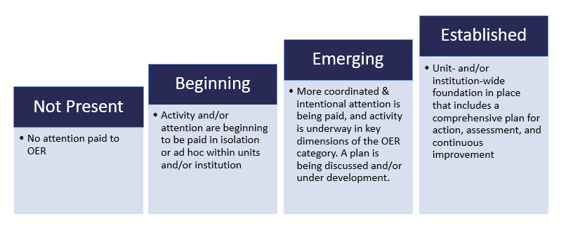
Scale of Adoption: Multiple Stages
Notes:
Brittany

Slide 11
Small Group Discussions 1) Do you assess, track or measure these dimensions now? 2) If you do, how? If not, how would you go about it? 3) What is missing from the Rubric –this category or others?
Please identify one person to report out.
*While leadership should be understood broadly and responsibility is required across all dimensions of the rubric, this section is focused on decision-makers and their responsibility and accountability
Notes:
Brittany
Divide into groups by table + remote participants
Ask them to identify one person who will report out a take-away or two from discussion.

Slide 12
One more Question:
Do you anticipate or see your institution or organization using/engaging with the rubric?
Very Likely Likely Not Sure Unlikely Definitely Unlikely
Notes:
Brittany

Slide 13
What’s Next?
A cohort-based project to pilot the Equity Through OER Rubric with higher education partners across the United States.
Participants will develop comprehensive plans to get to “Established” and contribute case studies.
We hope to announce funding in the coming months, followed by a call for participants.
Notes:
Annika
Concluding remarks, time permitting:
Quality and equity are intertwined: doing OER with an equity lens is doing OER well—with high levels of quality, integrity and fidelity to student needs and institutional effectiveness.
Equity is embedded in quality OER programs, just as quality is embedded in equity-minded OER programs, reinforcing the extent to which quality and equity are constituent components of one another.
The comprehensiveness is the point and the difference-maker. . .

Slide 14
Download Rubric: doers3.org

Slide 15
THANK YOU!
Annika Many
DOERS3 Consultant and Principal
edBridge Partners, LLC
amany@edbridgepartners.com
Brittany Dudek Manager, OER and Libraries
Colorado Community College System
brittany.dudek@cccs.edu
info@doers3.org

