Slide 1
Instructions for use:
If you are from Hawaii, delete slide 4 (UH Manoa tuition example) and use slide 5 (UNLV tuition example)
If you are from Nevada, delete slide 5 (UNLV tuition example) and use slide 4 (UH Manoa tuition example)
All other states – delete either slide 4 or 5
Slides 12-28 – pick your state’s slide, delete all others
Delete this slide before presenting!

Slide 2


Considering an out-of-state school?
Let WUE help you save money on tuition!

Slide 3
What is WUE?
WUE (pronounced (“woo-wee”) offers reduced nonresident tuition to residents in the West studying out-of-state at 160 public institutions in the region
Eligible states and territories include:
Alaska
Arizona
California
Colorado
Hawai'i
Idaho
Montana
Nevada
New Mexico
North Dakota
Oregon
South Dakota
U.S. Pacific Territories and
Freely Associated States
(currently CNMI and Guam)
Utah
Washington
Wyoming

Slide 4
How much is WUE tuition?
Resident = $10,872
Nonresident = $32,904
WUE = $16,308
(resident x 1.5)
Tuition Savings = $16,596!!
($32,904 - $16,308)
WUE is 150%
of the enrolling INSTITUTION’S resident tuition
(sometimes less!)
For Example*:
*Estimates from University of Hawai'i, Manoa 2017 Tuition

Slide 5
How do I qualify for WUE?
Be a resident of a WICHE state
Meet the institution’s WUE requirements
Apply to a participating institution

Slide 6
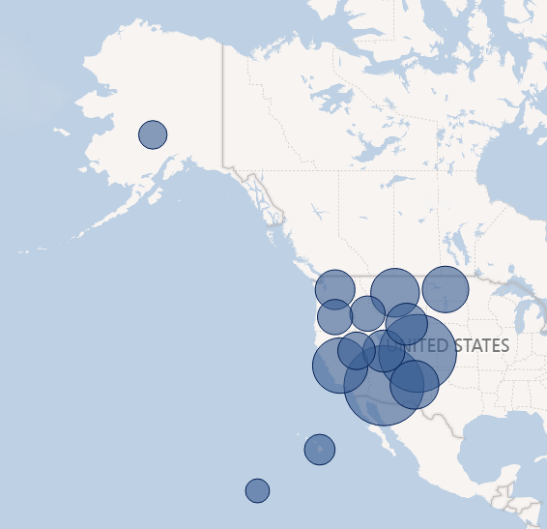
Where are the WUE institutions?
Our 160 two- and four-year schools are located throughout the WICHE region.
All WICHE members except Guam have one or more participating institutions.

Slide 7
Applying for WUE
There is not a general WUE application:
Apply directly to the institution.
Many of WICHE’s partner institutions use WUE as a merit scholarship. When you apply, look for:
  Early deadlines or first-come, first-served programs
  Is a separate application required?
  Minimum GPA and SAT/ACT scores
  Restrictions on eligible majors
  (i.e.: University of Arizona only offers WUE for mining engineering)

Slide 8
Applying for WUE (cont)
Can’t find application details? Contact the school directly
  Offices that handle WUE (this varies by school):
  Admissions, financial aid, or scholarship office

Slide 9
Things to remember:
WUE awards are time-limited, or may max out after a certain number of credits are earned
Students must remain in good academic standing
  Check with the school for specific GPA/minimum credit hours requirements
Students can’t use time paying the WUE rate to gain in-state residency

Slide 10
2017-18 Savings Facts
Estimated savings of
$365.4 million
40,000+
WUE awards
Average student savings of $9,000!

Slide 11
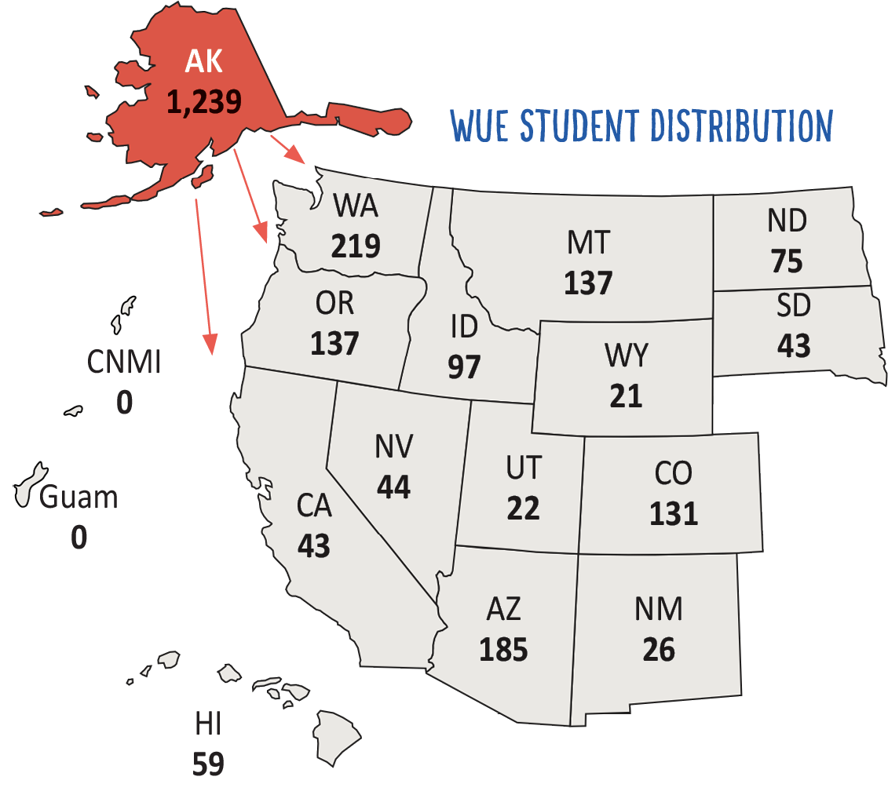
Alaska by the Numbers
1,239 Alaska undergrads paid 150% or less of resident tuition to save $11.6 million
AY 2017-18 Enrollment Data

Slide 12
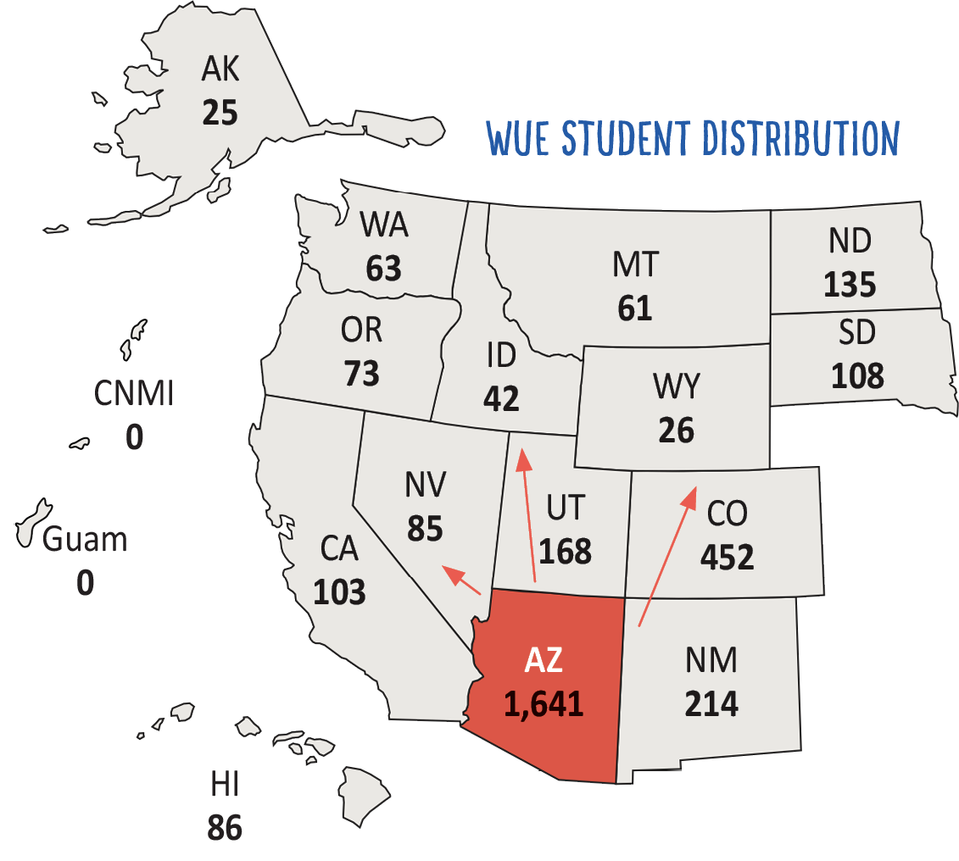
Arizona by the Numbers
1,641 Arizona undergrads paid 150% or less of resident tuition to save $13.2 million
AY 2017-18 Enrollment Data

Slide 13
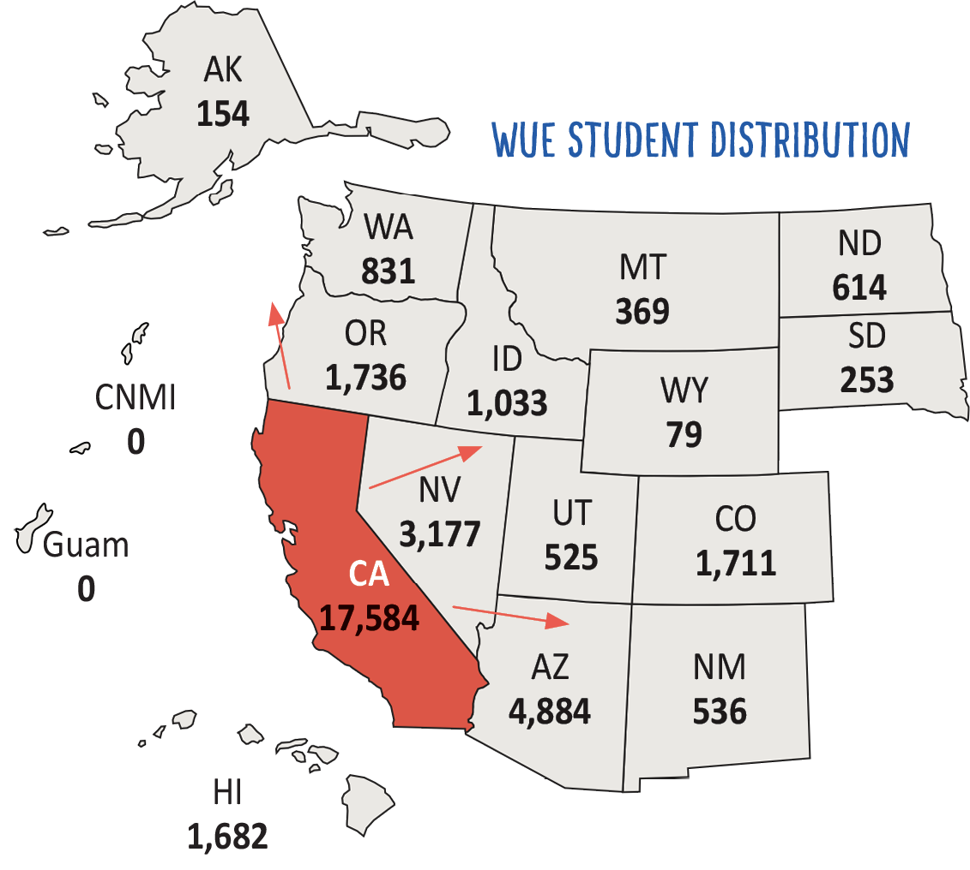
California by the Numbers
17,584 California undergrads paid 150% or less of resident tuition to save $175.3 million
AY 2017-18 Enrollment Data

Slide 14
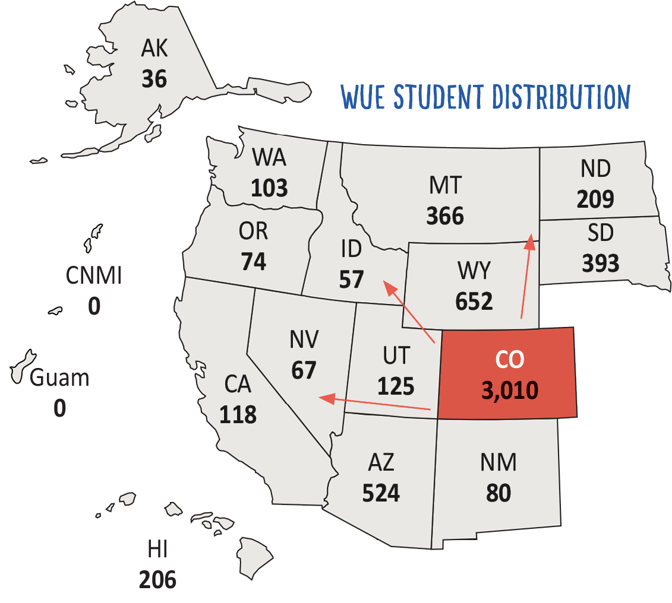
Colorado by the Numbers
3,010 Colorado undergrads paid 150% or less of resident tuition to save $24.2 million
AY 2017-18 Enrollment Data

Slide 15
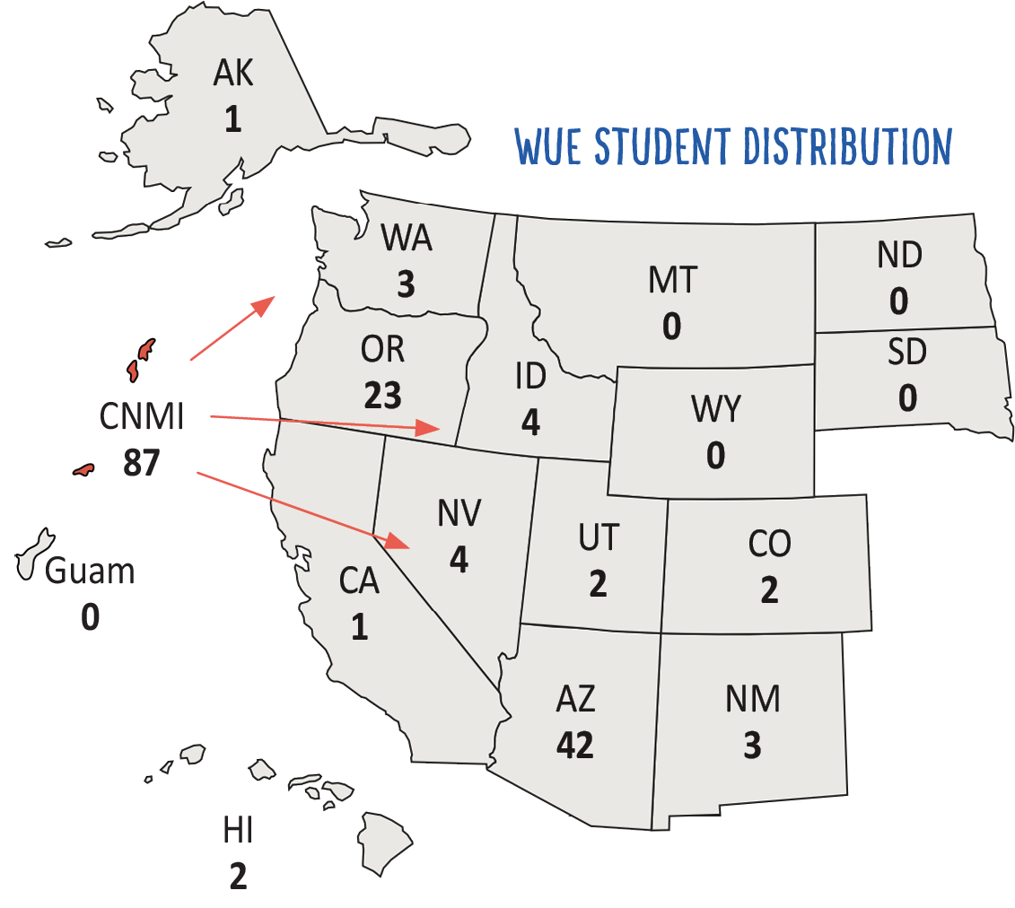
CNMI by the Numbers
87 CNMI undergrads paid 150% or less
of resident tuition to save more than $680,000
AY 2017-18 Enrollment Data

Slide 16
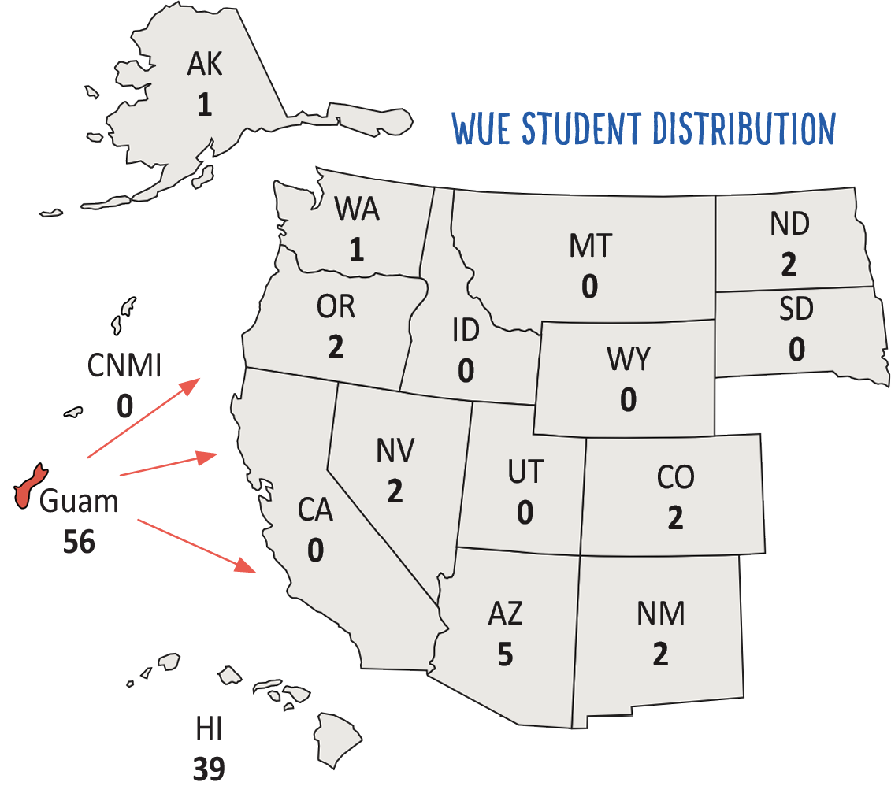
Guam by the Numbers
56 Guam undergrads paid 150% or less of resident tuition to save almost $781,000*
AY 2017-18 Enrollment Data
*2016 was Guam’s first year of WUE eligibility

Slide 17
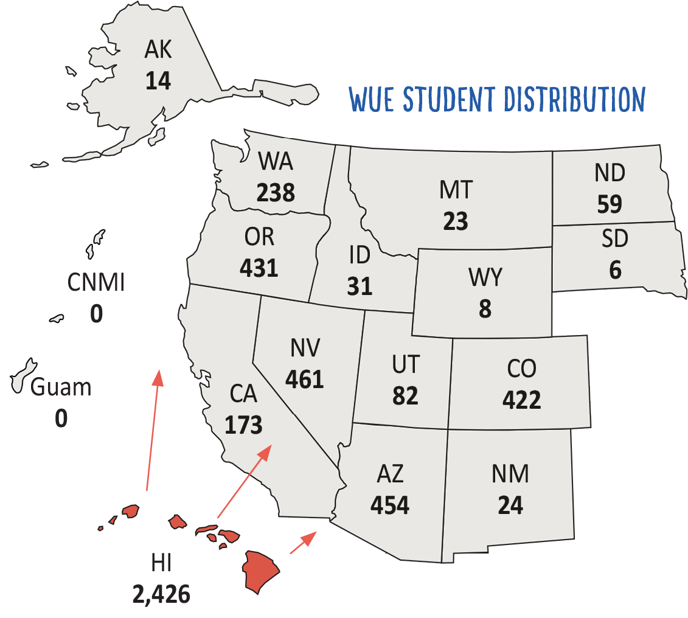
Hawaiʻi by the Numbers
2,426 Hawaiʻi undergrads paid 150% or less of resident tuition to save $22.1 million
AY 2017-18 Enrollment Data

Slide 18
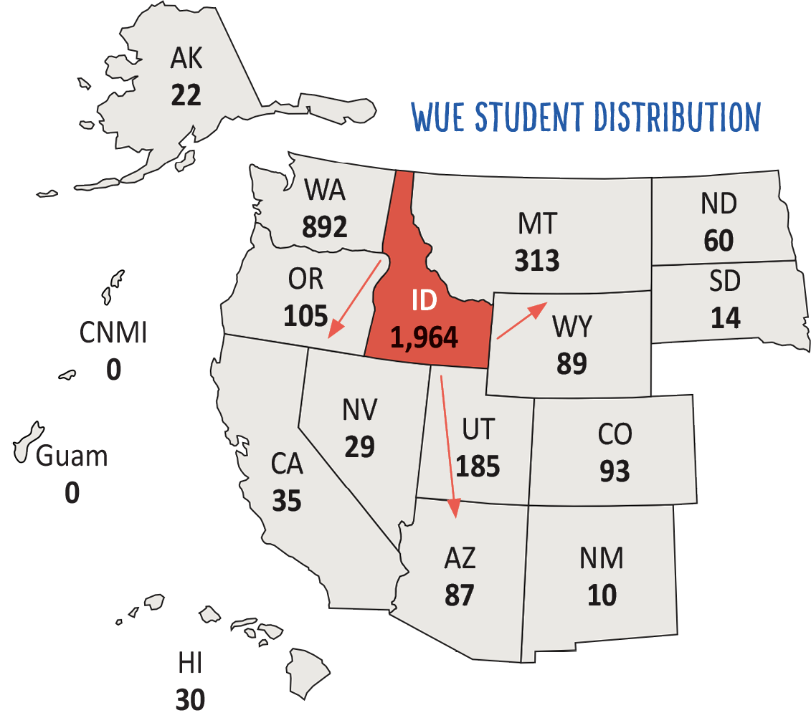
Idaho by the Numbers
1,964 Idaho undergrads paid 150% or less of resident tuition to save $16 million
AY 2017-18 Enrollment Data

Slide 19
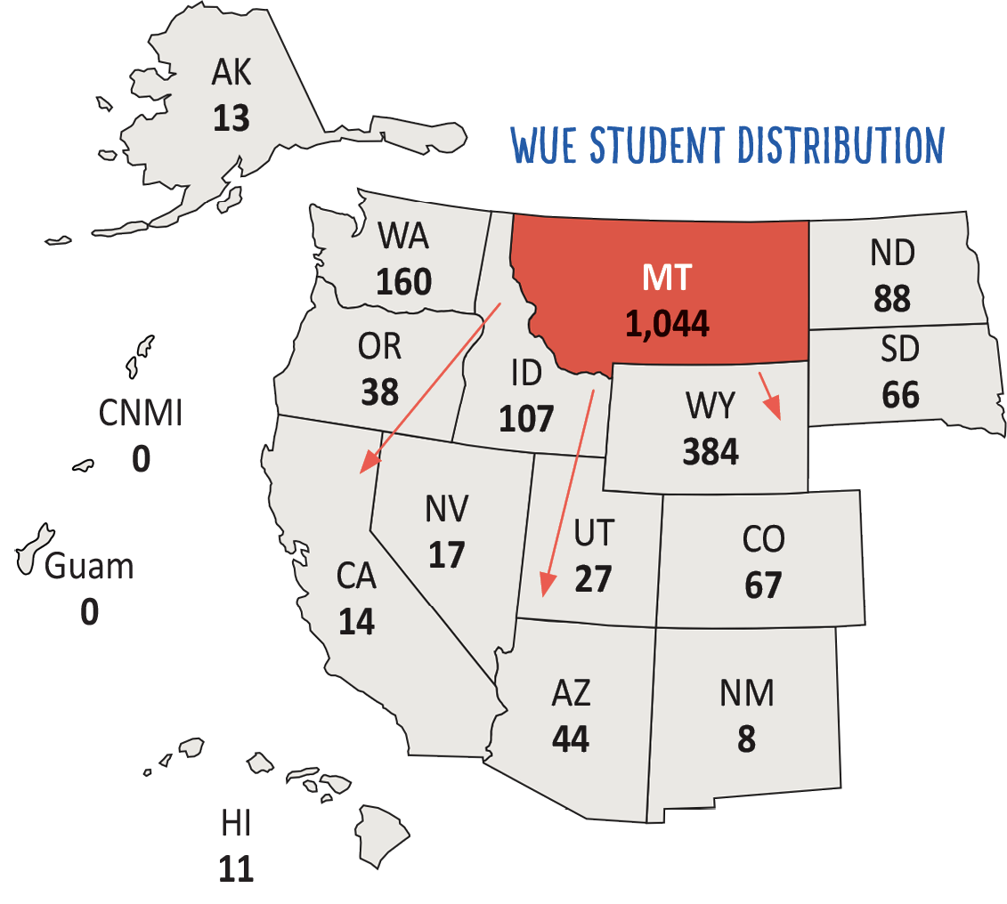
Montana by the Numbers
1,044 Montana undergrads paid 150% or less of resident tuition to save $6.1 million
AY 2017-18 Enrollment Data

Slide 20
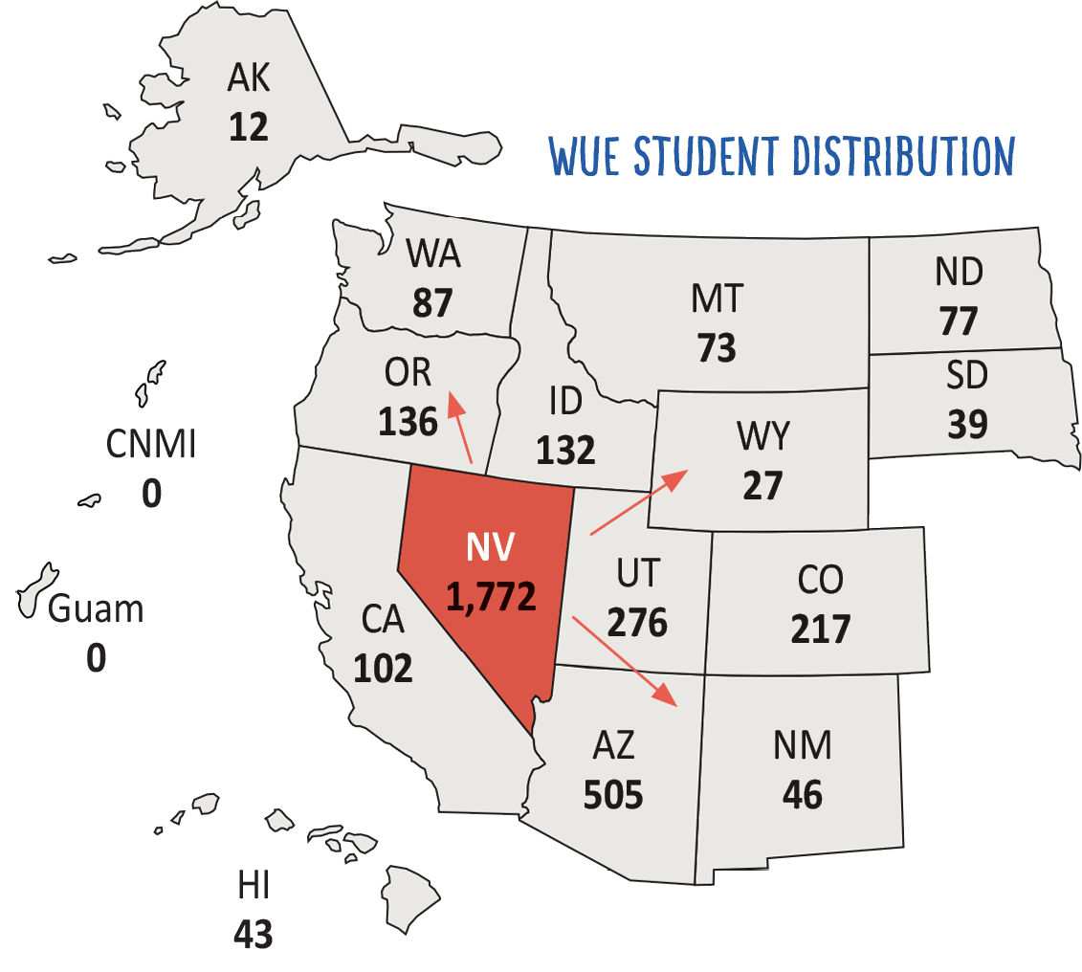
Nevada by the Numbers
1,772 Nevada undergrads paid 150% or less of resident tuition to save $14.7 million
AY 2017-18 Enrollment Data

Slide 21
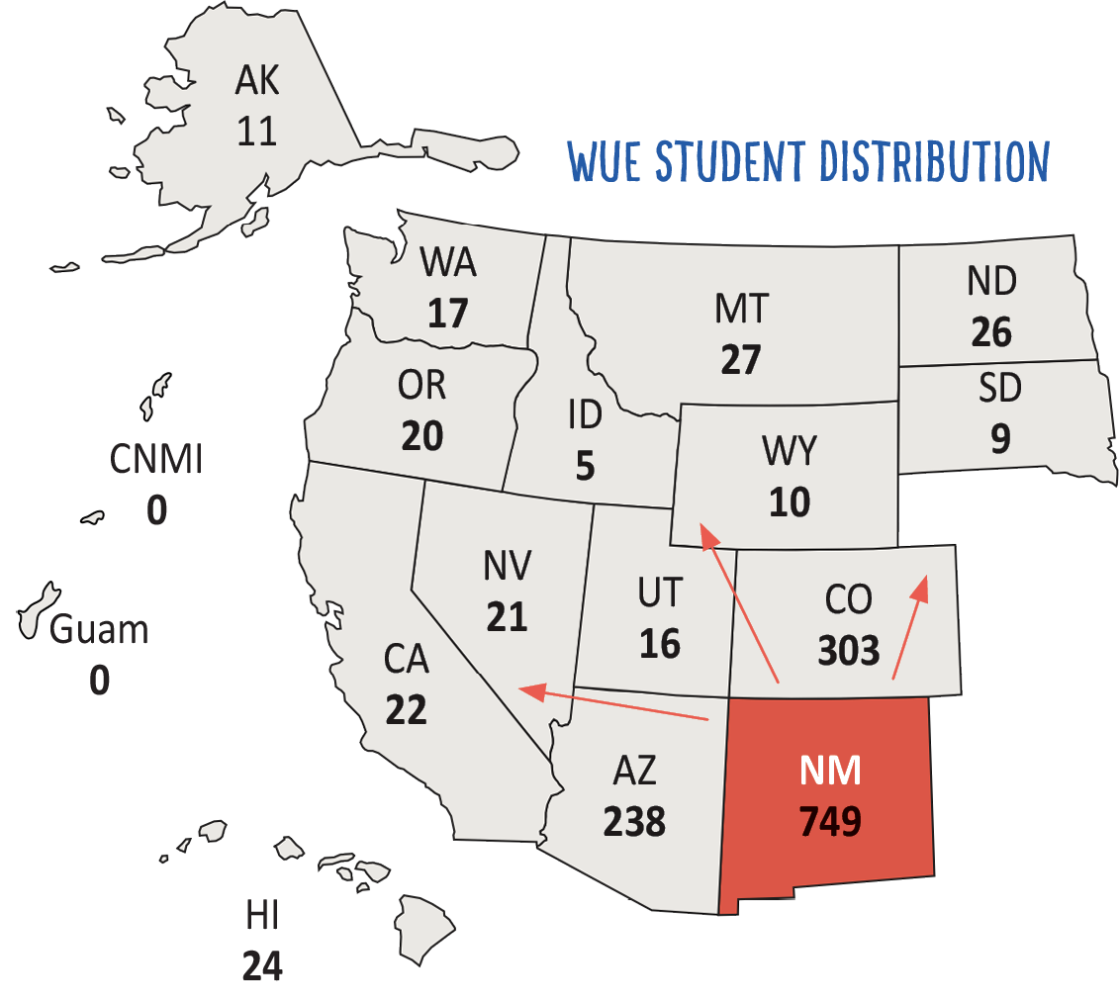
New Mexico by the Numbers
749 New Mexico undergrads paid 150% or less of resident tuition to save $6.1 million
AY 2017-18 Enrollment Data

Slide 22
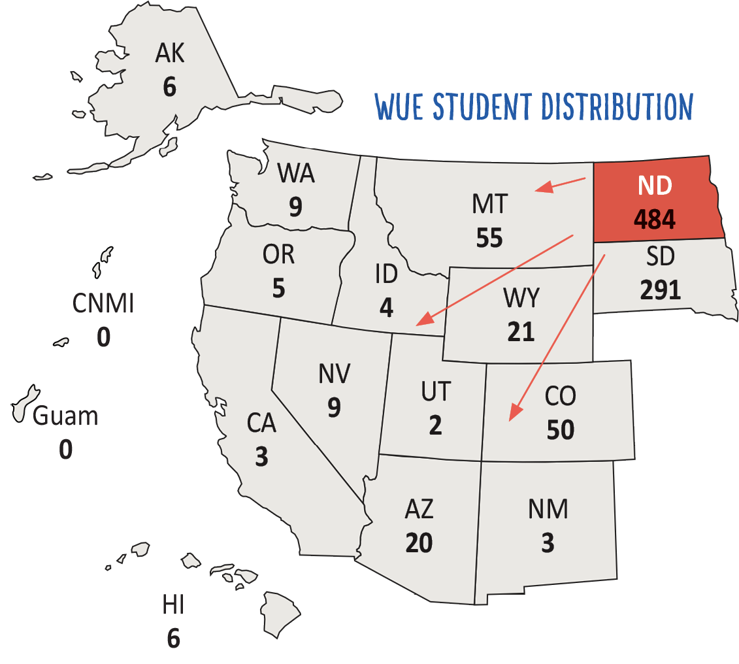
North Dakota by the Numbers
484 Colorado undergrads paid 150% or less of resident tuition to save $1.7 million
AY 2017-18 Enrollment Data

Slide 23
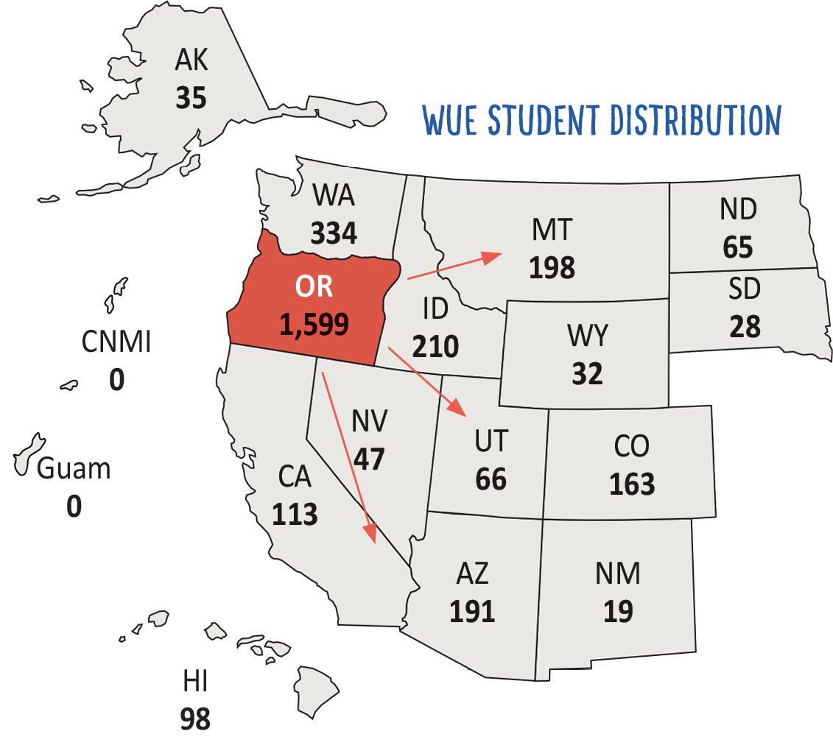
Oregon by the Numbers
1,599 Oregon undergrads paid 150% or less of resident tuition to save $15.8 million
AY 2017-18 Enrollment Data

Slide 24
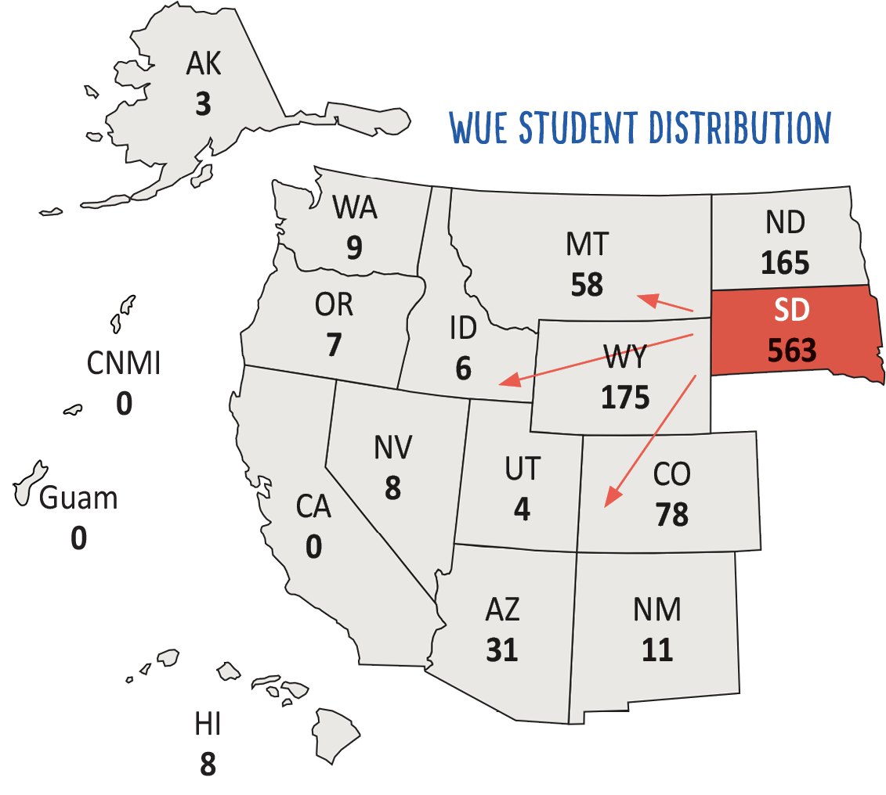
South Dakota by the Numbers
563 South Dakota undergrads paid 150% or less of resident tuition to save more than $4 million
AY 2017-18 Enrollment Data

Slide 25
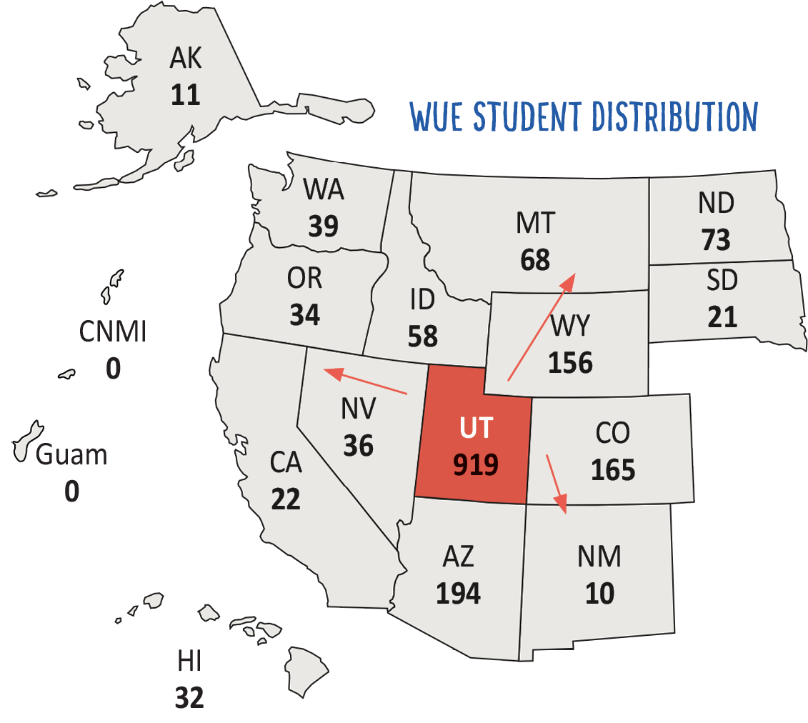
Utah by the Numbers
919 Utah undergrads paid 150% or less of resident tuition to save $6 million
AY 2017-18 Enrollment Data

Slide 26
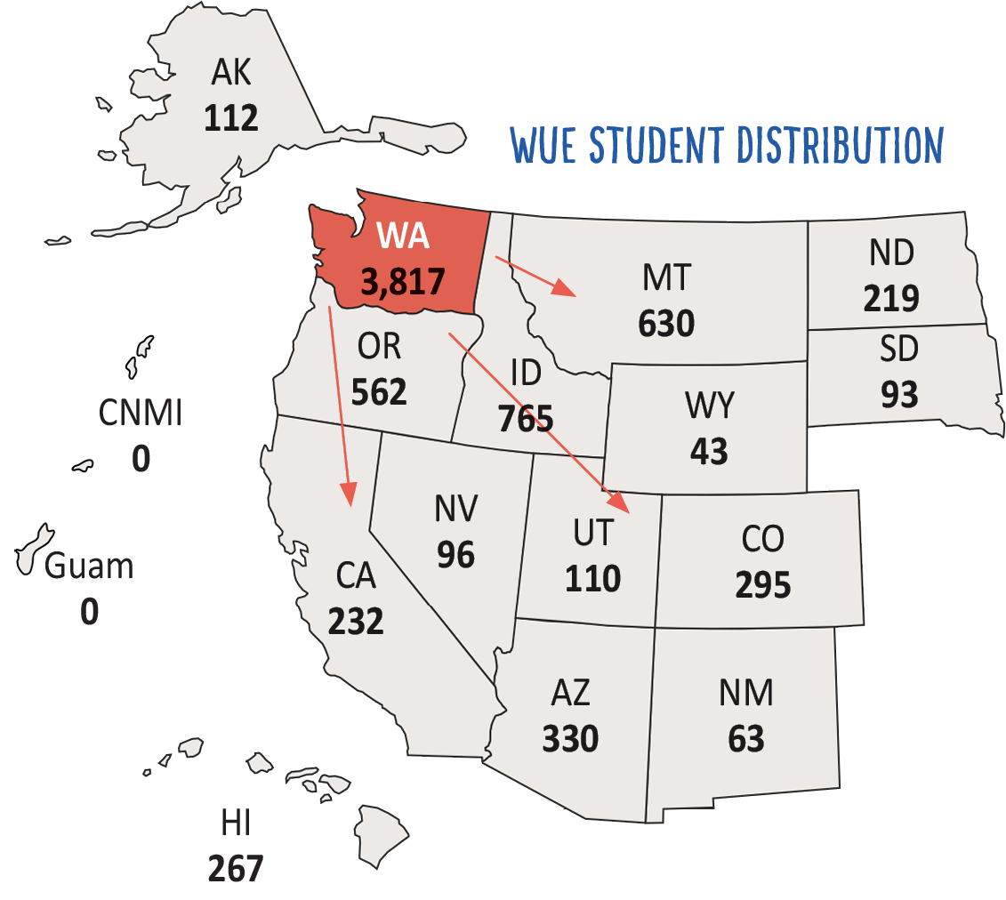
Washington by the Numbers
3,817 Washington undergrads paid 150% or less of resident tuition to save $41.2 million
AY 2017-18 Enrollment Data

Slide 27
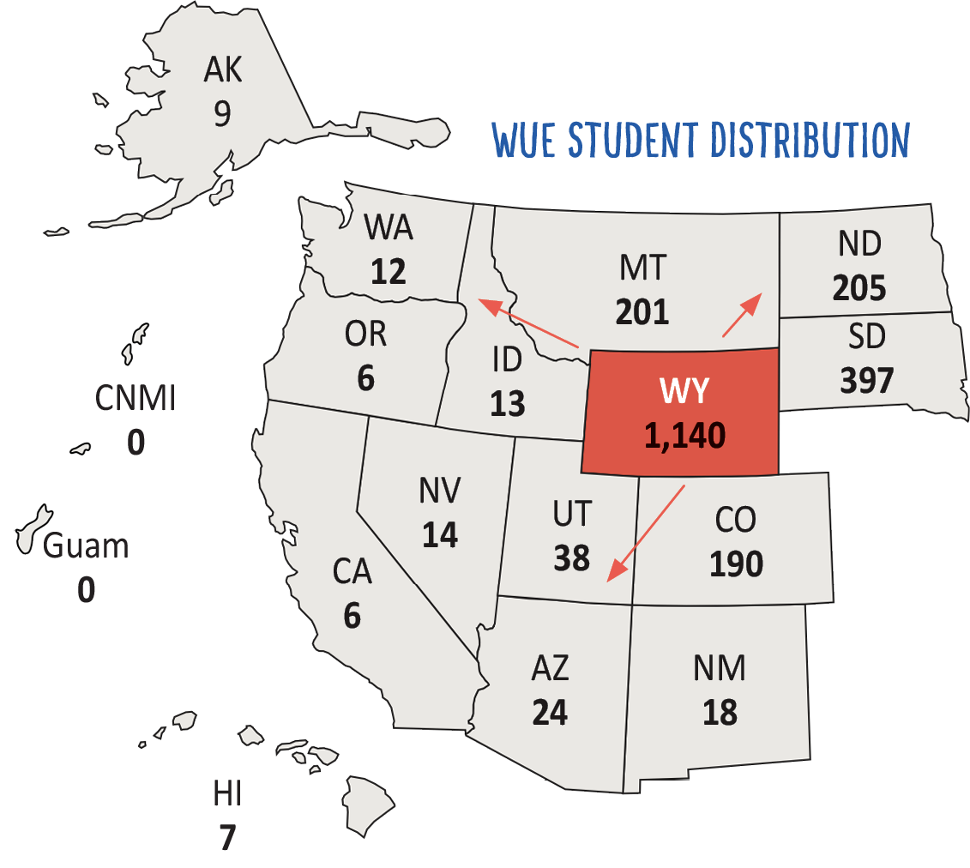
Wyoming by the Numbers
1,140 Wyoming undergrads paid 150% or less of resident tuition to save $5.8 million
AY 2017-18 Enrollment Data

Slide 28
Questions about WUE?
Step 1:
Visit www.wiche.edu
Step 2:
Check the school’s website for information and call for details
The institutions are your best resource!
If you still have questions after speaking with them, contact WICHE at:
TEL: 303.541.0270
info-sep@wiche.edu

